Slide 1
Enrollment 101/301
Academic Advising & Registration
Presented by the Office for Academic & Pre-Professional Advising

Slide 2

Today We’ll Discuss…
Academic Advising at UMBC
Building your Class Schedule
Academic Planning Tools
Preparing for Advising Checklist
After Orientation

Slide 3
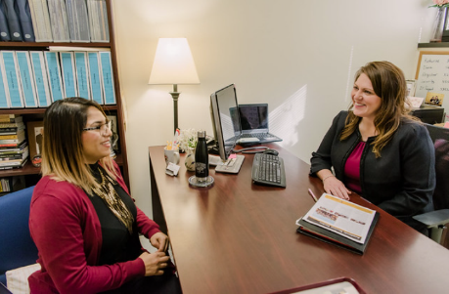
Academic Advising at UMBC
Partnership
Required each semester
All-Encompassing
  Adjustment to college
  Major and career choices
  Course selection & long-term planning
  Academic difficulties
  Academic “Extras” (i.e. - internships/study abroad/research

Slide 4
Types of Advisors
Orientation
Office for Academic & Pre-Professional Advising – Exploratory
Major/Department
Pre-Professional
Athletic
Honors College/Scholarship

Slide 5

Building Your Class Schedule
Aim for 15 credits per semester
Don’t forget summer/winter options!
Consider extracurricular commitments
Combination of GEP / major /elective courses
Keep in mind pending test or transfer credit!
Waitlists don’t count towards full-time enrollment

Slide 6
Your Schedule Should Include…
Remaining General Education Requirements
  Use your Degree Audit to determine which Gen Eds you still have to complete
  Pay attention to Foreign Language (201 Proficiency) & Math requirements
Major Requirements
  Review Major Degree Audit and Academic Pathways prior to advising tomorrow
Upper Level (UL) Electives
  Most majors won’t give you all 45 UL credits
  Take time to look at electives at 300-400 level

Slide 7
Example Schedule
Fall 2025
Major Requirement / 3 credits
Major Requirement / 3 credits
General Education Requirement
Ex. SPAN 103 / 3 credits
General Education Requirement
Ex. ANTH 211 / 3 credits
FYE (First Year Experience) or UL Elective
Ex. UNIV 101 Pre-Allied Health / 2 credits
Ex. HIST 301

Slide 8

Design your own degree plan through INDS!
Individualized Study (INDS)
Unique opportunity to match your courses to your goals
B.A. or B.S. INDS Degree Examples:
  Neuroscience (Pre-Med)
  Criminal Justice
  Sustainable Urban Design
  Arts Management
  Child-Centered Healthcare (Pre-Med)
  Astrobiology and Instrumental Data
  Video Game and Puzzle Concept Design
  Medical Device Development
https://inds.umbc.edu/
Meet with an advisor to start exploring
your individualized pathway!

Slide 9
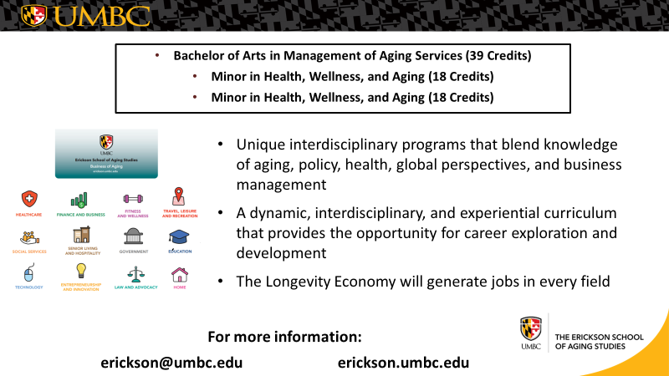
Erickson School of Aging Studies

Slide 10
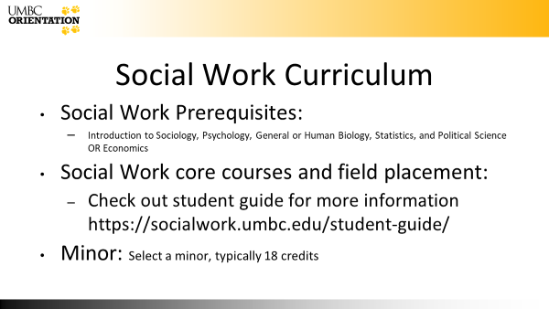
Curriculum

Slide 11
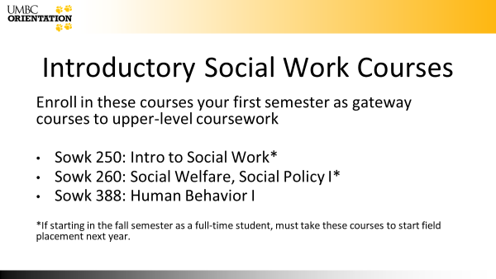
Intro Social Work Courses

Slide 12

Program

Slide 13
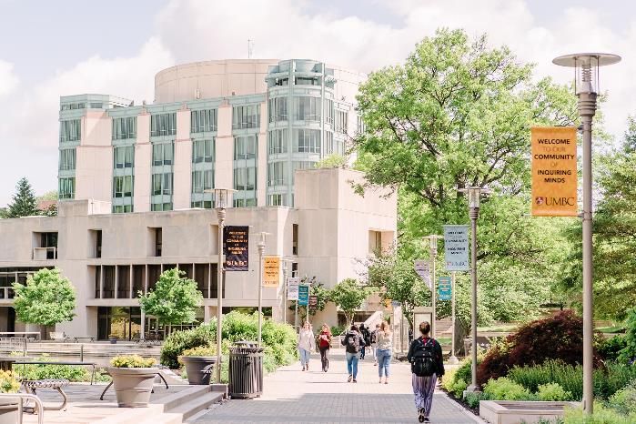
Academic Planning Tools
UMBC Degree Components
myUMBC Profile
Transfer Credit Report
Degree Audit
Academic Pathways
Class Search

Slide 14
UMBC Degree Components Breakdown
University Requirements
120 total credits
45 upper level credits
30 credits done in residency at UMBC
1 writing intensive course
UMBC GEP Requirements
ENGL 100 or ENGL 110
3 Arts/Humanities courses
3 Social Sciences
1 Math
2 Science (one must have a lab)
1-2 Culture courses
1 course (B.S. students)
OR
2 courses (B.A. students)
Language 201
Major, minor, certificate programs

Slide 15


Course Considerations for your First Semester
These courses are foundational!
Often they are pre-reqs for higher level courses (ENGL for many majors, MATH for most STEM majors)
ENGL helps build essential skills in writing, critical thinking and helps students engage with peers, faculty and campus resources
MATH is sequential- Starting early is crucial for building the foundation you need to move forward to higher level MATH and science courses

Slide 16
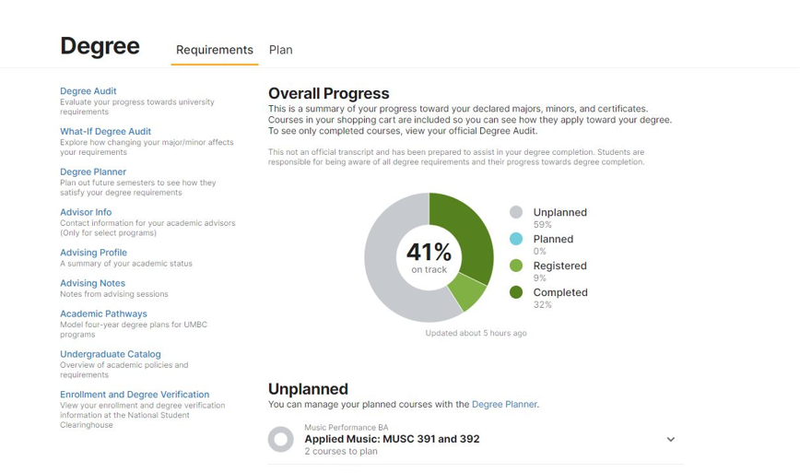
Academic Planning Tools
Degree Audit - progress towards all requirements
What if Degree Audit - will let you set a different major or degree program to see requirements and how much progress you’ve made
Advising profile - major, milestones, math placement, transfer credit
Advising notes - notes from sessions with your academic advisor(s)

Slide 17
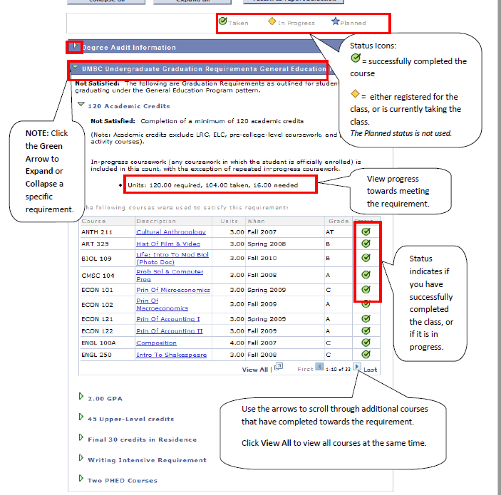
Viewing your Degree Audit
View all progress towards all
University, GEP, majors, minors, and
Certificate programs

Slide 18
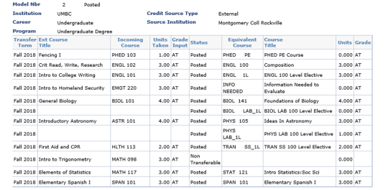
Transfer Credit Report
Notes:
In some cases, D grades will be accepted for General Education requirements. D grades are never accepted for major requirements. So any courses you are wanting to transfer in and receive major credits for, need to at least have a C grade. And please make sure you check with your major department to determine if there are any additional grade requirements

Slide 19
Course Review Process
When to Submit a Course Review form:
•Need a specific course for your major or minor
•Prerequisite for a course
•General Education requirement
Course Review

Slide 20
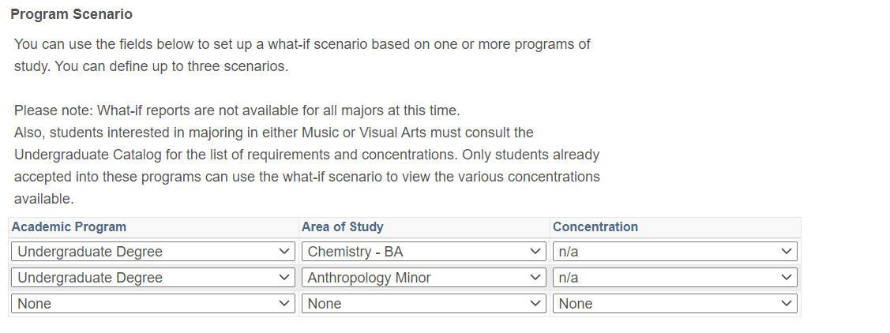
Creating a What-If Degree Audit
Click on link in myUMBC
Click on “Create new report”
Choose areas of study you are interested in
This will show you requirements and how much progress you’ve made
Will not make any official changes!
Notes:
You can include minors and certificates in this report

Slide 21
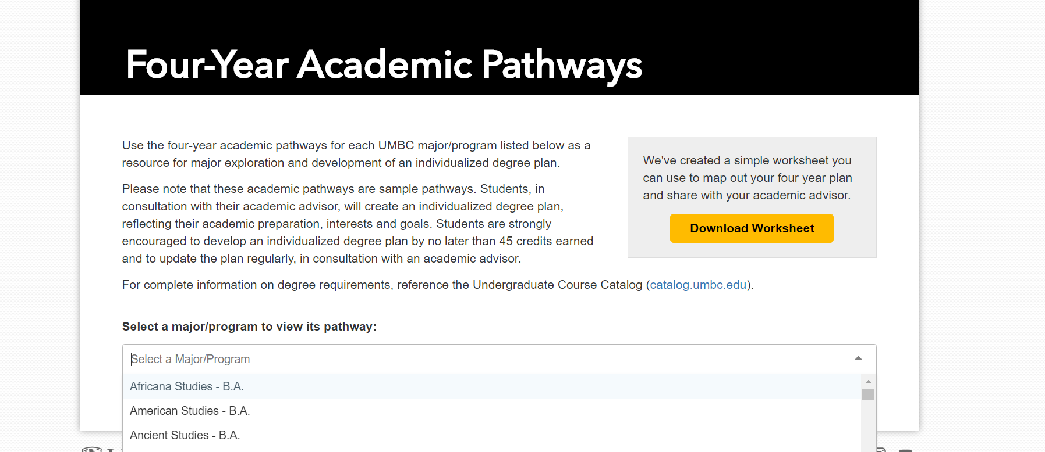
Exploring Academic Pathways

Slide 22
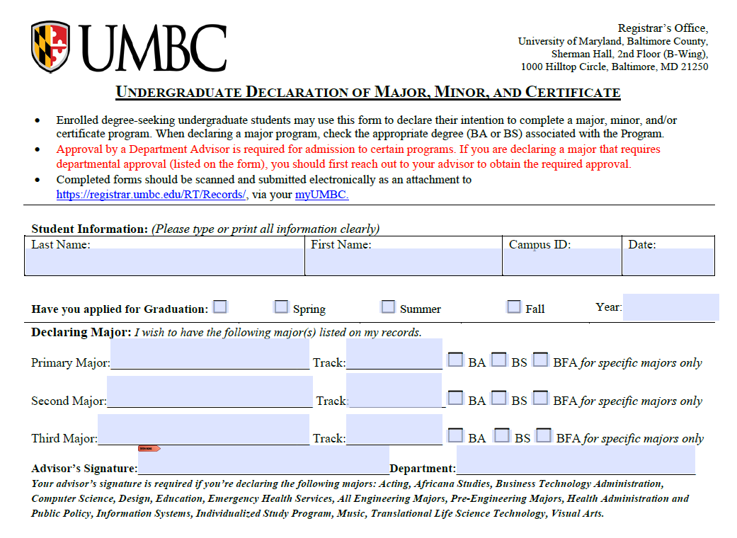
Changing or Updating your major
Provide student information
Indicate B.A. or B.S.
Advisor signature needed for major changes
Take note of specific advisors needed certain majors
Notes:
Going over how to use the declaration of major form

Slide 23
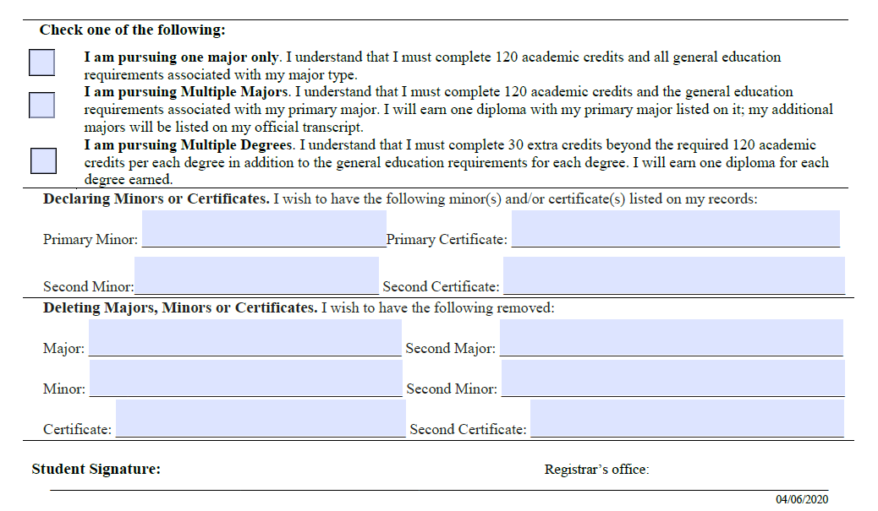
Changing or Updating your major
Indicate degree type
Multiple majors vs. multiple degrees
Add or Delete any majors, minors or certificates
If only deleting, do not need to fill out the top portion or get advisor signature
Student signature
Submit via RT ticket
1-2 weeks to process

Slide 24
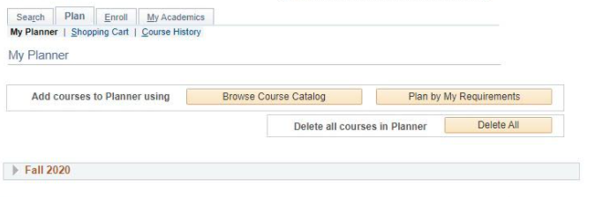
Degree Planner
Allows you to pick courses and plan out what semester you will take them
This will be reflected in your degree donut
Make sure your plan stays up to date!

Slide 25
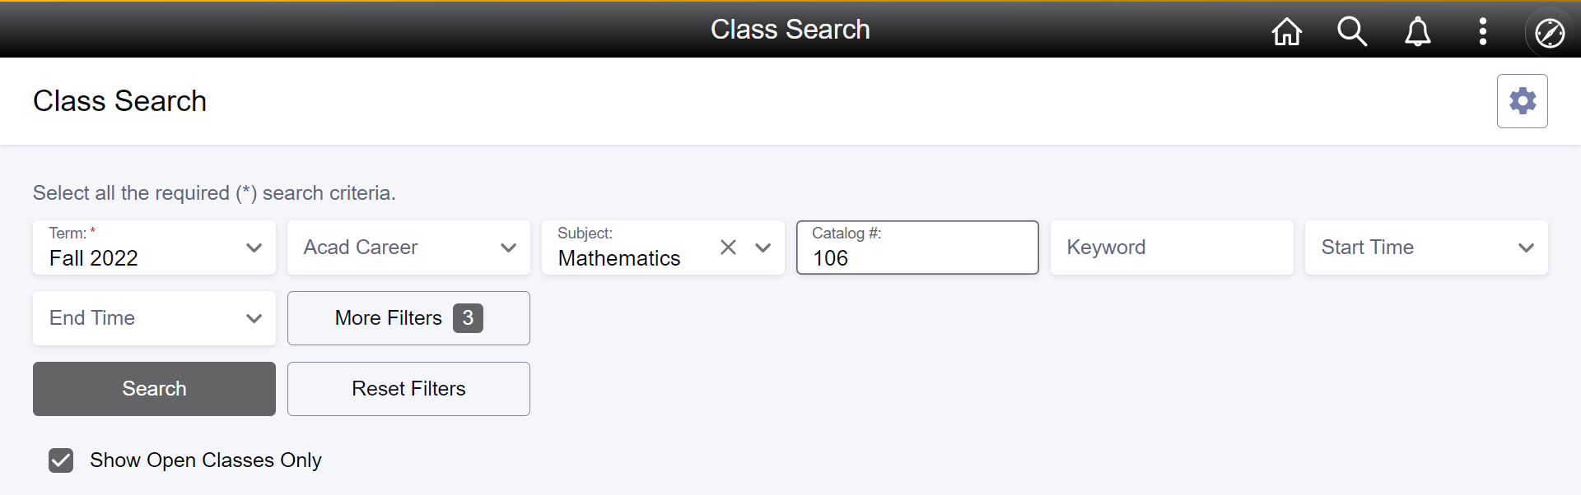
Class Search

Slide 26
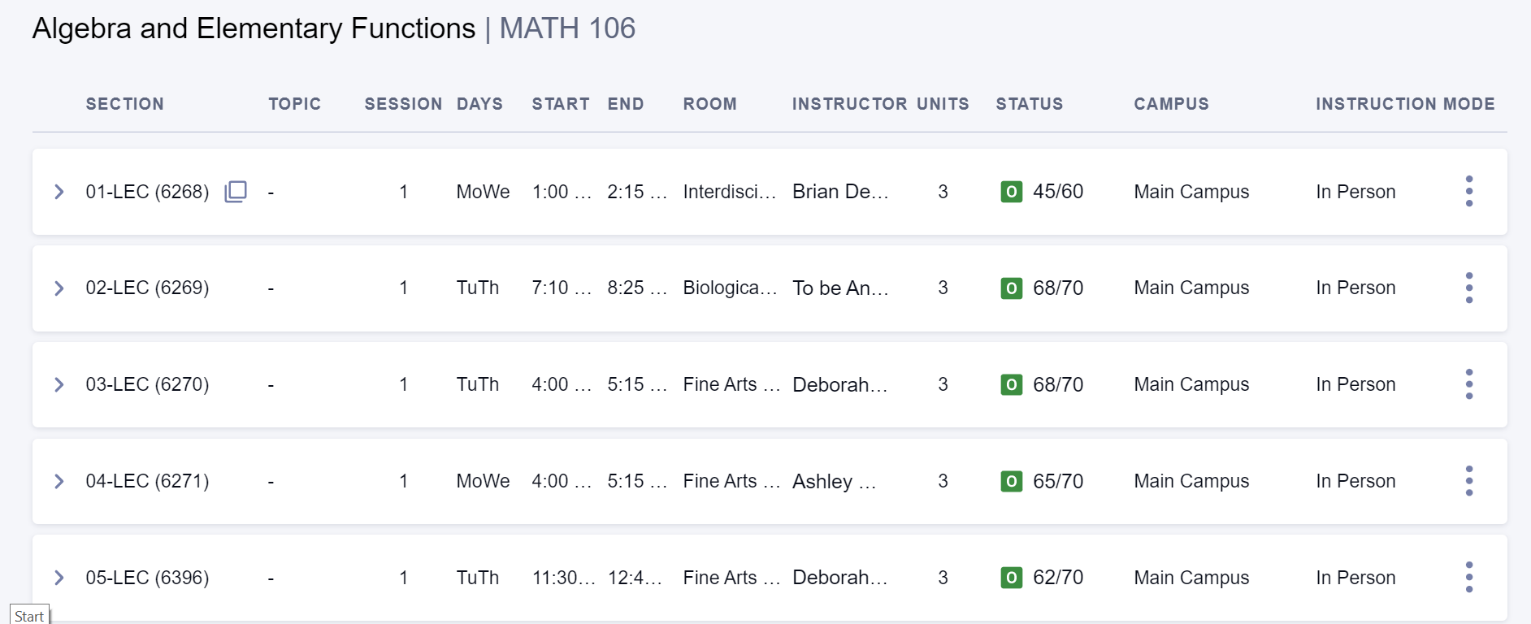
Class Search Cont.
Notes:
Click the arrow to expand and find out more information about the course

Slide 27
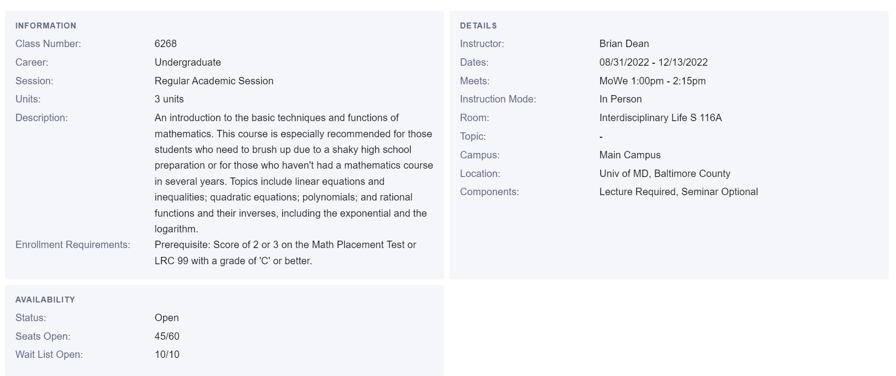
Class Search Conti.

Slide 28
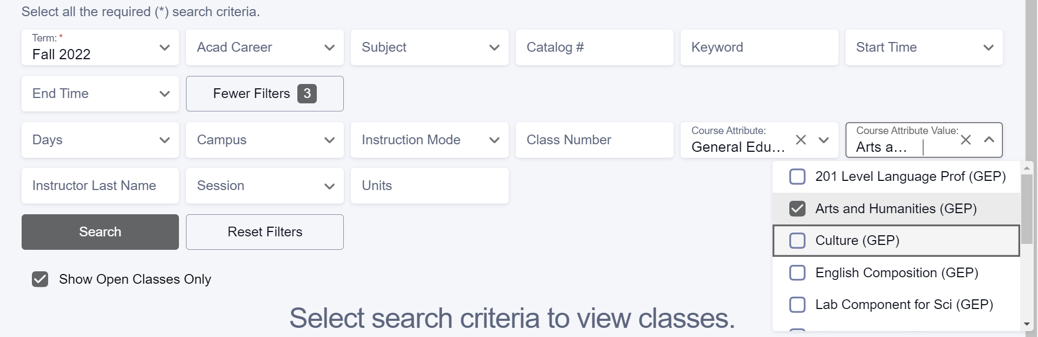
Class Search Con.
Course Attribute > “General Education Program” / Course Attribute Value > Select General Education Category

Slide 29
Advising Appointment: Checklist for Success!
Confirm Your Appointment Time - 12pm, 1:30pm, 3pm (also have some evening appts at 6pm and 7:30pm) orientationadvising@umbc.edu
Technology - Be Ready!
Download WebEx to your Laptop or Desktop Computer (do not use your phone!)
When creating your WebEx account, please sign up with your First AND Last Name
Connect with the Right Orientation Advisor
Changing major? Adding a pre-professional pathway? Update your info for tomorrow with the QR Code!
Students will have opportunity to officially make changes via the Declaration/Change of Major form after Orientation

Slide 30
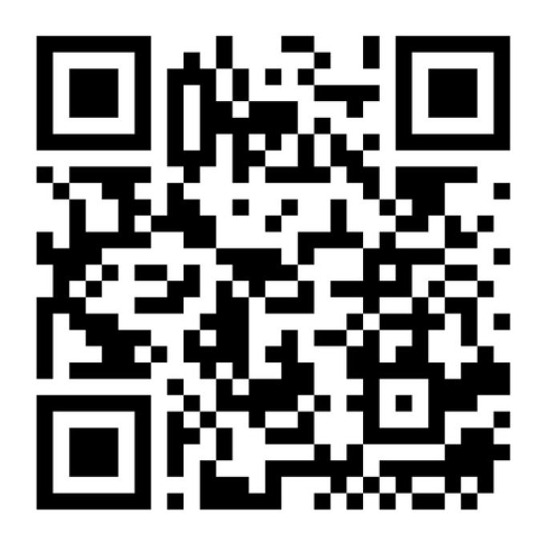
QR Code

Slide 31
Advising Appointment: Checklist for Success!!
Test & Transfer Credit- Have Info Accessible!
Have a list of any AP tests you have taken (and scores, if applicable), as well as any pending transfer credit you may have
Academic Resources- Take What You’ve Learned & Use Them!
Practice tonight using the features in myUMBC such Class Search, Academic Pathways and Degree Audit
Questions- Write them Down!
Take advantage of reviewing these materials ahead of time and write down any questions you have for your Academic Advisor

Slide 32
After Orientation Advising…
You can make schedule changes after your initial registration
Connect this winter with your academic department for follow up scheduling questions
Complete Declaration/Change of Major form to officially make any updates to your major, minor and/or certificate programs

Slide 33
AFTER ORIENTATION ADVISING REMINDERS
https://advising.umbc.edu/post-orientation-2/

Slide 34

Contact Info
Office for Academic & Pre-Professional Advising
advising.umbc.edu
410-455-2729
Sherman Hall B-Wing 224
Follow us on Instagram!
@umbc_advising

