Slide 1
Thriving as a Retriever at UMBC
The Divisions of
Undergraduate Academic Affairs
and
Student Affairs

Slide 2
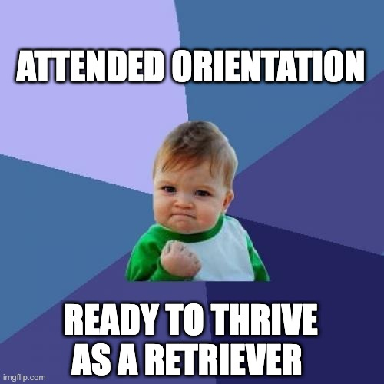
Session Objectives & Overview
You should acquire:
skills needed for success in and out of the classroom
resources for academic and personal success
connections with fellow students
Notes:
Today’s Session will cover Academic Transition Courses, Academic Success Resources, Campus Life/Involvement Opportunities, and more as well as give you a chance to meet several other new students

Slide 3
Retriever Connects
What are you excited and/or nervous about as you transition to college?
Notes:
Slido (no more than 2 mins)

Slide 4
Introductions
POLL
Are you In-State or Out-of-State?
What town or city are you from?
STEM or A/H/SS or Exploratory?
Commuting or Living on campus?
Plants or Pets?

Slide 5
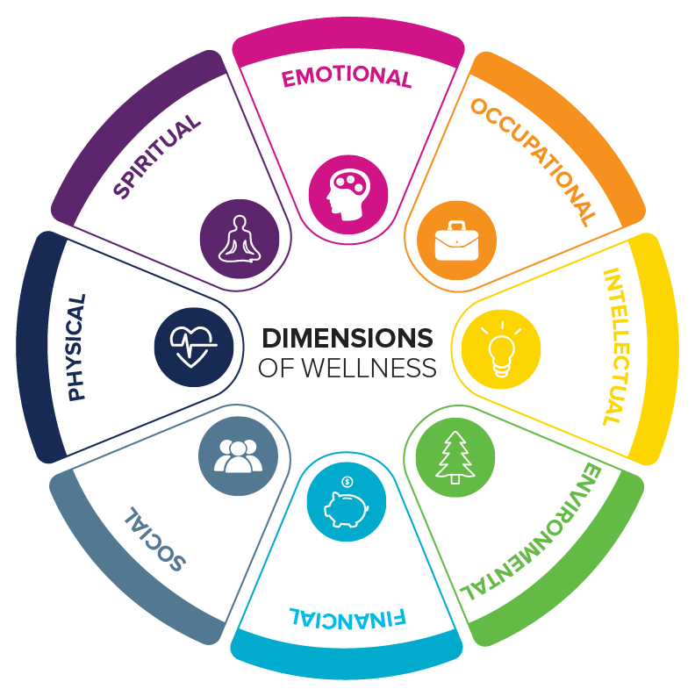

Slide 6
Academic Engagement & Transition Programs (AETP)
UNIV101: Intro to the University Seminar (2 credit hours)
Fall 2025:
College Sections: Arts , Humanities, Social Sciences, Natural/Mathematical Sciences, Computing, Engineering
Cohort Sections: Special sections for specific programs, permission required
Get connected with a faculty or staff instructor, a teaching assistant, and fellow New Retrievers to learn about campus, academic planning, and skills to succeed at UMBC.
Ask your Orientation Advisor about which section is right for you!
See the Orientation Guide for more information
aetp.umbc.edu
Notes:
Academic Transition Courses are open to ANY new student (freshmen and transfer students). UNIV courses are 2-credit stand alone course and are a great way to get to know the campus, connect with a staff member and other new students, and earn an extra credit while learning what it takes to be a successful UMBC student (UNIV 101 - first-years only). First-Year Seminars are 3-credit Gen Ed options with very unique topics taught by faculty who want to work with new students. Look at the class schedule for the topics. Talk to your advisor TOMORROW when you register for classes about one or more of this options!

Slide 7
Academic Engagement & Transition Programs (AETP)
FYS: First Year Seminars (3 credit hours)
Small group, special topics and discussion based classes that fulfill a General Education Program Requirement (GEP).
Offered in: Arts and Humanities (AH), Social Sciences (SS), Culture (C), and Science Non-lab (S) areas.
Unique topics that you won’t find elsewhere on campus. Some topics include:
80’s Pop Culture and Politics, History of Student Disabilities, Decoding AI, and more!
See the Orientation Guide for more information
aetp.umbc.edu

Slide 8
Resources for
Student Success
Academic Success Center (ASC)
Academic Advocacy
Staff (support through difficult academic situations)
Peer (academic skills, time management, study skills, etc.)
Academic Policy
Drop-In Tutoring
Computing Success Center
Writing Center
SI/PASS
Department Tutoring Centers
Study Groups
Office Hours
Advising (ask about your Degree Audit!)
Student Disability Services (SDS)
Notes:
Transfer credit includes dual enrollment, AP/IB scores

Slide 9
Retriever Connect
Starting College is a new challenge, what would you identify as a strength you have coming in to college and an area of improvement for your first semester?
Notes:
Slido (no more than 2 mins)

Slide 10
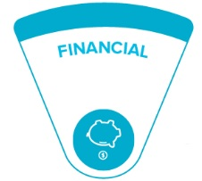
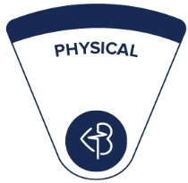
Holistic Wellness: it’s not just Physical and Mental
FAFSA Deadline
Priority for Fall 2025 was March 1, 2025
Must complete EVERY YEAR!!!
Scholarship Retriever
Complete Common Application!
Money Smart Week
Every Spring Semester (Attend events to be entered into a chance to win Scholarships)
Health & Wellbeing
Retriever Integrated Health
Massages, Acupuncture, Mental Health Services, Check ups and prescription refills**
Campus Dietician
The RAC
Group fitness classes
Intramurals
Office of Health Promotions
Support health lifestyle
Notes:
Amery Update with proper information.

Slide 11
Retriever Connect:
What does involvement outside of the classroom mean to you?

Slide 12
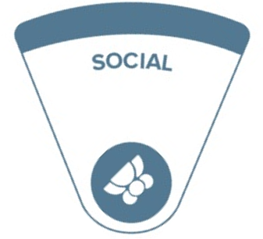
Involvement
Campus Life
Student Organizations
Over 200 Student Orgs to choose from
Opportunities to start a new org if interested!
Fraternity and Sorority Life
With 15 chapters in four councils let us help you find your match!
Tri-Alpha Honors Society
Calling all First Generation Students! Join an honors Society for you!
The Student Events Board (seb)
Student Government Association
First Year Ambassador program
Leadership Development programs
For more information Visit the website below:
campuslife.umbc.edu
Notes:
Make changes to this slide adding dates

Slide 13
Involvement
Areas to get connected
The Women’s, Gender, and Equity Center
Student Belonging
The Mosaic
Gathering Space for Spiritual Well-Being
The Pride Center
Athletics & Recreation
Retriever Support Services
Retriever Essential- Food Pantry
Veteran Lounge- Space for Veterans, Dependants and Adult Learners to connect
Commuter Connections
Get involved as a Commuter

Slide 14
High Impact Experiences
Undergraduate Research
Undergraduate Research and Creative Achievement Day (April 22, 2026)
Service-Learning
Shriver Center
Center for Democracy and Civic Life
STRiVE
Dinner with Friends
Internships
Connect with the Career Center for resume and interview preparation
On Campus Employment
Learn about Handshake
Mentorship with Student Affairs Success Initiatives
Join a mentorship group with your peers
Global Engagement
Education Abroad
Serving as a Tutor with ASC

Slide 15
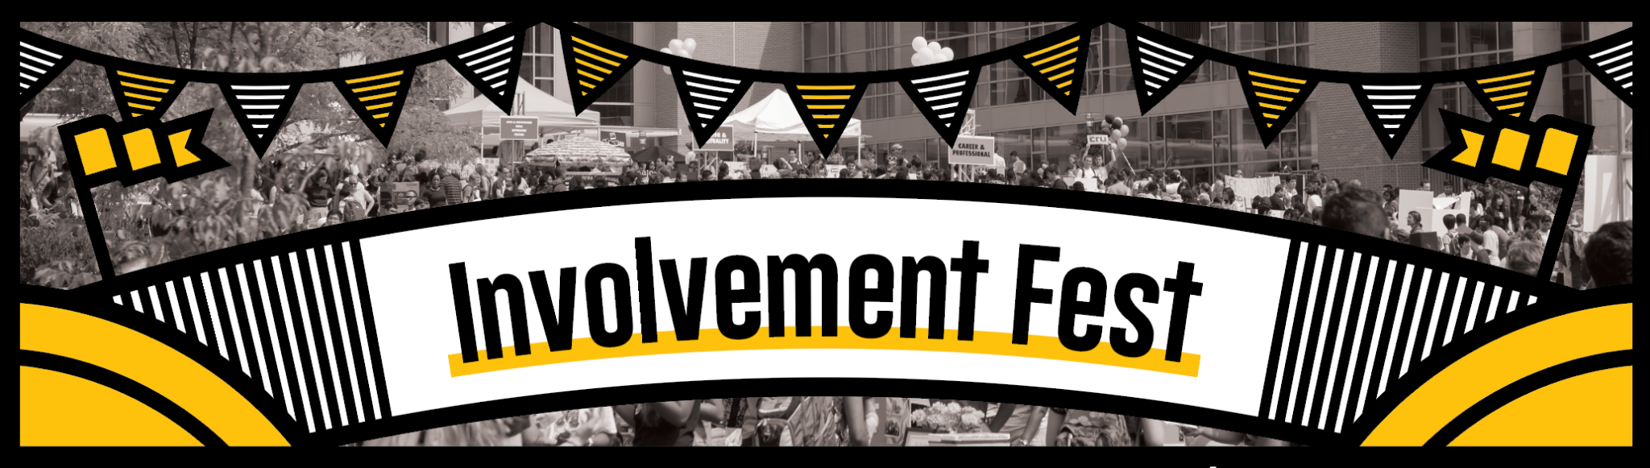
Opportunities for Engagement
Welcome Retrievers
Begins 8/23/25
Involvement Fest
9/3 at Noon (RAC)
Mentorship Opportunities
Spring 2025
Homecoming
10/11
Career Fair
9/17

Slide 16
Programs You May Be Interested In!
Welcome, Retrievers!
A month of programming to ensure that you are welcomed into the community properly! (A cross campus collaboration)
The Commons Takeover (August 24th)
Good Morning Commuters (September 2nd)
Pack the RAC (September 5th)
UMBC Soccer Games
Women’s game- August 24th
Men’s game- August 25th
Involvement Fest (September 3rd)
Want to join a student org? Look no further Join us
Golden Ticket Kick-off (September 6th)
A welcome celebration for first-generation students and parents. Join us as we build our First-Gen Network at UMBC.
Bachata & Salsa Night (September 26th)
Come celebrate Hispanic Heritage month with us!
Homecoming (10/11)
UMBC presents

Slide 17
Retriever Connect:
What are you going to get involved in this semester?
Notes:
Up to 2-3 people share

Slide 18
Top Stops For The First 6 Weeks
Financial Aid & Scholarships (Library)
Office of Academic and Pre-Professional Advising (Sherman Hall)
Academic Success Center (Library)
Retriever Learning Center (Library)
Retriever Integrated Health (RIH)
Mental Health Services
Registrar’s Office (Online & Sherman Hall)
Retriever Activity Center (RAC)
Career Center (Math/Psychology Building)
myUMBC Events page (events.umbc.edu)

Slide 19
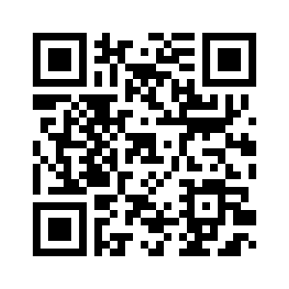
Find what you need here!
Notes:
update linktree with contact information.

Slide 20
Questions??

Slide 21
