Slide 1
Life at UMBC
Building Community and Partnering for Success

Slide 2
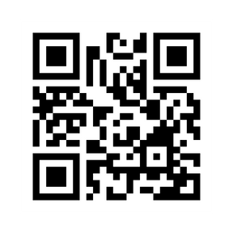
Retriever Integrated Health (RIH)
Phone: 410-455-2542
Website: https://health.umbc.edu

Slide 3
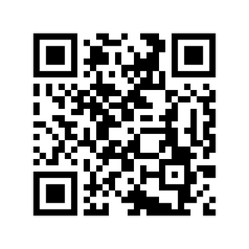
Dining
Phone: 443-612-3663
Website: https://dineoncampus.com/UMBC

Slide 4
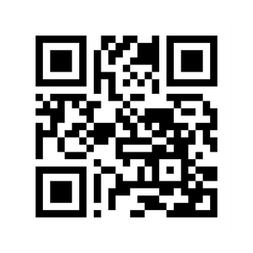
Residential Life
Phone: 410-455-2591
Website: https://reslife.umbc.edu/

Slide 5
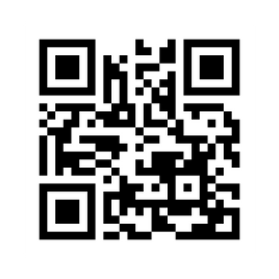
Campus Police
Phone: 410-455-5555
Website: https://police.umbc.edu/

Slide 6
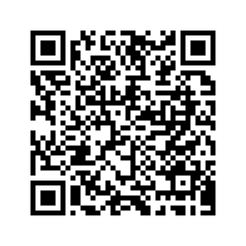
Retriever Support Services
Phone: 410-455-2770
Website: https://studentaffairs.umbc.edu/student-support/retriever-support-services/mission/
Notes:
*We want students to see faculty as accessible and here to help them succeed
*We know you are smart, but we want you to define success in how much you grow in both your academic pursuits, but also those outside of the classroom (relationships, service, world views, etc.)
*You know yourself the best at this point; as we go through these resources keep your strengths and struggles in mind to see how you may prioritize how you lean in in your first year
*I will break my adivce down in three key areas; Academic, Involvement, and Personal & Professional Development

Slide 7
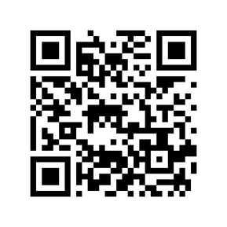
UMBC’s Bookstore
Phone: 410-455-2665
Website: https://bookstore.umbc.edu/home
Notes:
*We want students to see faculty as accessible and here to help them succeed
*We know you are smart, but we want you to define success in how much you grow in both your academic pursuits, but also those outside of the classroom (relationships, service, world views, etc.)
*You know yourself the best at this point; as we go through these resources keep your strengths and struggles in mind to see how you may prioritize how you lean in in your first year
*I will break my adivce down in three key areas; Academic, Involvement, and Personal & Professional Development

