Slide 1
I Am, We Are, I Will
Orientation 2025

Slide 3
I Am, We Are, I Will
Orientation 2025

Slide 4
I AM ______________

Slide 5
creative
extroverted
loyal
a gamer
brave
I AM ______________
an athlete
inquisitive
hard-working
playful
loving
friendly
nerdy
introspective
an artist

Slide 6
an activist
creative
extroverted
environmentally conscious
loyal
hopeful
conservative
a gamer
generous
brave
honest
I AM ______________
an athlete
inquisitive
a pacifist
hard-working
playful
realistic
loving
progressive
traditional
friendly
community-minded
an optimist
nerdy
introspective
an artist
a leader
spiritual
a feminist

Slide 7
an activist
creative
extroverted
a lesbian
a first-generation student
Asian
Hindu
environmentally conscious
loyal
hopeful
conservative
multi-lingual
Turkish
asexual
a gamer
generous
brave
honest
I AM ______________
a man
an athlete
inquisitive
a pacifist
Black
a wheelchair user
hard-working
agnostic
playful
an immigrant
realistic
loving
progressive
traditional
friendly
community-minded
non-binary
an optimist
nerdy
introspective
an artist
a leader
spiritual
Christian
a feminist
Puerto Rican

Slide 8
WE ARE ______________

Slide 9
supportive
authentic
encouraging
accepting
WE ARE ______________
friendly
affirming
welcoming
curious
empathetic
communicative

Slide 10
dynamic
authentic
patient
supportive
vibrant
encouraging
determined
accepting
WE ARE ______________
proud
focused
friendly
reliable
smart
affirming
welcoming
chill
curious
energetic
empathetic
communicative

Slide 11
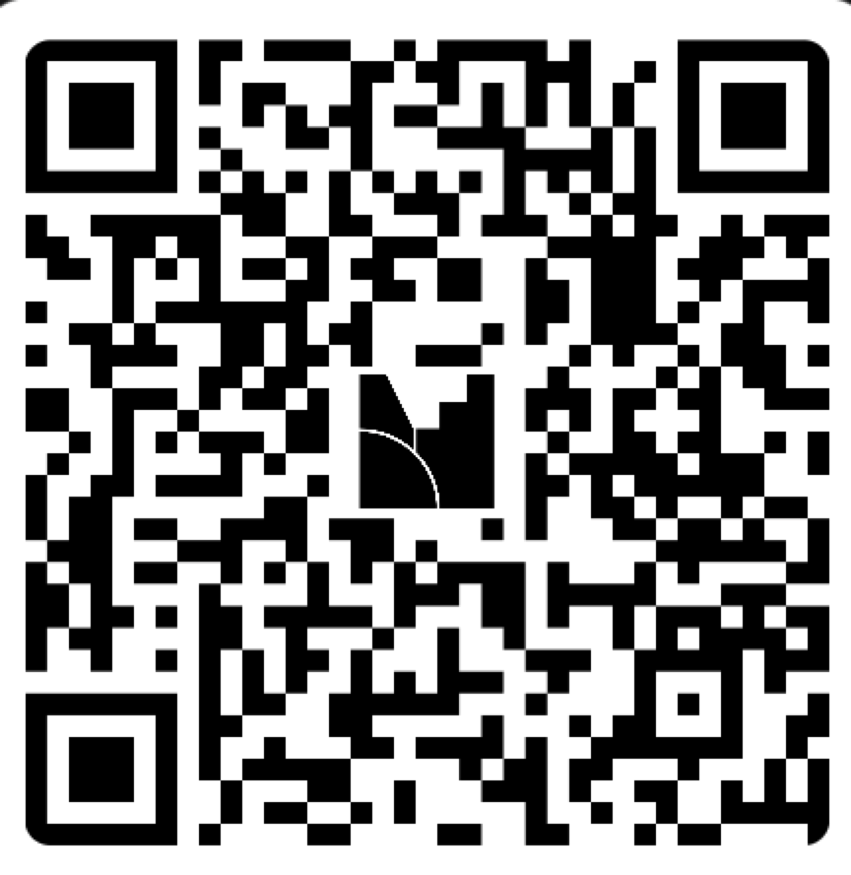
WE ARE ______________
What do you want to be true about our community?
What are we going to be together?
Join @ menti.com| use code 8398 2032

Slide 12
We each have a role to play in cultivating belonging.
Inclusive excellence at UMBC can only happen when we all contribute. Contribute to belonging and inclusion by:
Seeking to understand yourself and others
Being willing to be uncomfortable
Engaging with curiosity
Accepting shared responsibility for our community

Slide 13
