Slide 1
Grit 101:
Faculty Connections at
an Honors University

Slide 2
Who am I and Why am I Here?
What I’ve studied
What I’ve done
Why UMBC?

Slide 3
There’s a lot to cover, including...
Setting the stage for success (growth mindset)
Academic success
Getting involved
Personal and professional growth
Building faculty relationships
Where should we start?

Slide 5
Setting the Stage for Success
Student success IS the goal at UMBC: our top priority is your success. We are a team that works together to achieve this goal.
Success is defined within and outside of the classroom
Success is often measured by the results. It is also defined by the experiences that help you grow and understand yourself.
So…does that mean I need an A?

Slide 6
Academic Success
Prioritize your academics and utilize key resources:
Advising will explain: course selection, academic difficulty, connecting majors & careers
UNIV Seminar courses will assist and provide: academic credit & support the first semester
Academic Success Center offers: tutoring, SI/PASS, academic advocacy
Individual instructors/courses have: Office hours & study groups
Connect with your OPA today on resources they’ve used!

Slide 7
A
The expectation is that most students do not know how the university works AND will reach out when they get stuck.

Slide 8
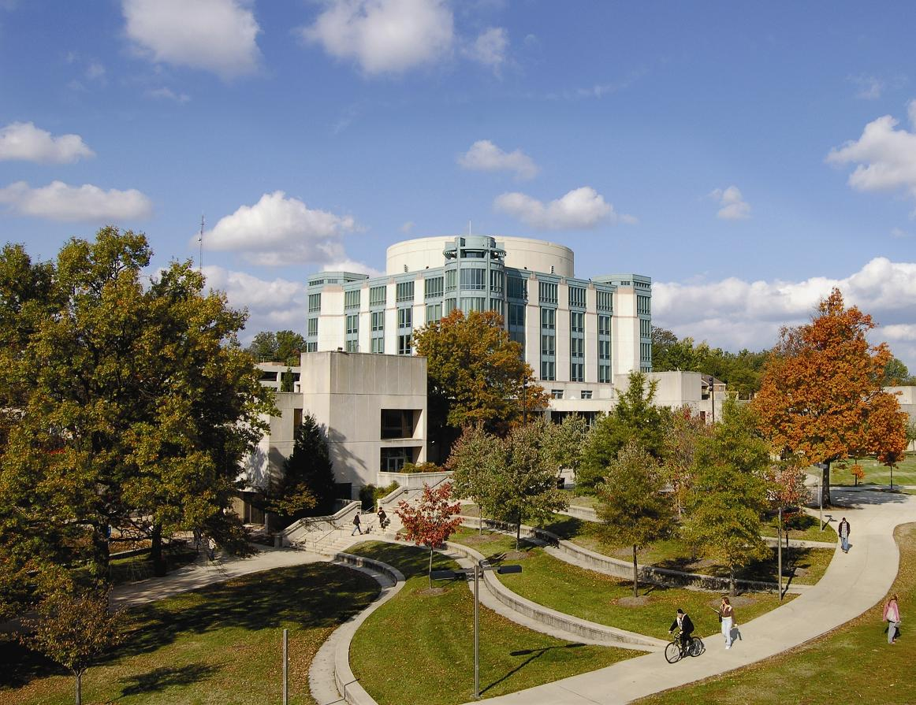

Slide 9
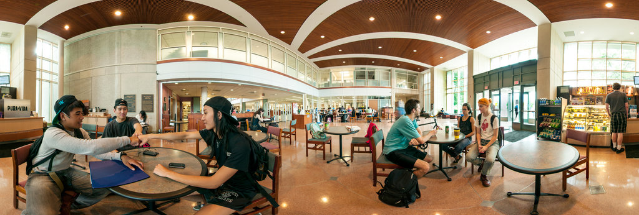
Lesser Known Library Benefits...
Borrow course textbooks, recommended reading, and even
computers
Access to a wide range of academic publications
Study rooms
View from the seventh floor

Slide 10
Involvement
Prioritize making connections:
Welcome Retrievers & Involvement Fest
Campus Life (Student Orgs, SEB, SGA)
Living on campus or off – there is a community for you!
Athletics & Recreation (RAC, Club/Intramural Sports,
Group Fitness, Dietician)
Connect with others and ask which resources they’ve used!

Slide 11
The expectation is that most students do not know how the university works AND will reach out when they get stuck.

Slide 12
Personal / Professional Growth
Prioritizing self-exploration to align passions to your future goals
Retriever Integrated Health (RIH)
Initiatives for Identity, Inclusion, & Belonging (I3B)
Career Center (Internships, Jobs, On Campus Employment)
Shriver Center (Service-Learning)
Applied Learning (Research & Prestigious Scholarships,
Education Abroad)
Connect with others and ask which resources they’ve used!

Slide 13
Building Faculty Relationships
Learn what behaviors are expected in and out of the classroom
Student handbook
Course syllabi
Find faculty who have shared interests
Browsing departmental websites for your major
Attending first year, departmental, and college events
Set expectations!
Failure is not forever and all of us have experienced it too
At the first sign of trouble, ask for help…don’t wait

Slide 14
Show up! Attendance is the biggest predictor of success in your first year BECAUSE you need to be present MENTALLY AND PHYSICALLY to learn

Slide 15
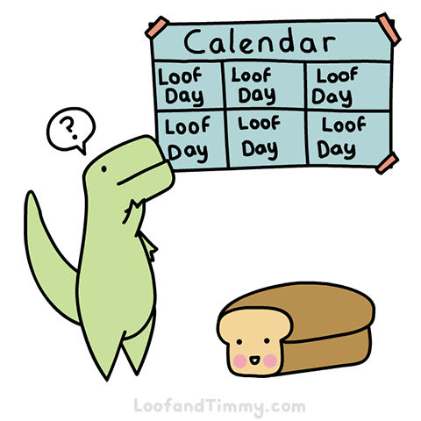
Lastly, Plan (Just a Good Idea)
BUILD YOUR SCHEDULE
Add your homework, labs, and projects to your calendar
Reserve time to start these assignments
When the semester starts, reserve time for office hours
THINK ABOUT YOUR MOTIVATIONS
What kind of job are you looking for?
What are you trying to learn short term?
What would you like to do this semester?
AND ALSO...

Slide 16
Think About Your Day
For every credit hour, you should spend at least 1 - 4 hours studying each week
For a four credit course, that means 4 - 16 hours
Amount of time spent depends on assignment load and course difficulty
You probably won’t excel in your classes by spending an hour a week on the material and assignments

Slide 17
Think About Your Day (Cont.)
It takes a lot of physical and mental effort to be active in class and complete you assignments.
How do you recharge? Are you particular about your coffee, or do you have a favorite quick lunch option?
What about studying? Do you prefer your desk at home, or a quiet place on campus? Keep looking for new places to spend your time

Slide 18
Congrats and see you all in this semester!

