Slide 1

UMBC Family Orientation
Finding the Balance
2025

Slide 2
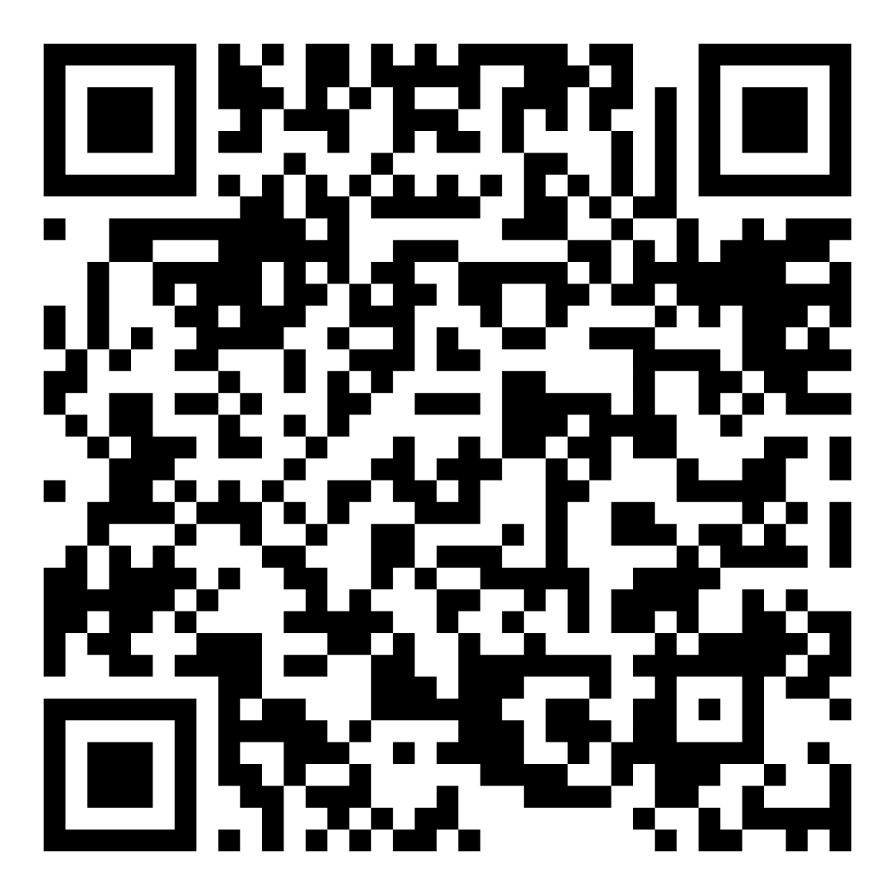
Text “UMBC1970” to 22333
Notes:
Display word cloud using this link: https://www.polleverywhere.com/free_text_polls/rLqTXXeV2tTqDLKz8gYHm ; Click Present
Families can respond to the question through text message and their response will be displayed through the wordcloud
Responses of word cloud have to be cleared after each session

Slide 3
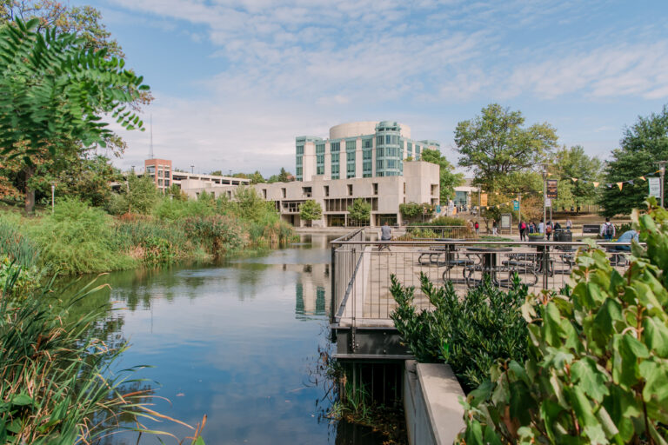
Agenda
Transitions
Engage with the Journey
Campus as a Community
Challenge vs Support
Finding the Balance

Slide 4
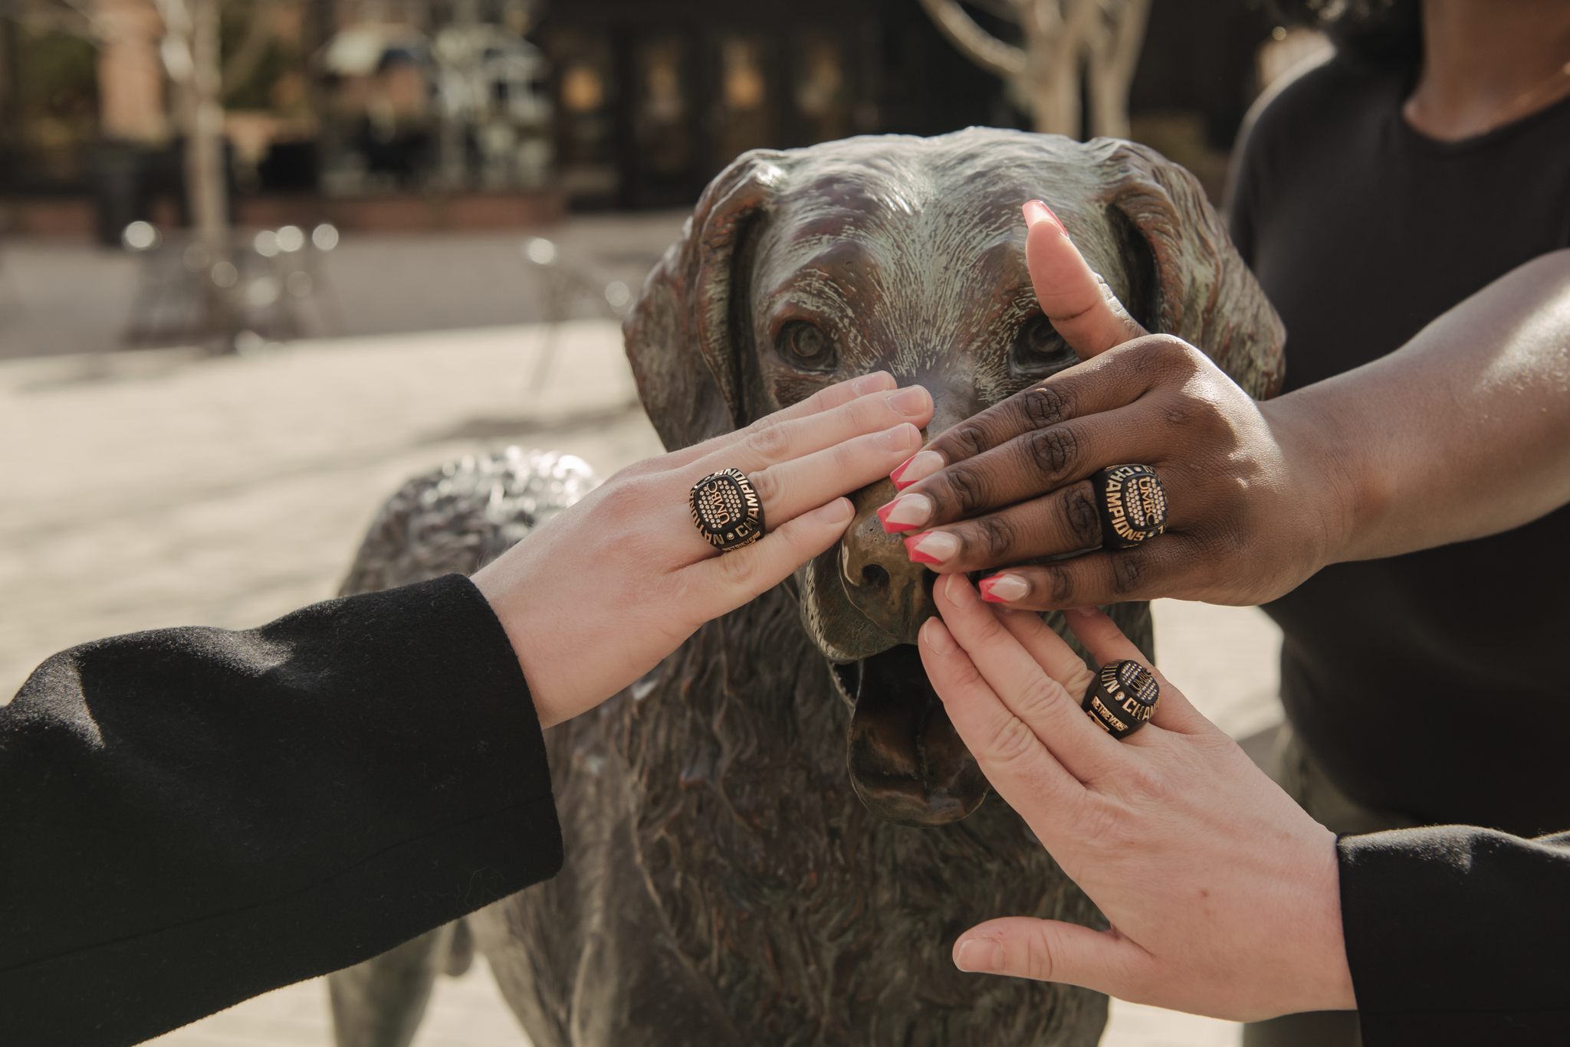
Transitions
Every place is unique
UMBC’s mission and purpose
We want this to feel like home
Notes:
-Discuss personal story of change
-Discuss previous institutions
-Talk about the culture, language
-University missions/purpose to challenge and support students for ‘whatever is next’ (grad school, industry, professional school)
-Plant seeds for independence and intellectual curiosity
-Stress that we want students to feel connected, make UMBC ‘home’ for greater success

Slide 5
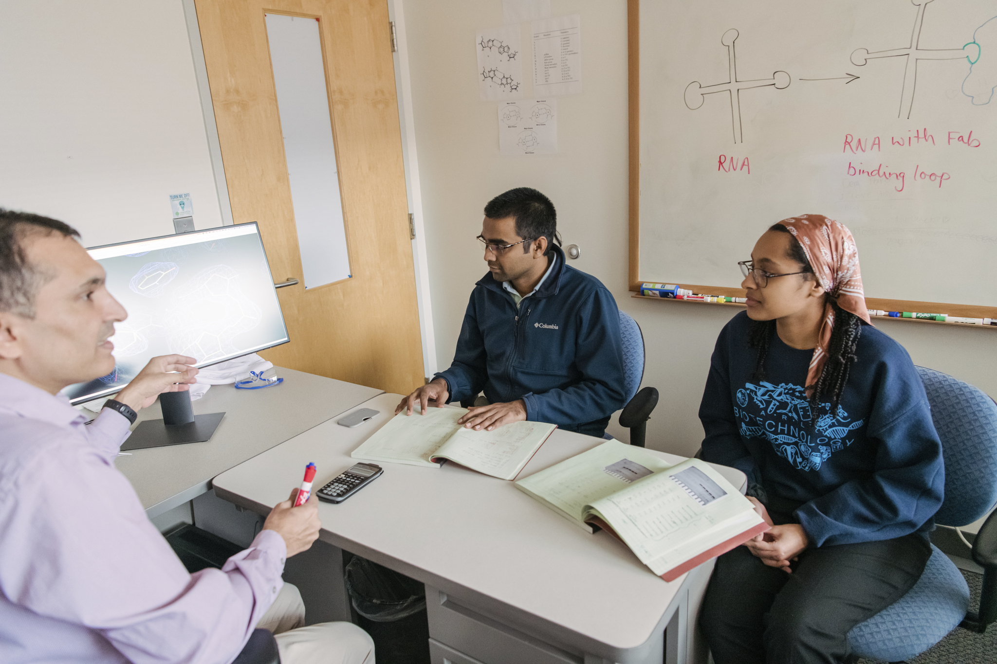
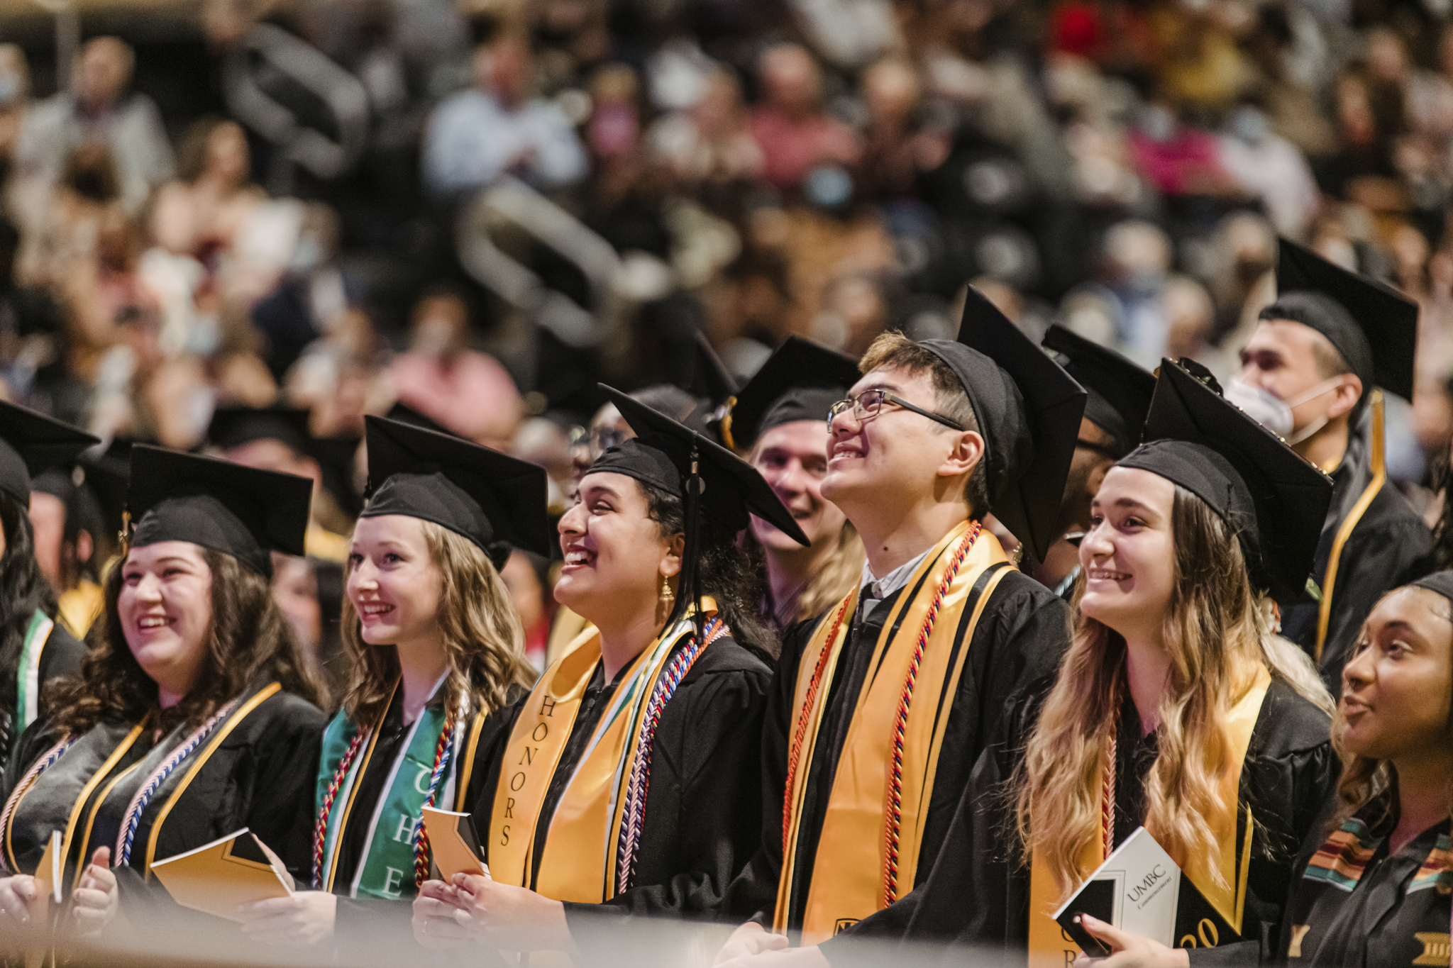
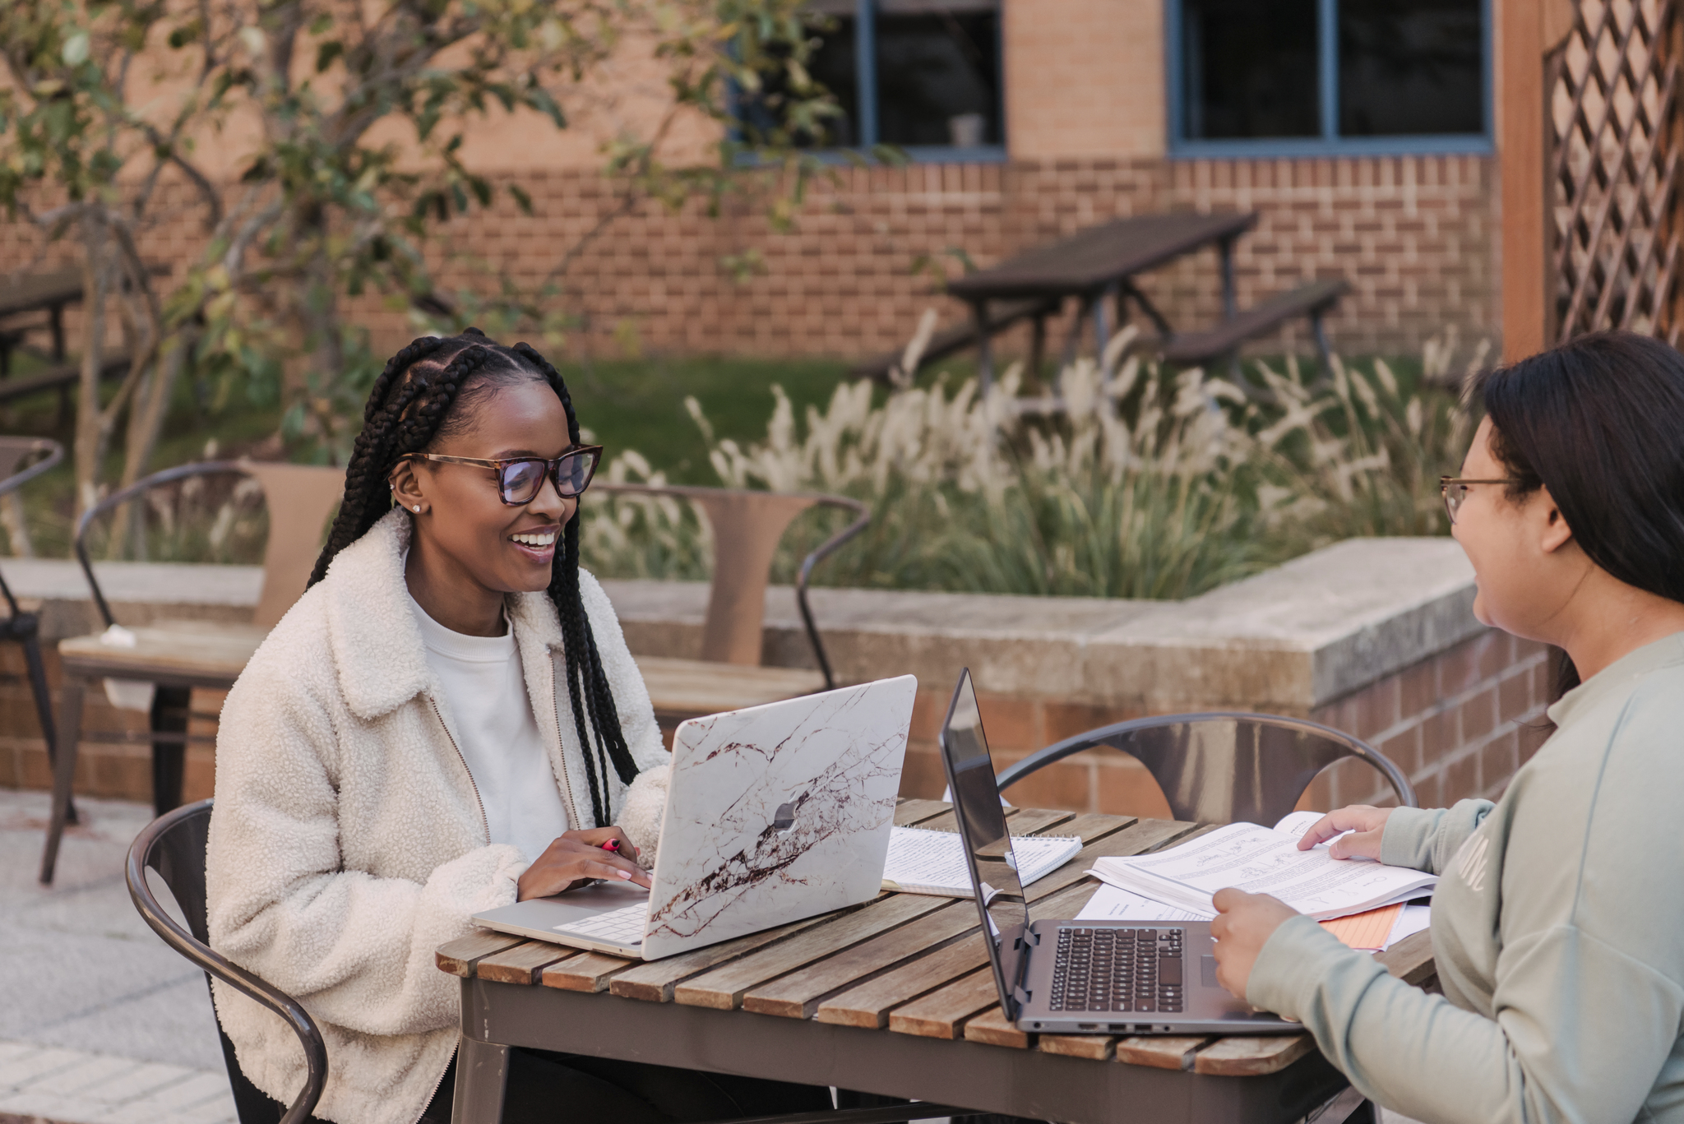
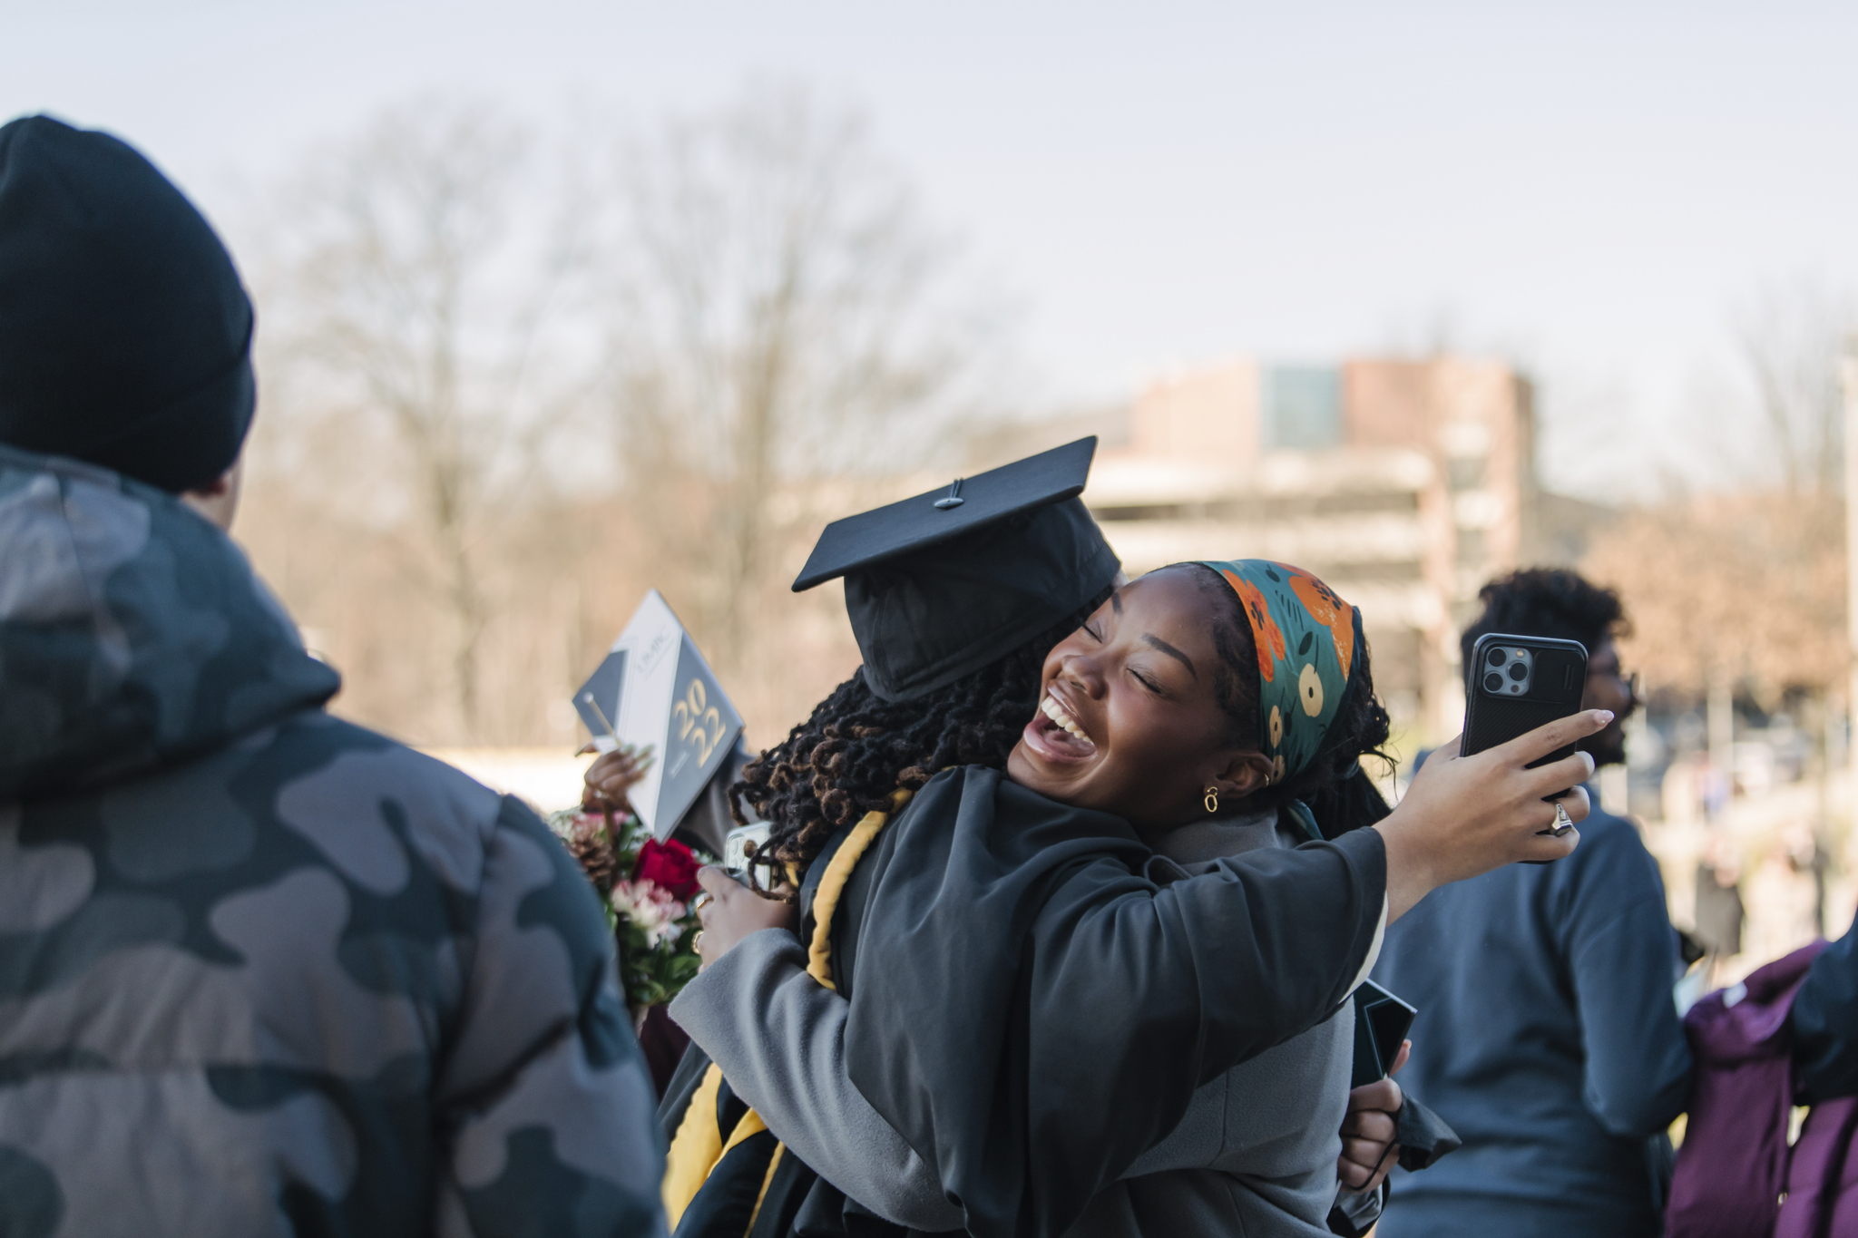
Engage with the Journey
Notes:
-Each transition is a new beginning.
-Admissions to UMBC is no longer the goal
-Graduation as one goal – Need the grades in the classes to get the degree
-What is after graduation? - Need the “extra” to get the JOB (Research, internships, clubs/orgs, relationships, etc.)
-Now to make these semesters/years/experiences mean something
-UMBC is an institution with high expectations and high achieving students

Slide 6
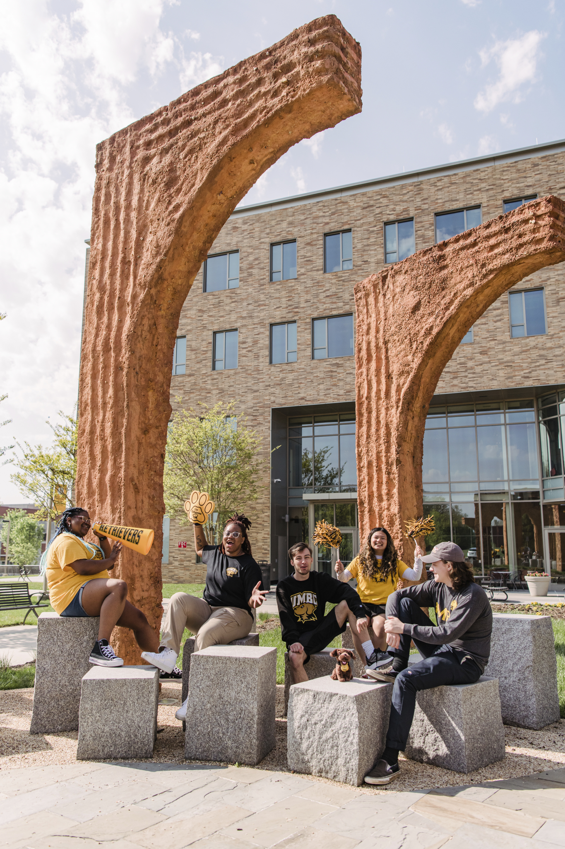
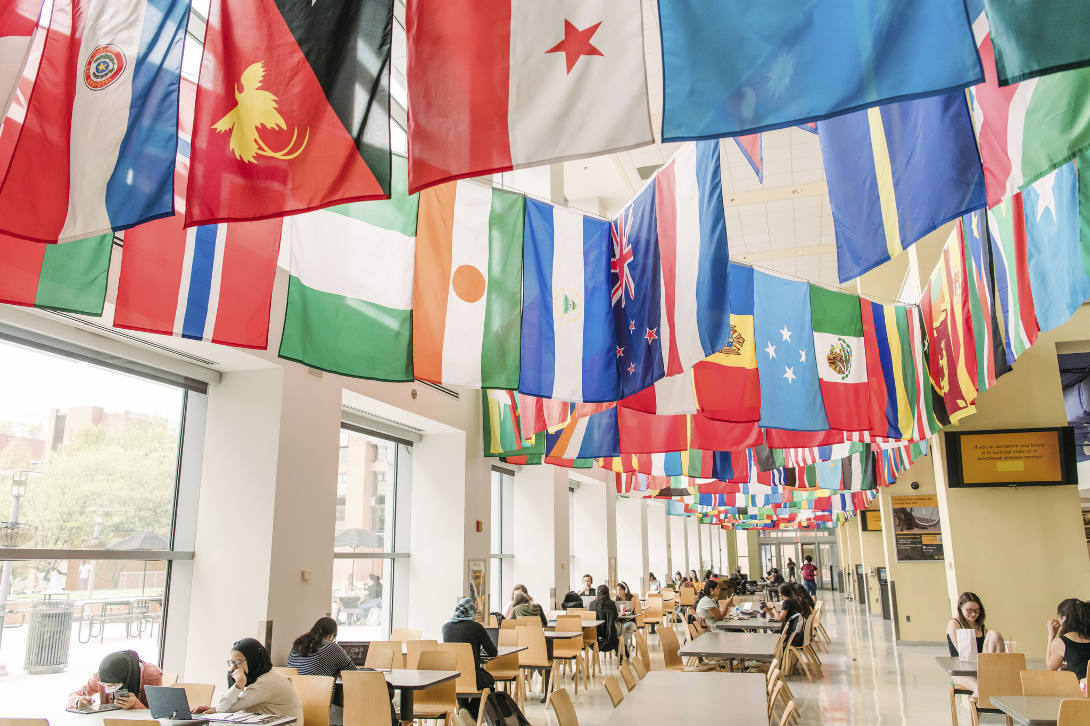
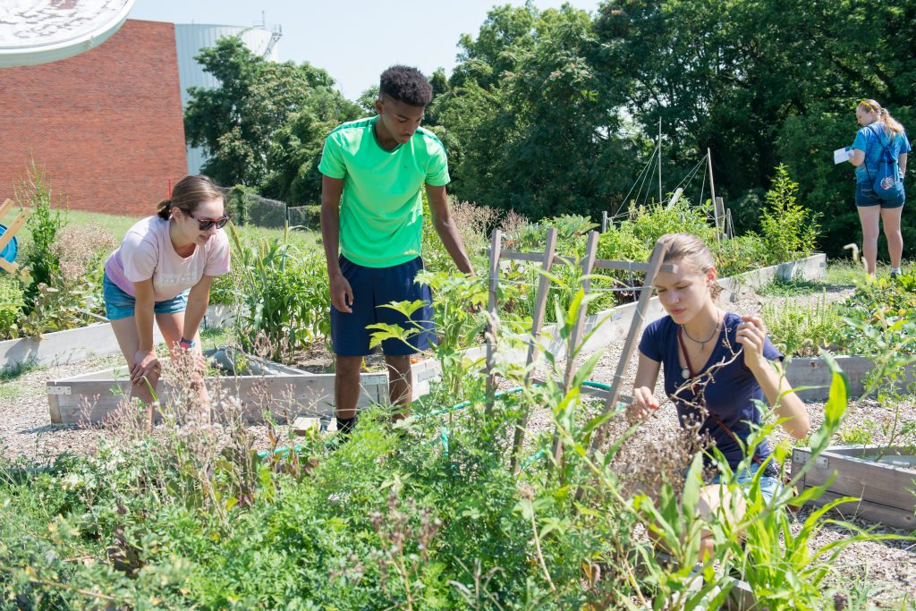
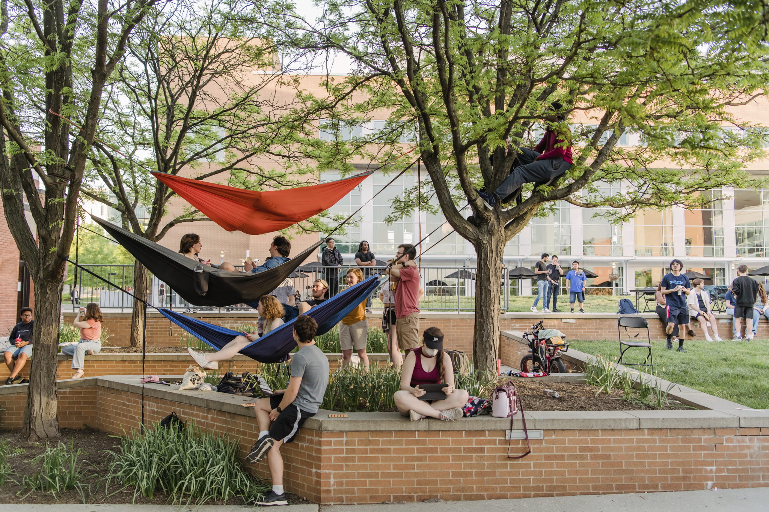
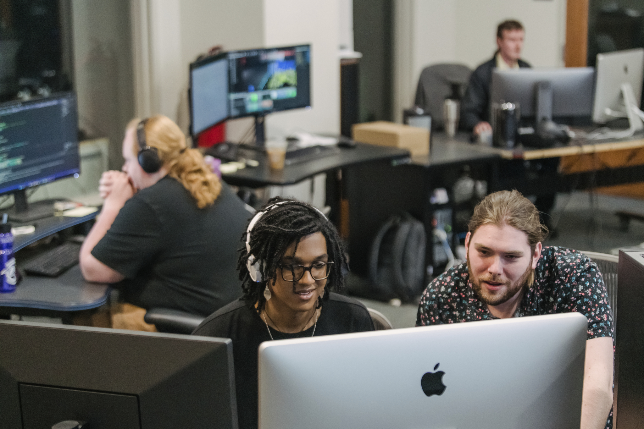
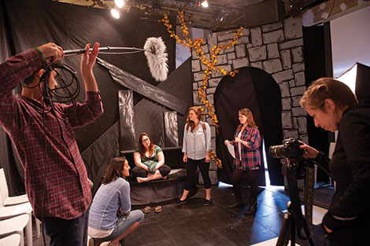
Campus as a Community
Notes:
-Students bring a number of experiences and dimensions with them, we want to celebrate them all in our community
-You are part of the UMBC community now too
-Students need your support and we need your support
-15 years ago, there was no family involvement during college years
-Now we know we need to work together for student success

Slide 7

Challenge vs Support
Notes:
-Bucket swing vs flat swing analogy
-Discuss what challenge vs support means in context of what students are doing at orientation and during their first semester/year
-Orientation: creating intentional space for students to engage with each other and current students
-Transfer Welcome Day, Welcome Week, Homecoming, etc…. Transition is not a checkbox for today and that support is ongoing
-Orientation: Demonstrate all the resources available at UMBC

Slide 8
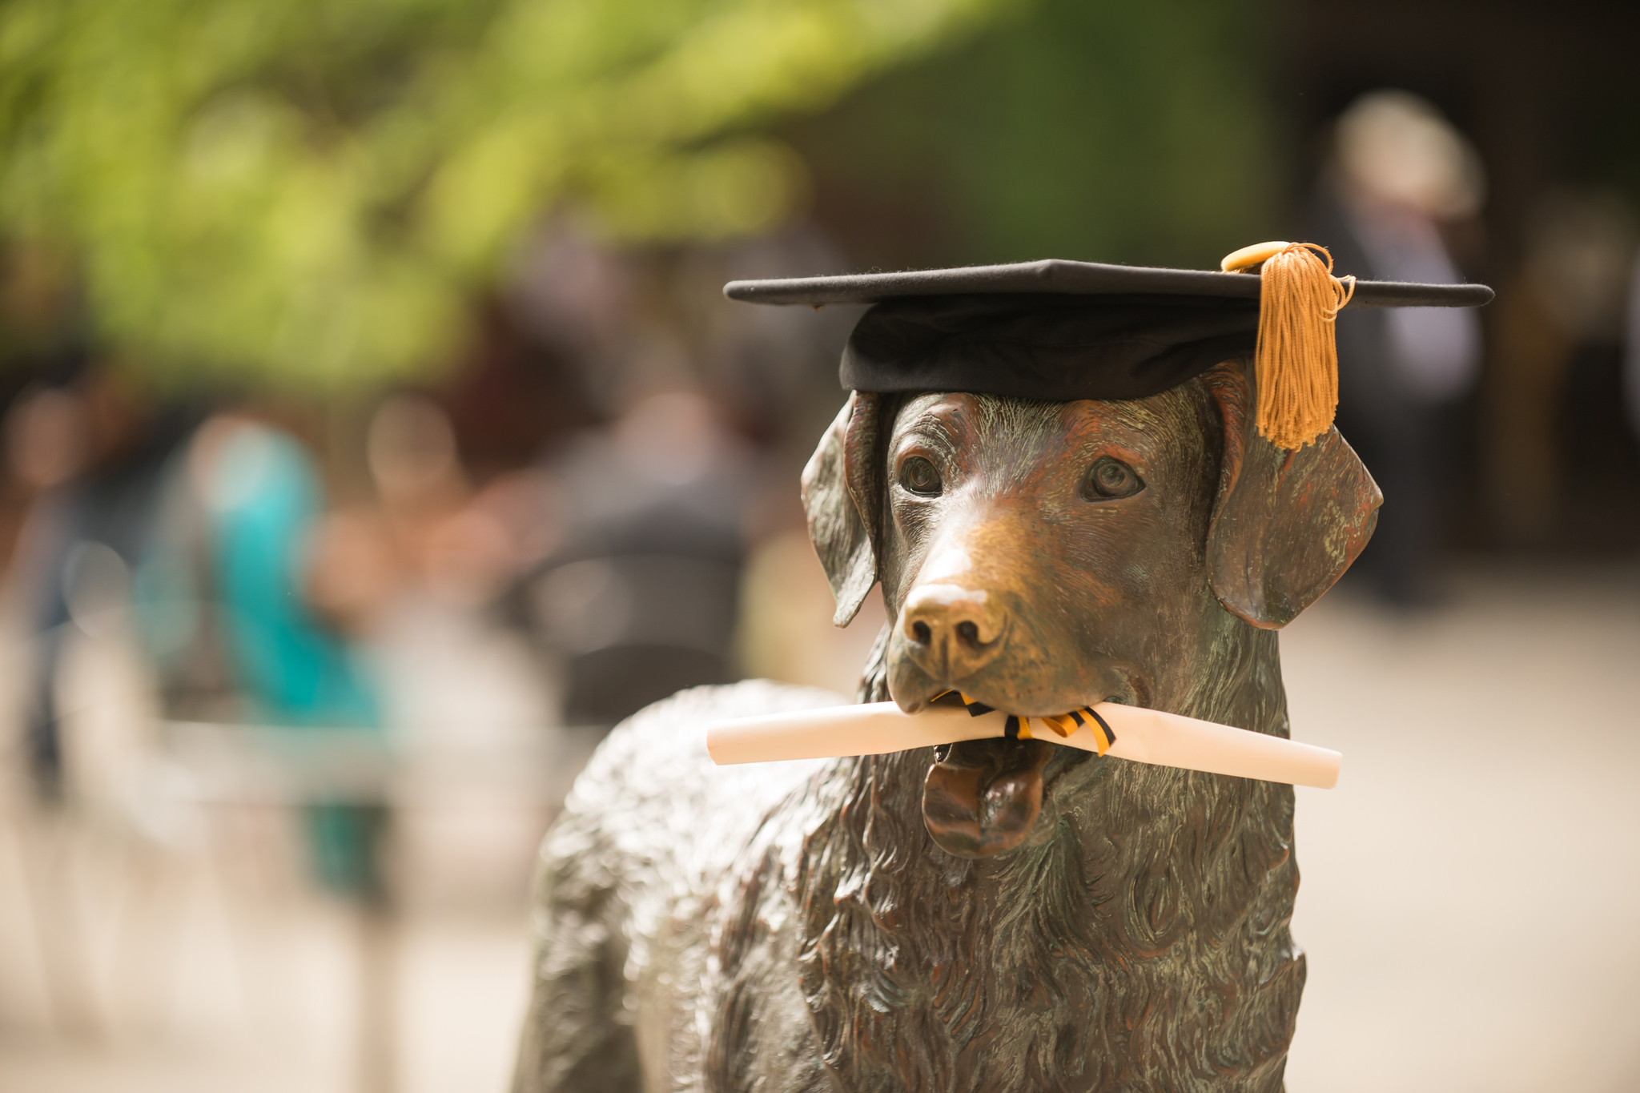
Finding the Balance
Expectations
Responsibilities
Notes:
Poll audience about their expectations? Poll audience about what they think their responsibilities are?
-Expectations of involvement, engagement, students taking ownership of their education. As a family communicate expectations early.
-Responsibility of students to seek help, be proactive. Responsibility of families to encourage, support, be knowledgeable of resources, look for warning signs, be mindful of time expectations

Slide 9
Once again, meet your Orientation Peer Ambassadors
Notes:
Introduce OPAs as a resource that will be with them all day.
Introduce the idea behind the skits: We know not all scenarios can be covered, but we wanted to introduce a couple of things we have seen and heard before.
Skit 1- “Making friends, getting involved on campus”. Afterwards talk through the benefits of getting involved, have OPAs share their experiences with establishing networks, study groups, involvement on campus.
Skit 2-” Midterms, I’m not smart enough for school” . Discuss academic rigor, first year alerts, academic support. Asking for help.
Skit 3- “Going a way for an internship”. Poll audience how many of their students work? How many had internships or done research. Have the OPAs explain their involvement in research, service learning or internships.
Skit 4- “No one is here to help me”. Afterwards talk about the purposeful challenge we give students to advocate for themselves and helping them build these skills for life beyond UMBC.

Slide 10
Contact Us
Office of Undergraduate Admissions and Orientation
410-455-2292
orientation@umbc.edu

