Slide 1
Financing Your Student’s Education
Presented by:
Student Business Services &
The Office of Financial Aid & Scholarships
Notes:
Intro to program and names/titles of representatives

Slide 2
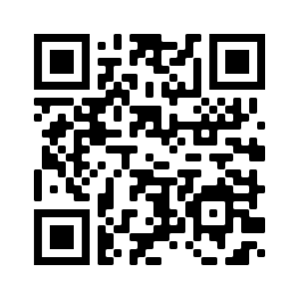
Student Business Services
Administration Building, 3rd floor
Monday-Friday, 8:30am-4:00pm (Payments until 2:30pm)
SBS Team: 410-455-2288
Notes:
SBS rep

Slide 3
Student Business Services
Monthly E-Bills
Payment Processing
Payment Plan Enrollment
E-refunds
Authorizing Additional Users
Notes:
SBS rep

Slide 4
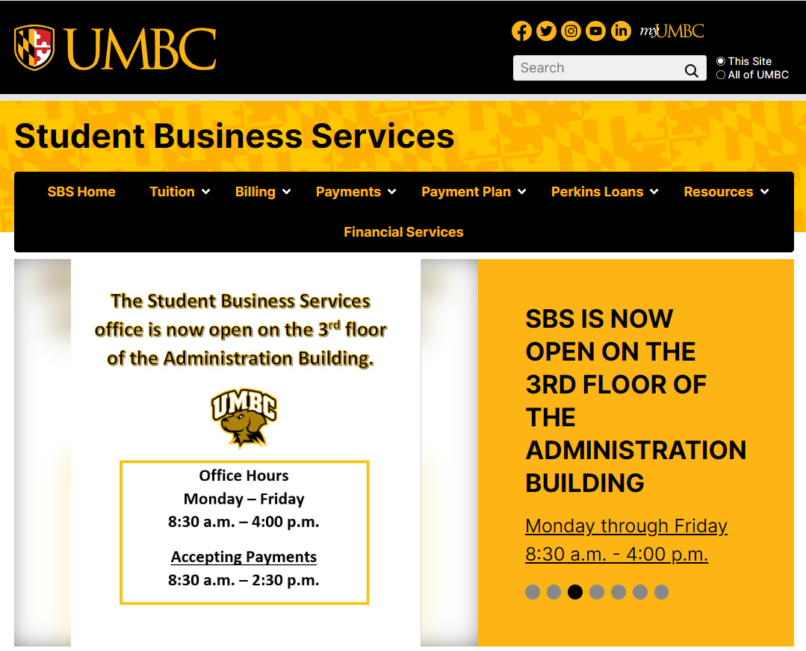
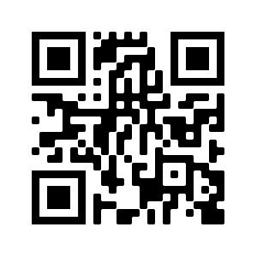
sbs.umbc.edu
Notes:
SBS rep

Slide 5
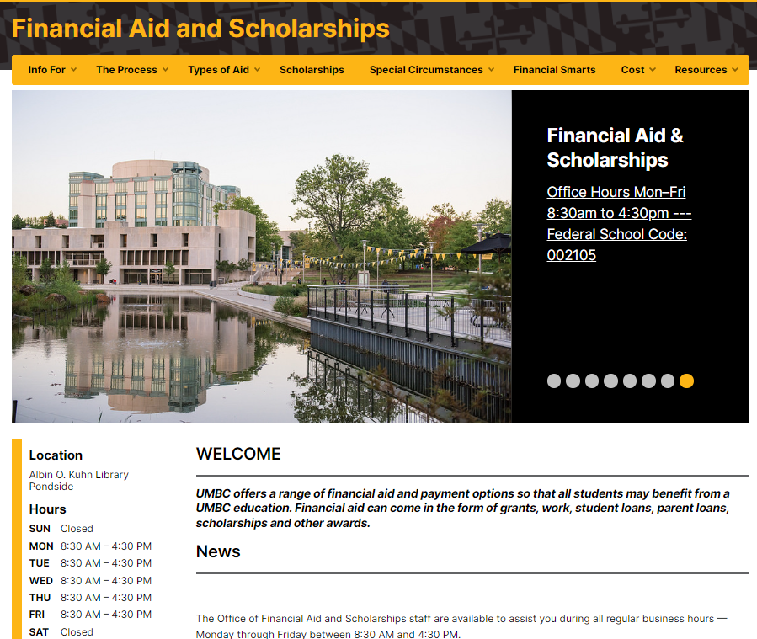
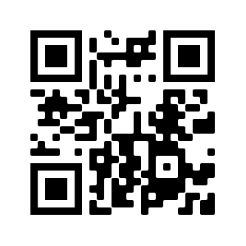
Lower level of the Library, pondside
Monday-Friday, 8:30am-4:30pm
Financial Aid: 410-455-2387
Merit Scholarships: 410-455-3813
Notes:
FinAid Rep
Our website is a great resource for finding information on types of aid, timelines, and forms. The Cost tab houses our Cost Calculator tool that helps you estimate out of pocket expenses before charges are posted for your student!

Slide 6
Office of Financial Aid and Scholarships
Merit Scholarships
Financial Aid
Awarding of Merit Scholarships
Scholarship Retriever
Transfer Scholarships
Private Scholarship Notifications
FAFSA processing
Verification of Student accounts
MHEC award processing
Financial aid counseling
Financial aid awarding.
Notes:
The office is open Monday-Friday from 8:30am-4:30pm and is comprised of three separate units: Merit Scholarships, Financial Smarts, and Financial Aid.
Students are assigned financial aid counselors based on the first letter of their last name. Contact information for our offices and information on students counselors can be found on our contact page.

Slide 7
Financial Aid Myths or Fact?
My family makes too much money for financial aid, so we just didn't submit a FAFSA.
MYTH: Many families qualify for some form of aid—especially institutional aid, merit aid, and federal loans—even if they don’t receive a Pell Grant. Always submit the FAFSA to find out
My student pays their own bills and files their own taxes. They are independent and I don’t need to be on the FAFSA.
MYTH: Students are considered dependent in terms of the FAFSA unless they are 24 years old, a graduate student, extenuating circumstances preventing them from contacting their parents.
Families can appeal for additional financial aid.
TRUE: Families can submit the “change in circumstances appeal” to indicate that their circumstances have changed since the time of FAFSA submission.

Slide 9
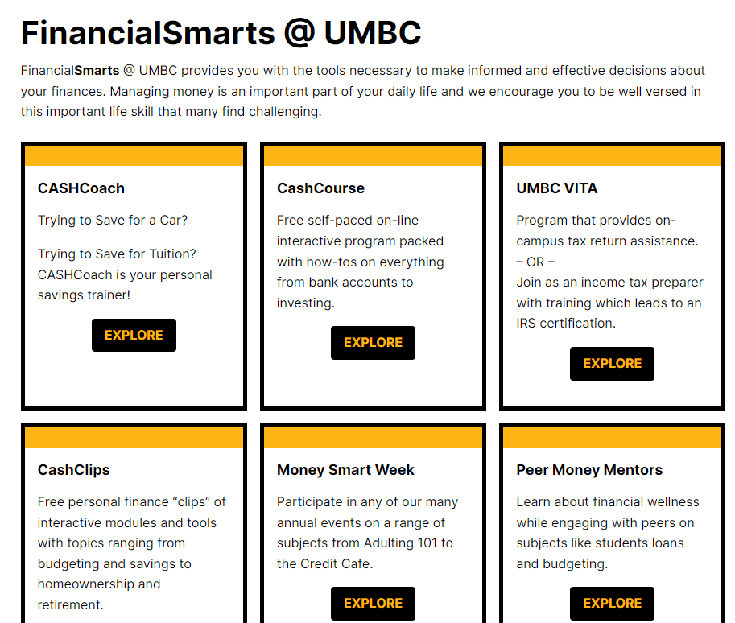
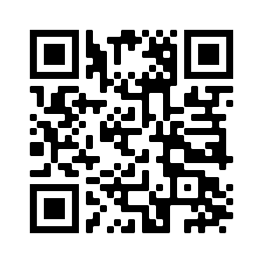
FinancialSmarts
Financial Smarts @ UMBC provides you with the tools necessary to make informed and effective decisions about your finances. Managing money is an important part of your daily life and we encourage you to be well versed in this important life skill that many find challenging.
financialsmarts.umbc.edu
Notes:
OFAS rep
FinancialSmarts helps provide students with the tools they need to make informed financial decisions. From skills like budgeting, saving, investing, and taxes to life goals like auto loans, home ownership or retirement, FinancialSmarts can help your student with life-long financial success.
You can partner with your student to help them understand and successfully navigate finances here at UMBC and beyond.

Slide 10
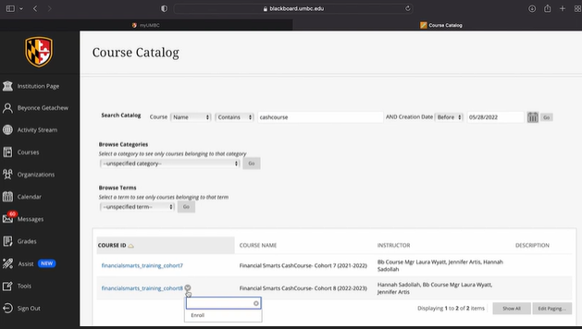
Cash Course: Modules and Prizes
UMBC provides a free self-paced financial education program via BlackBoard. CashCourse is complete with presentations, informational guides, games, and how-to’s on everything from bank accounts to investing.
● Students who complete the pre–assessment and one module will be entered into our $100 scholarship drawing.
.
● Students who complete the pre–assessment and two or more modules will be entered into our $300 scholarship drawing.
● Students who complete the pre–assessment and all modules (earn your FinancialSmarts CashCourse digital badge) will be entered into our $500 scholarship drawing.

Slide 11
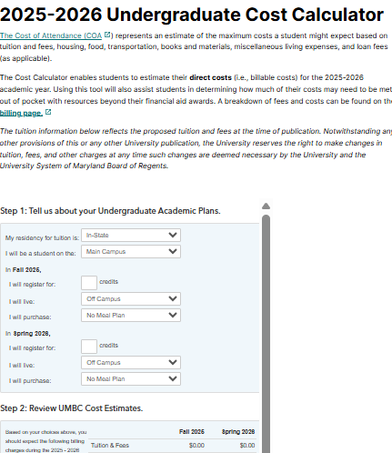
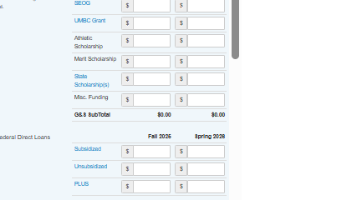
Notes:
Financial Aid Rep

Slide 12
UMBC’s commitment to financial awareness
UMBC encourages students and their families to make informed, responsible decisions when considering student loans as part of their educational financing plan.
Federal Direct Loans (Student Borrower)
Subsidized: For undergraduates with financial need. Government pays interest while in school and during grace/deferment.
Unsubsidized: For undergrad and grad students. Interest accrues during all periods; not need-based.
Parent PLUS Loans (Optional)
For parents of dependent undergraduates.
Covers remaining cost of attendance after other aid.
Requires credit check; higher interest rate than student loans.
Alternative/Private Loans
Offered by banks and private lenders.
Credit-based; often requires a co-signer.
Typically used after federal options are exhausted.

Slide 13
Accept financial aid via “Financial Aid Inquiry” on myUMBC
Complete (Parent PLUS/Alternative) loan requirements (optional)
Apply for Scholarships
Sign up for the Fall 2025 Monthly Payment Plan
Use Cost Calculator to estimate charges
Notes:
FinAid rep first 4 bullets
-Students who have a FAFSA on file should have an aid package. They can access this on myUMBC under their Financial Aid card or on the Financial Aid Inquiry.
-If your student is taking out Federal loans, they will need to complete the MPN (Master Promissory Note) and Entrance Counseling at studentaid.gov. This is required for all new borrowers.
-If you intend to take out additional loans beyond the Federal loans offered to the student such as Parent PLUS and alternative/private loans, we encourage you to complete this as soon as possible.
-If your student is receiving any scholarships from outside sources, report these to UMBC with the scholarship notification form. Students can apply for scholarship opportunities with Scholarship Retriever as well.
SBS rep:
-Sign Up for Monthly Payment Plans (billing and mpp schedule on next slide)
-Use Cost Calculator to estimate charges and sign up for a MPP

Slide 14
Initiate or submit Third Party Payment Information (tuition assistance, tuition remission, VA, 529)
Tuition charges can be viewed mid-July on Account Inquiry
Notes:
SBS rep

Slide 15
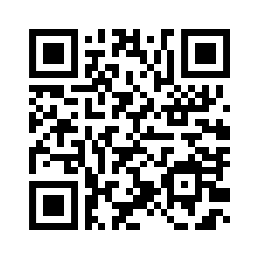
Billing Schedule
Register By | E-Bill Date | Due Date | Late Fee Charged
July 31 | August 1 | August 20 | Late fees are
August 31 | September 1 | September 20 | Charged Typically
September 30 | October 1 | October 20 | on the 25th of the Month
Monthly Payment Plan (MPP)
MPP Installments | Deadline to Sign Up | 1st Payment Due
4 | July 19 | July 20
3 | August 19 | August 20
2 | September 19 | September 20
 |  | Final payment: October 20
Notes:
SBS rep

Slide 16
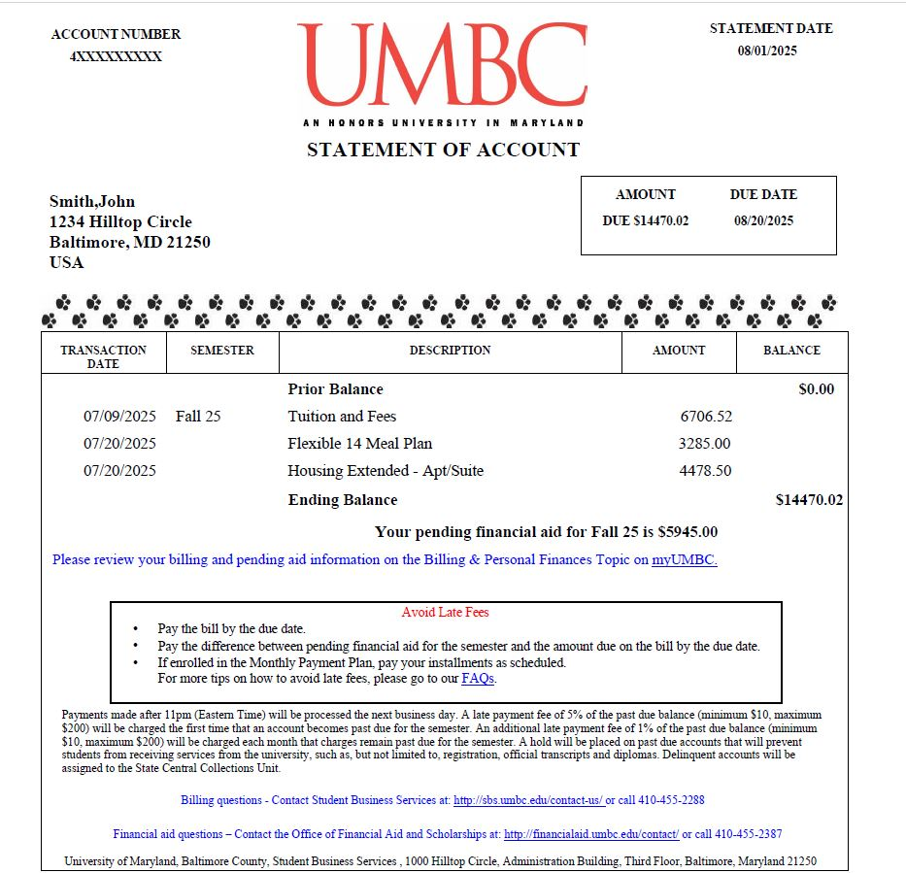

Slide 17
Pay Online
ACH eCheck & Campus Card (no fee)
Credit Card (2.75% convenience fee)
International Wires
Pay In-Person
Cash & Checks Accepted
No Credit Card Payments
Drop Box Available

Slide 18
E Refunds
Student refunds issued electronically
Select e-refund preference:
Deposit to a bank of your choice
Direct Deposit to BankMobile Vibe account
Mailed paper check

Slide 19
Authorizing Additional Users (Parents/Others)
Profile Sharing
Sharing financial information via myUMBC
Online – students authorize access to view billing and financial aid details
Offline – students authorize access to receive information in-person, by telephone and email
Adding Payer
Students authorize access via myUMBC to:
View e-bills
Sign up for Monthly Payment Plan
Make online payments
Notes:
SBS rep

Slide 20
Submit your 2025-2026 FAFSA application at studentaid.gov/h/apply-for-aid/fafsa
Remind your student to monitor myUMBC for To Do’s and alerts
Notes:
**link to FAFSA page?
Reminder that next semester registration opens shortly and they will want to make sure accts are in good standing
* Info about Managing my student acct page?

Slide 21
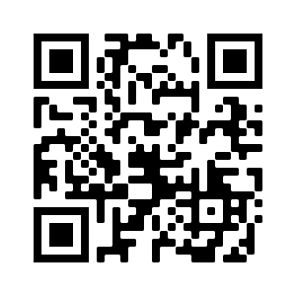
Aid Disbursement
Enrollment | First Disbursement Date
Full-time undergraduate students (12+ credits) | August 19th
Part-time undergraduate students (1-11 credits) | September 16th
The full disbursement calendar: financialaid.umbc.edu/calendar/
If pending financial aid is equal to or exceeds the balance due by the billing due date, students will not receive late fees.
Notes:
FinAid rep
Aid begins disbursing for students who are enrolled full time (12 or more credits) as early as August 21st. Students who are enrolled part time (less than 12 credits) will have aid begin disbursing as of September 19th.
The first disbursement date is after the billing due date for Fall 2023, however, students will not receive late fees if their pending financial aid equals or exceeds the balance due.

Slide 22
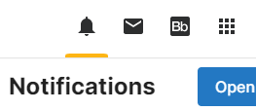
Remind your student to check myUMBC Notifications
Notes:
SBS rep

Slide 23
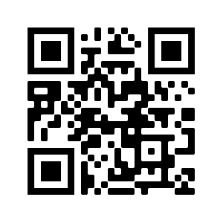
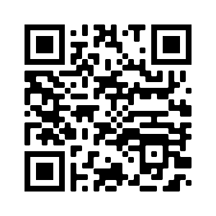
Questions
SBS FAQs
Financial Aid FAQs

