Slide 1
Connecting Students, Families and UMBC
Family Orientation
Summer 2025
Yvette Mozie-Ross, PhD
Vice Provost for Enrollment Management and Planning

Slide 2
Session Overview
Introduction
Importance of Family
Higher Ed Context
Strategies for Enhancing Communication
myUMBC Profile Sharing
Questions

Slide 3
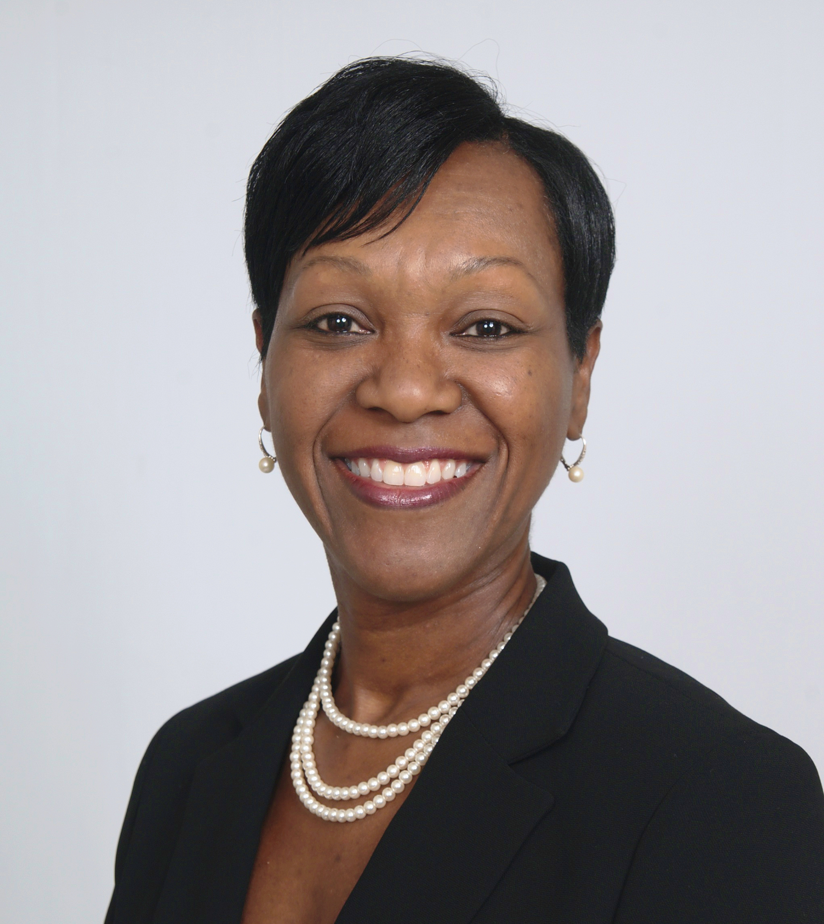
Your Presenter
Yvette Mozie-Ross, Vice Provost for Enrollment Management and Planning
Supporting Students from Recruitment to Graduation
30+ Years of Service to UMBC and Higher Ed
Doctorate in Education Policy and Leadership (Higher Ed Administration)
UMBC Alumna
Parent of a UMBC Student

Slide 4


Importance of Family
What we know for sure…
Your student’s success thus far has, at least in part, to do with your unwavering support and guidance along the way.
To get them to the next major milestone, completion of their undergraduate degree, your continued support and guidance will be critical.

Slide 5
But conversations may feel a bit different than what you have been accustomed to.

Slide 6
Higher Education Context
Family Educational Rights and Privacy Act (FERPA):
  Student has a right to access their educational record and, if deemed necessary, take corrective action.
  Institution has an obligation to limit disclosure of student’s personal identifiable information to third parties without prior written consent from the student.

Slide 7
Strategies for Enhancing Communication

Slide 8
Strategies for Enhancing Communication
#1
Be clear about your expectations.

Slide 9
Recommendations…
Have conversations with your student about your expectations for sharing information prior to the start of the academic year. (Side Note: Waiting to have this important conversation during mid-terms or finals is usually not very effective.)
Discuss in a relaxing setting i.e. vacation, dining out, etc.
Be clear and unapologetic. This is a non-negotiable.
Remind students along the way of expectations.

Slide 10
Strategies for Enhancing Communication
#2
Know where to go for what.

Slide 11
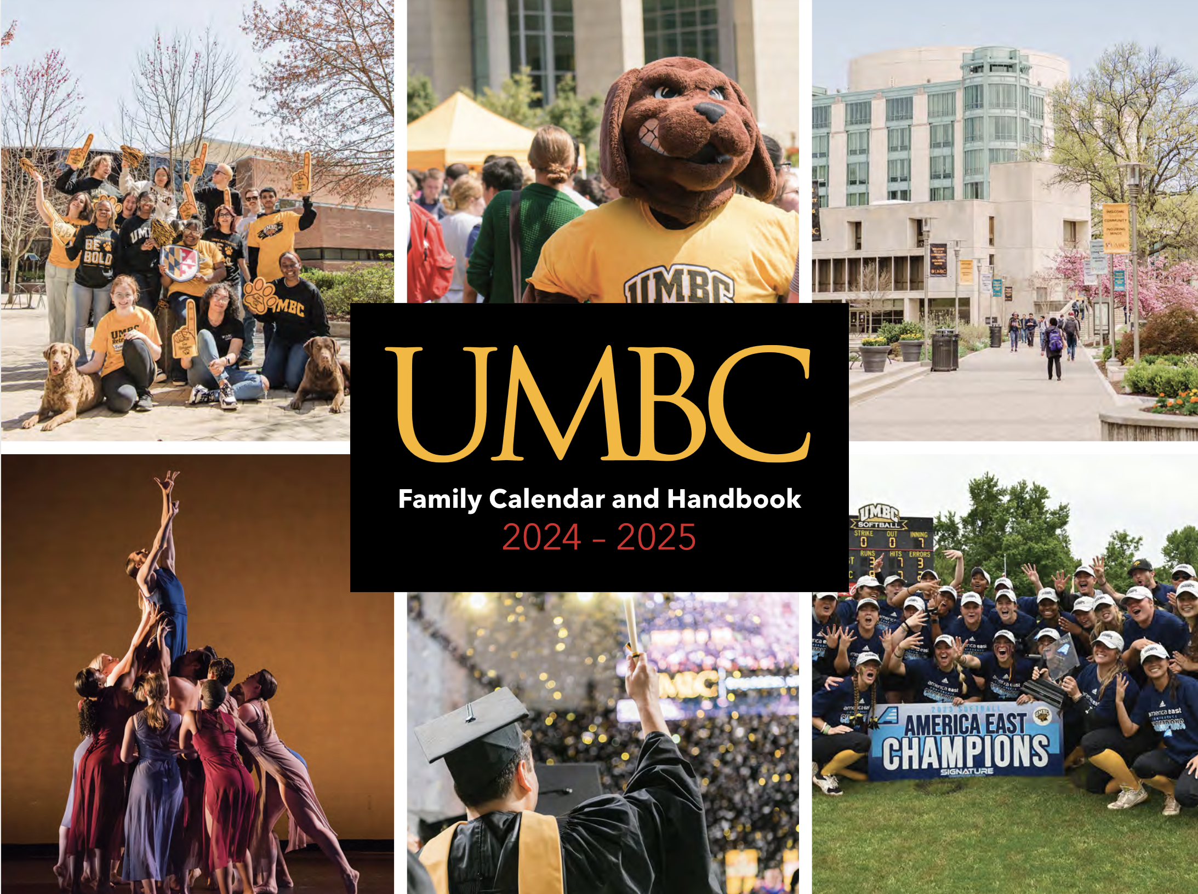
Family Calendar and Handbook

Slide 12
Recommendations…
Read from front to back prior to start of classes.
Transfer important dates, deadlines, email addresses and telephone numbers to your personal organizational devices.
To add dates to your personal Calendar, subscribe to this URL:
Be prepared to have timely and strategic conversations with your students.
https://my3.my.umbc.edu/groups/official-dates

Slide 13
Examples of Helpful Information…
10 Sept.
Schedule Adjustment Deadline.
Last Day to Add a Class.
Last Day to Drop a Class w/o a grade of W.
5 Nov.
Last Day to Withdraw from an Individual Course w/ a grade of W.
Last Day to Change Grade Method to S/SU.

Slide 14

How You Might Use this Information
5 days prior to Sept. 10, ask your student:
Have you attended each of your classes?
Have you reviewed the syllabus for each of your classes?
Do you need to make an adjustment to your schedule?
Remind student that the last day to adjust their schedule (add or drop a class without a grade of W) is Sept. 10.

Slide 15

How You Might Use this Information
Two weeks prior to Nov. 5, ask your student:
Have you received any feedback in the way of graded homework assignment, paper, test, etc. that gives you an indication of how you’re doing?
Have you received an Early Academic Alert?
Do you need to consider withdrawing from the course?
Remind student the last day to withdraw from an individual course (with a grade of W) OR change grade method from Regular to Satisfactory/Unsatisfactory is Nov. 5.

Slide 16
Strategies for Enhancing Communication
#3
Know how things work.

Slide 17
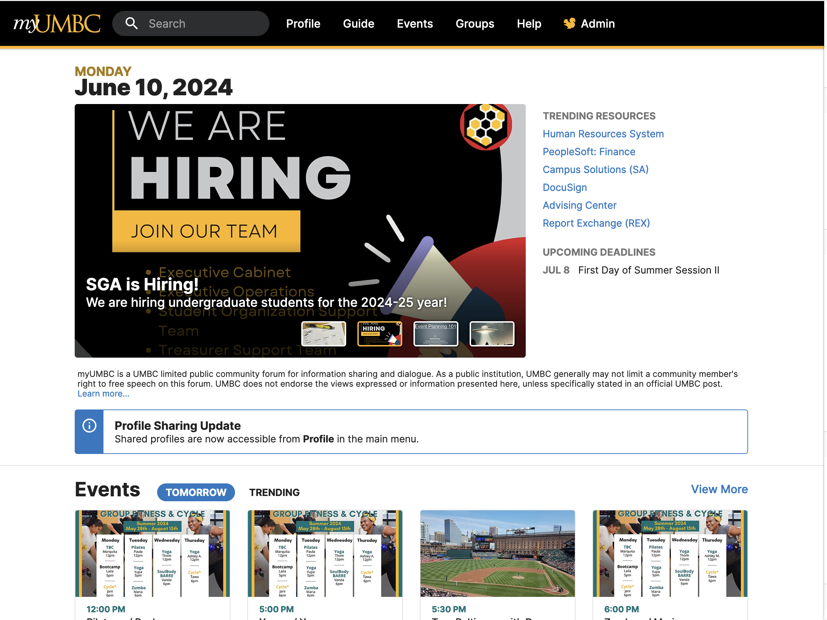
myUMBC
Portal for all campus transactions and communications related to:
Academic matters
Business and administrative matters
Social, co-curricular, community matters

Slide 18
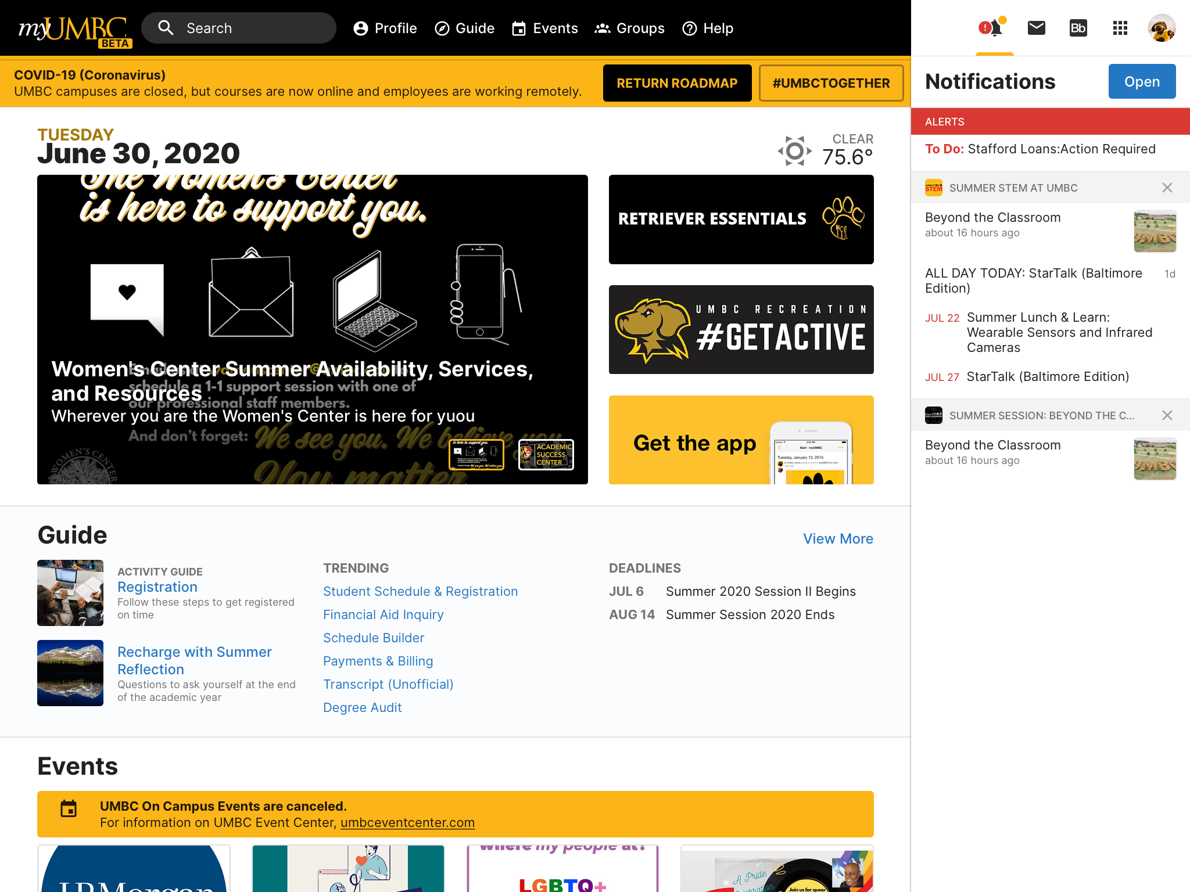

Slide 19
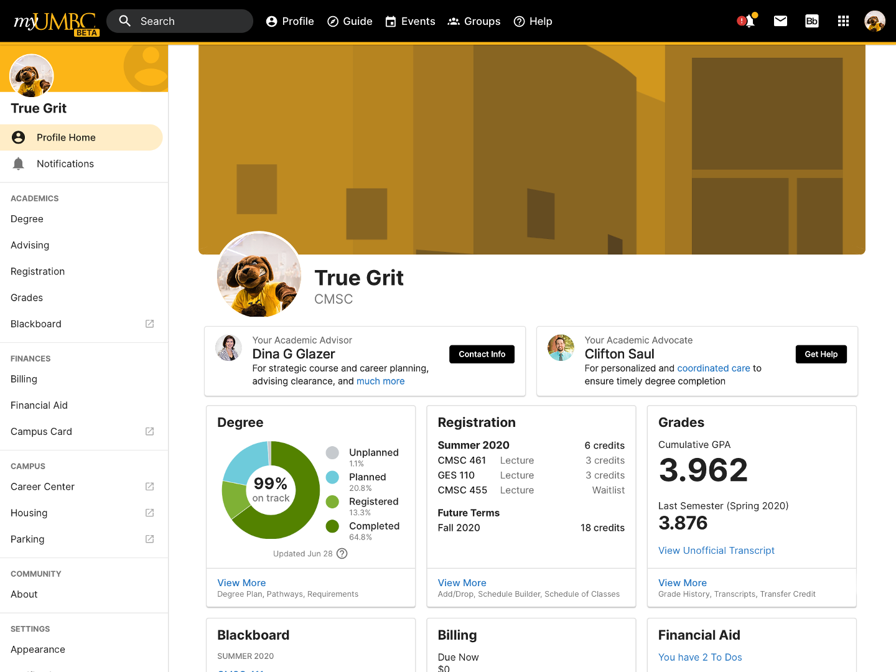

Slide 20
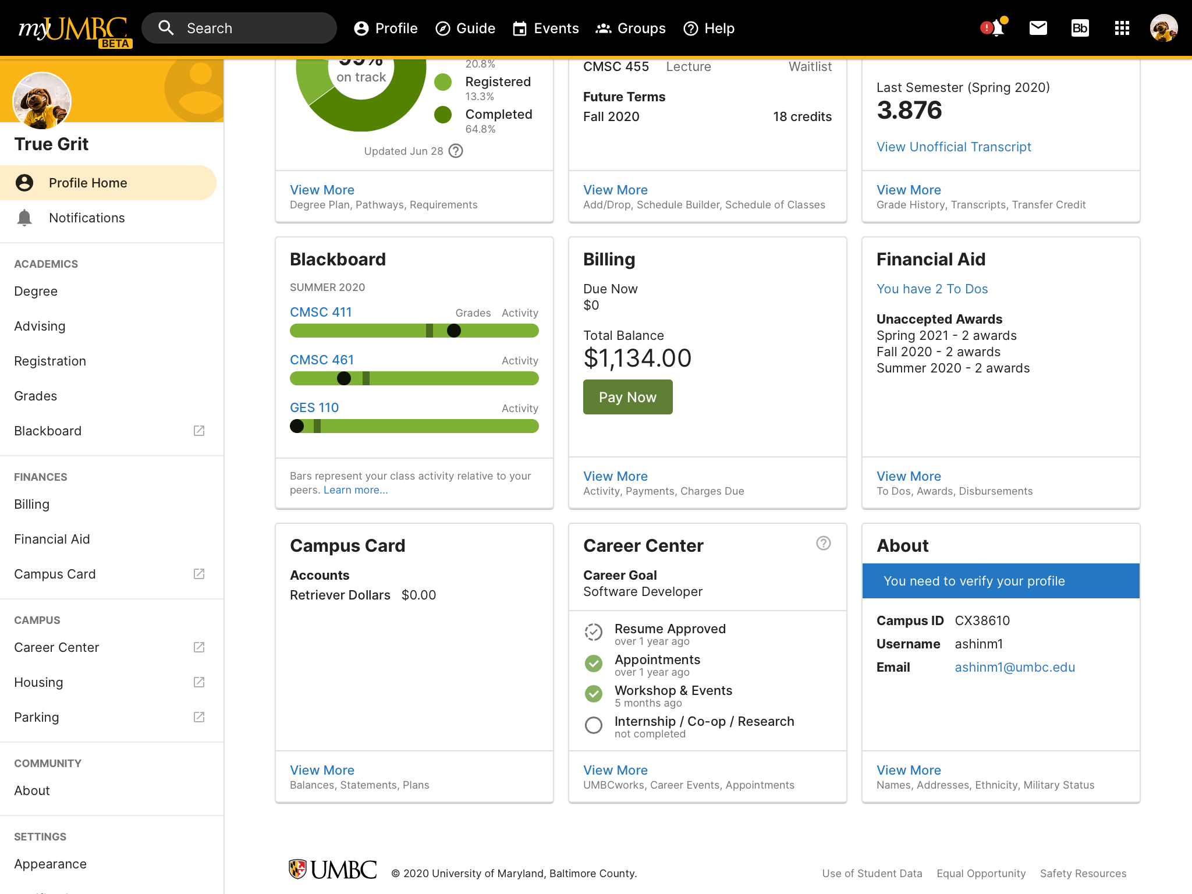

Slide 21
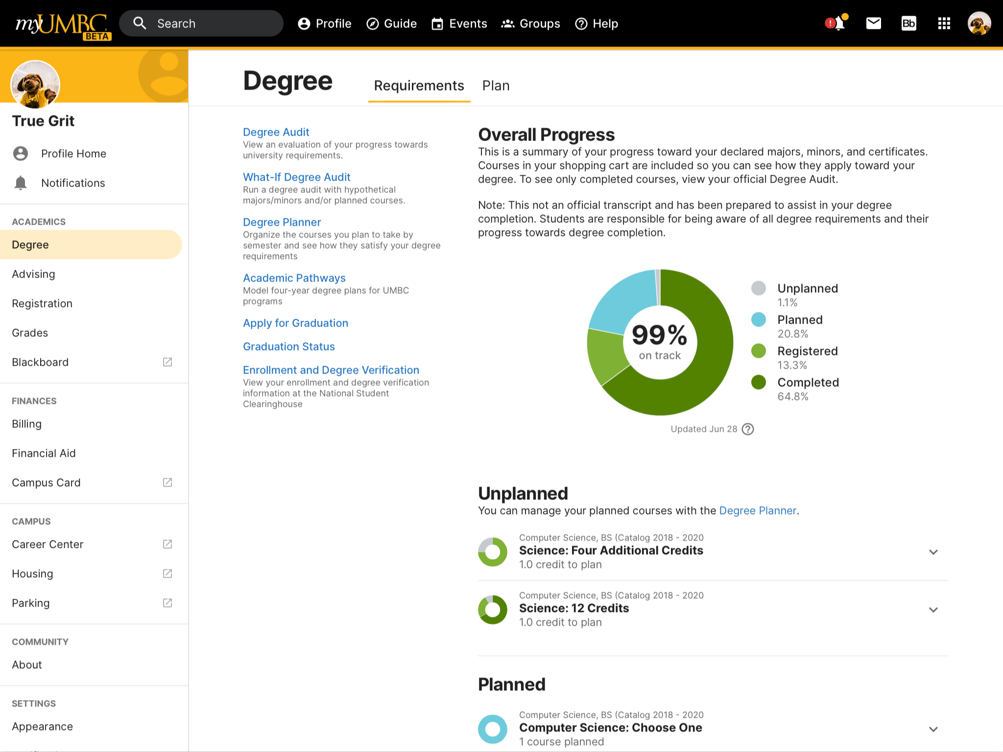

Slide 22
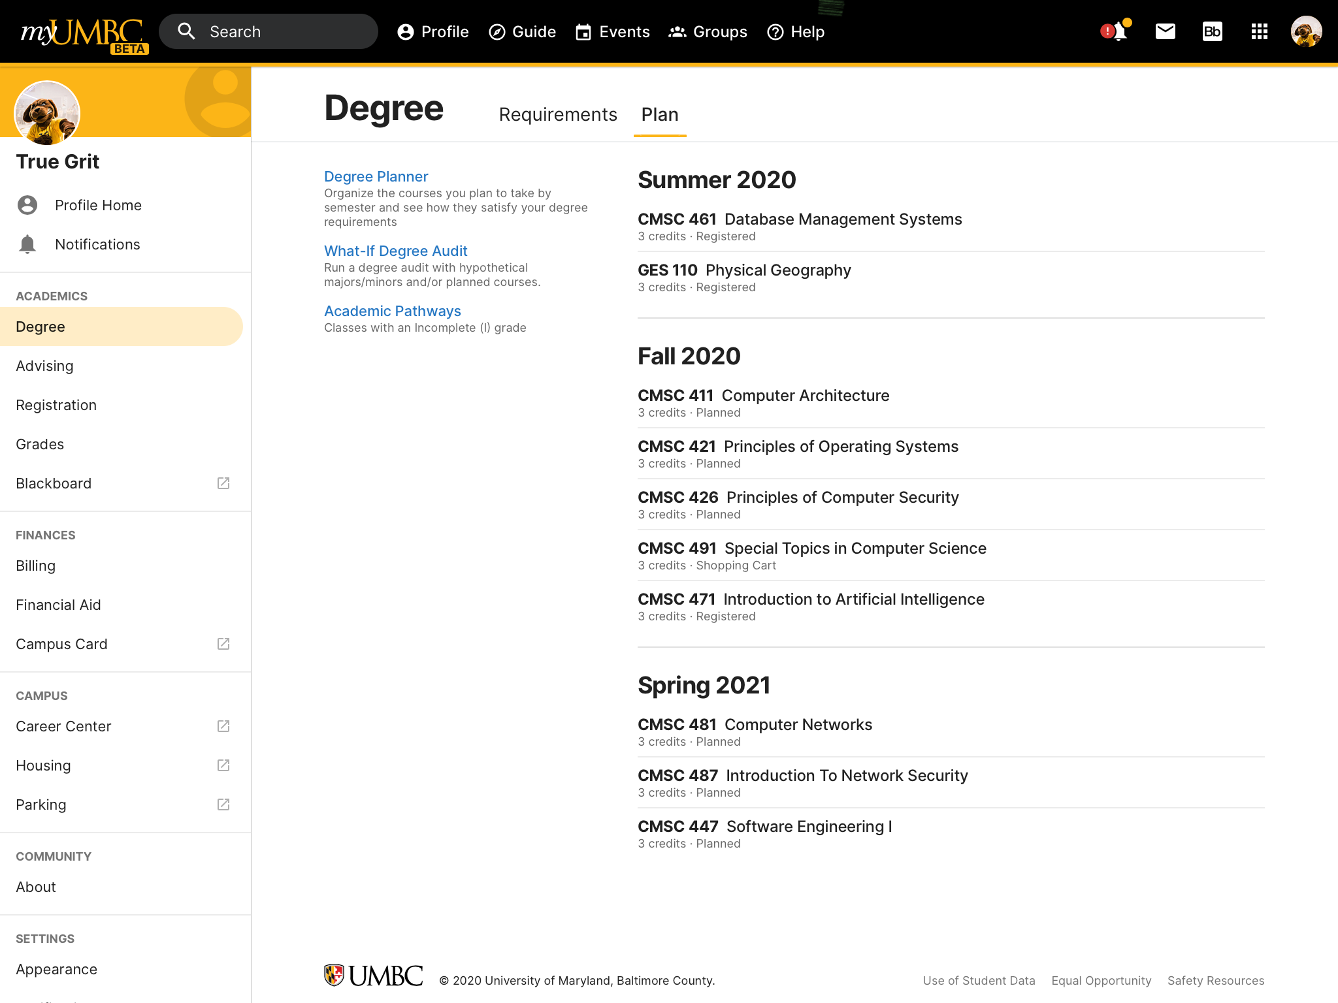

Slide 23
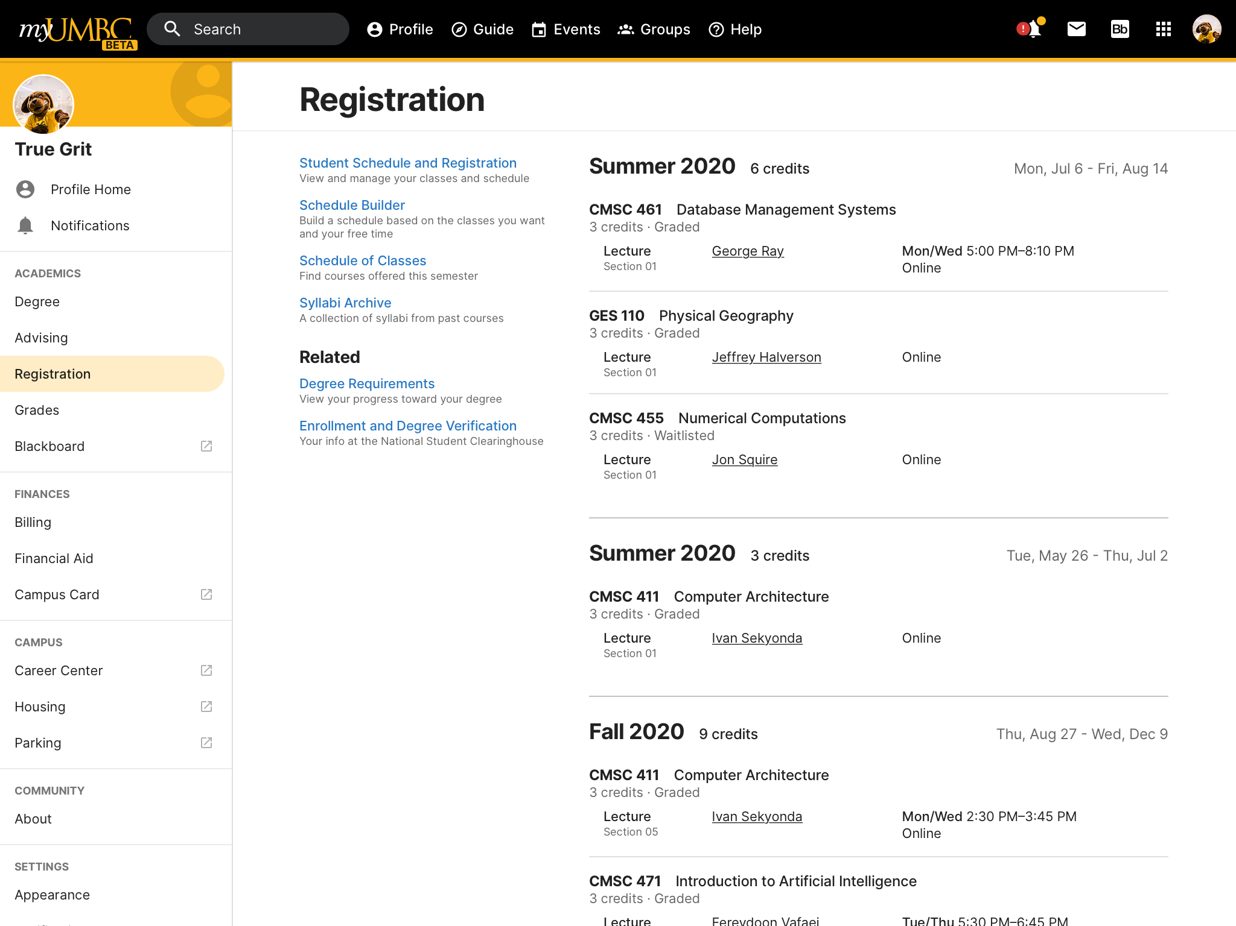

Slide 26
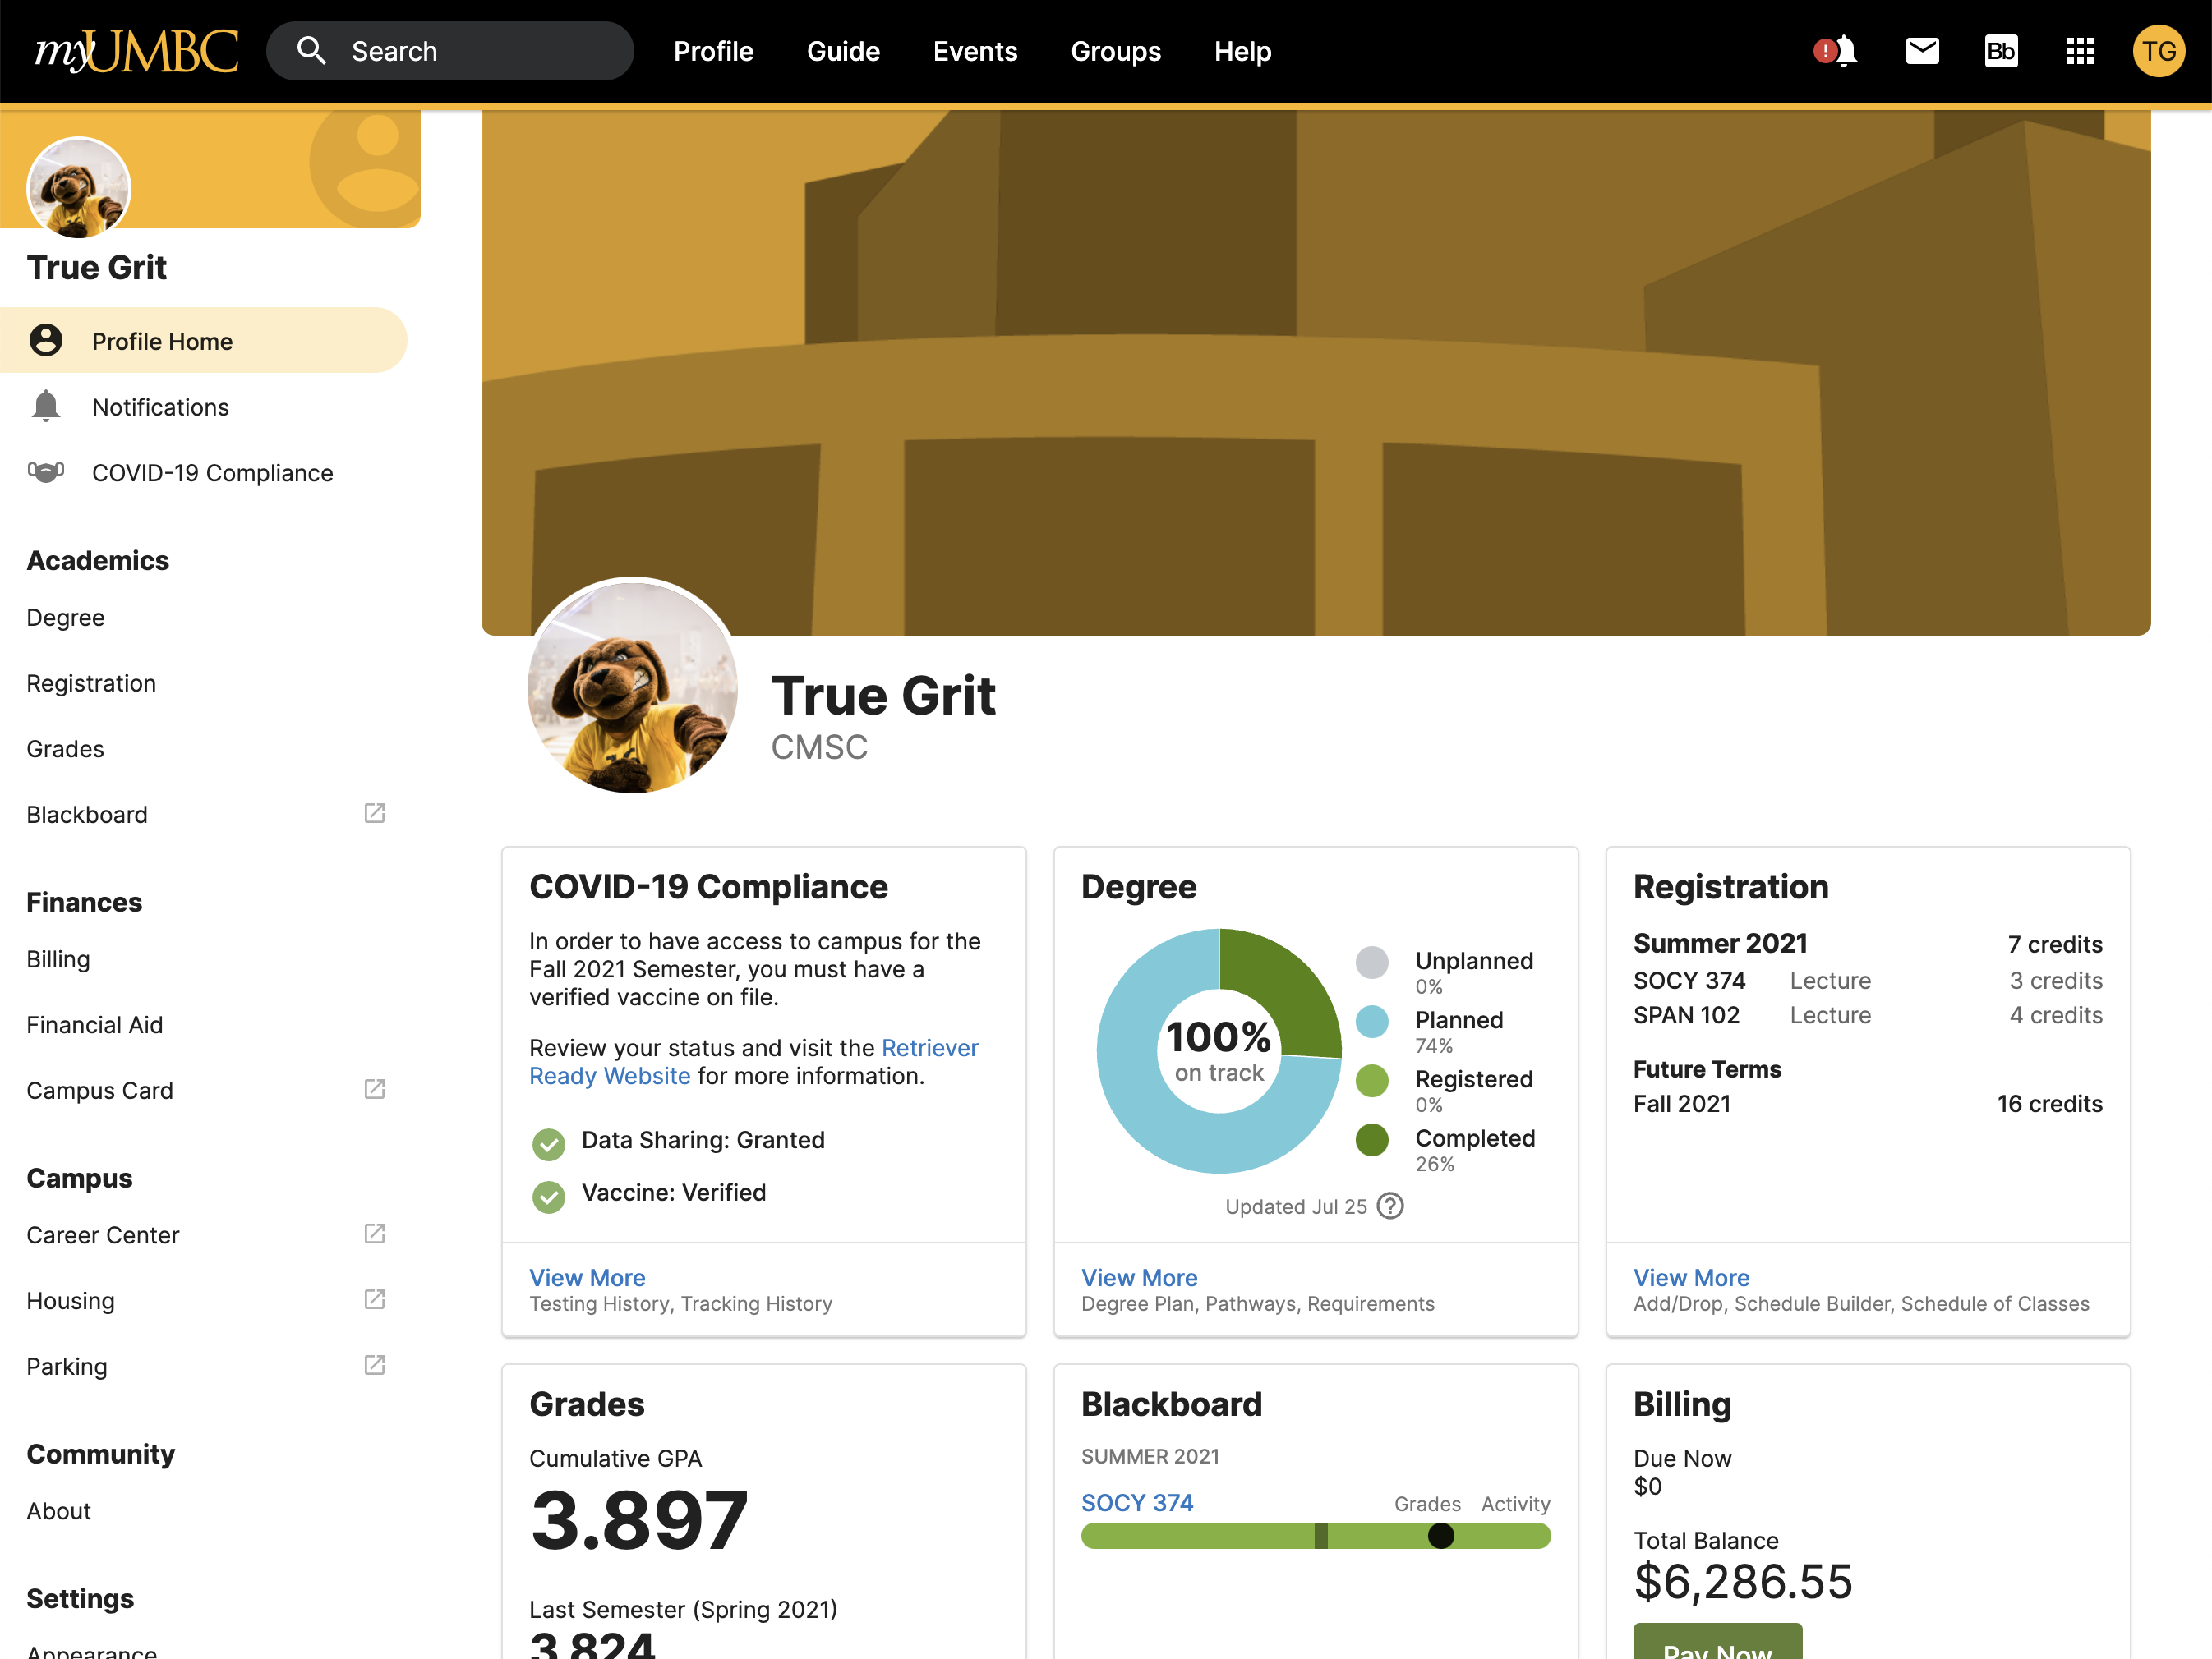

Slide 27
Introducing...
Profile Sharing

Slide 28
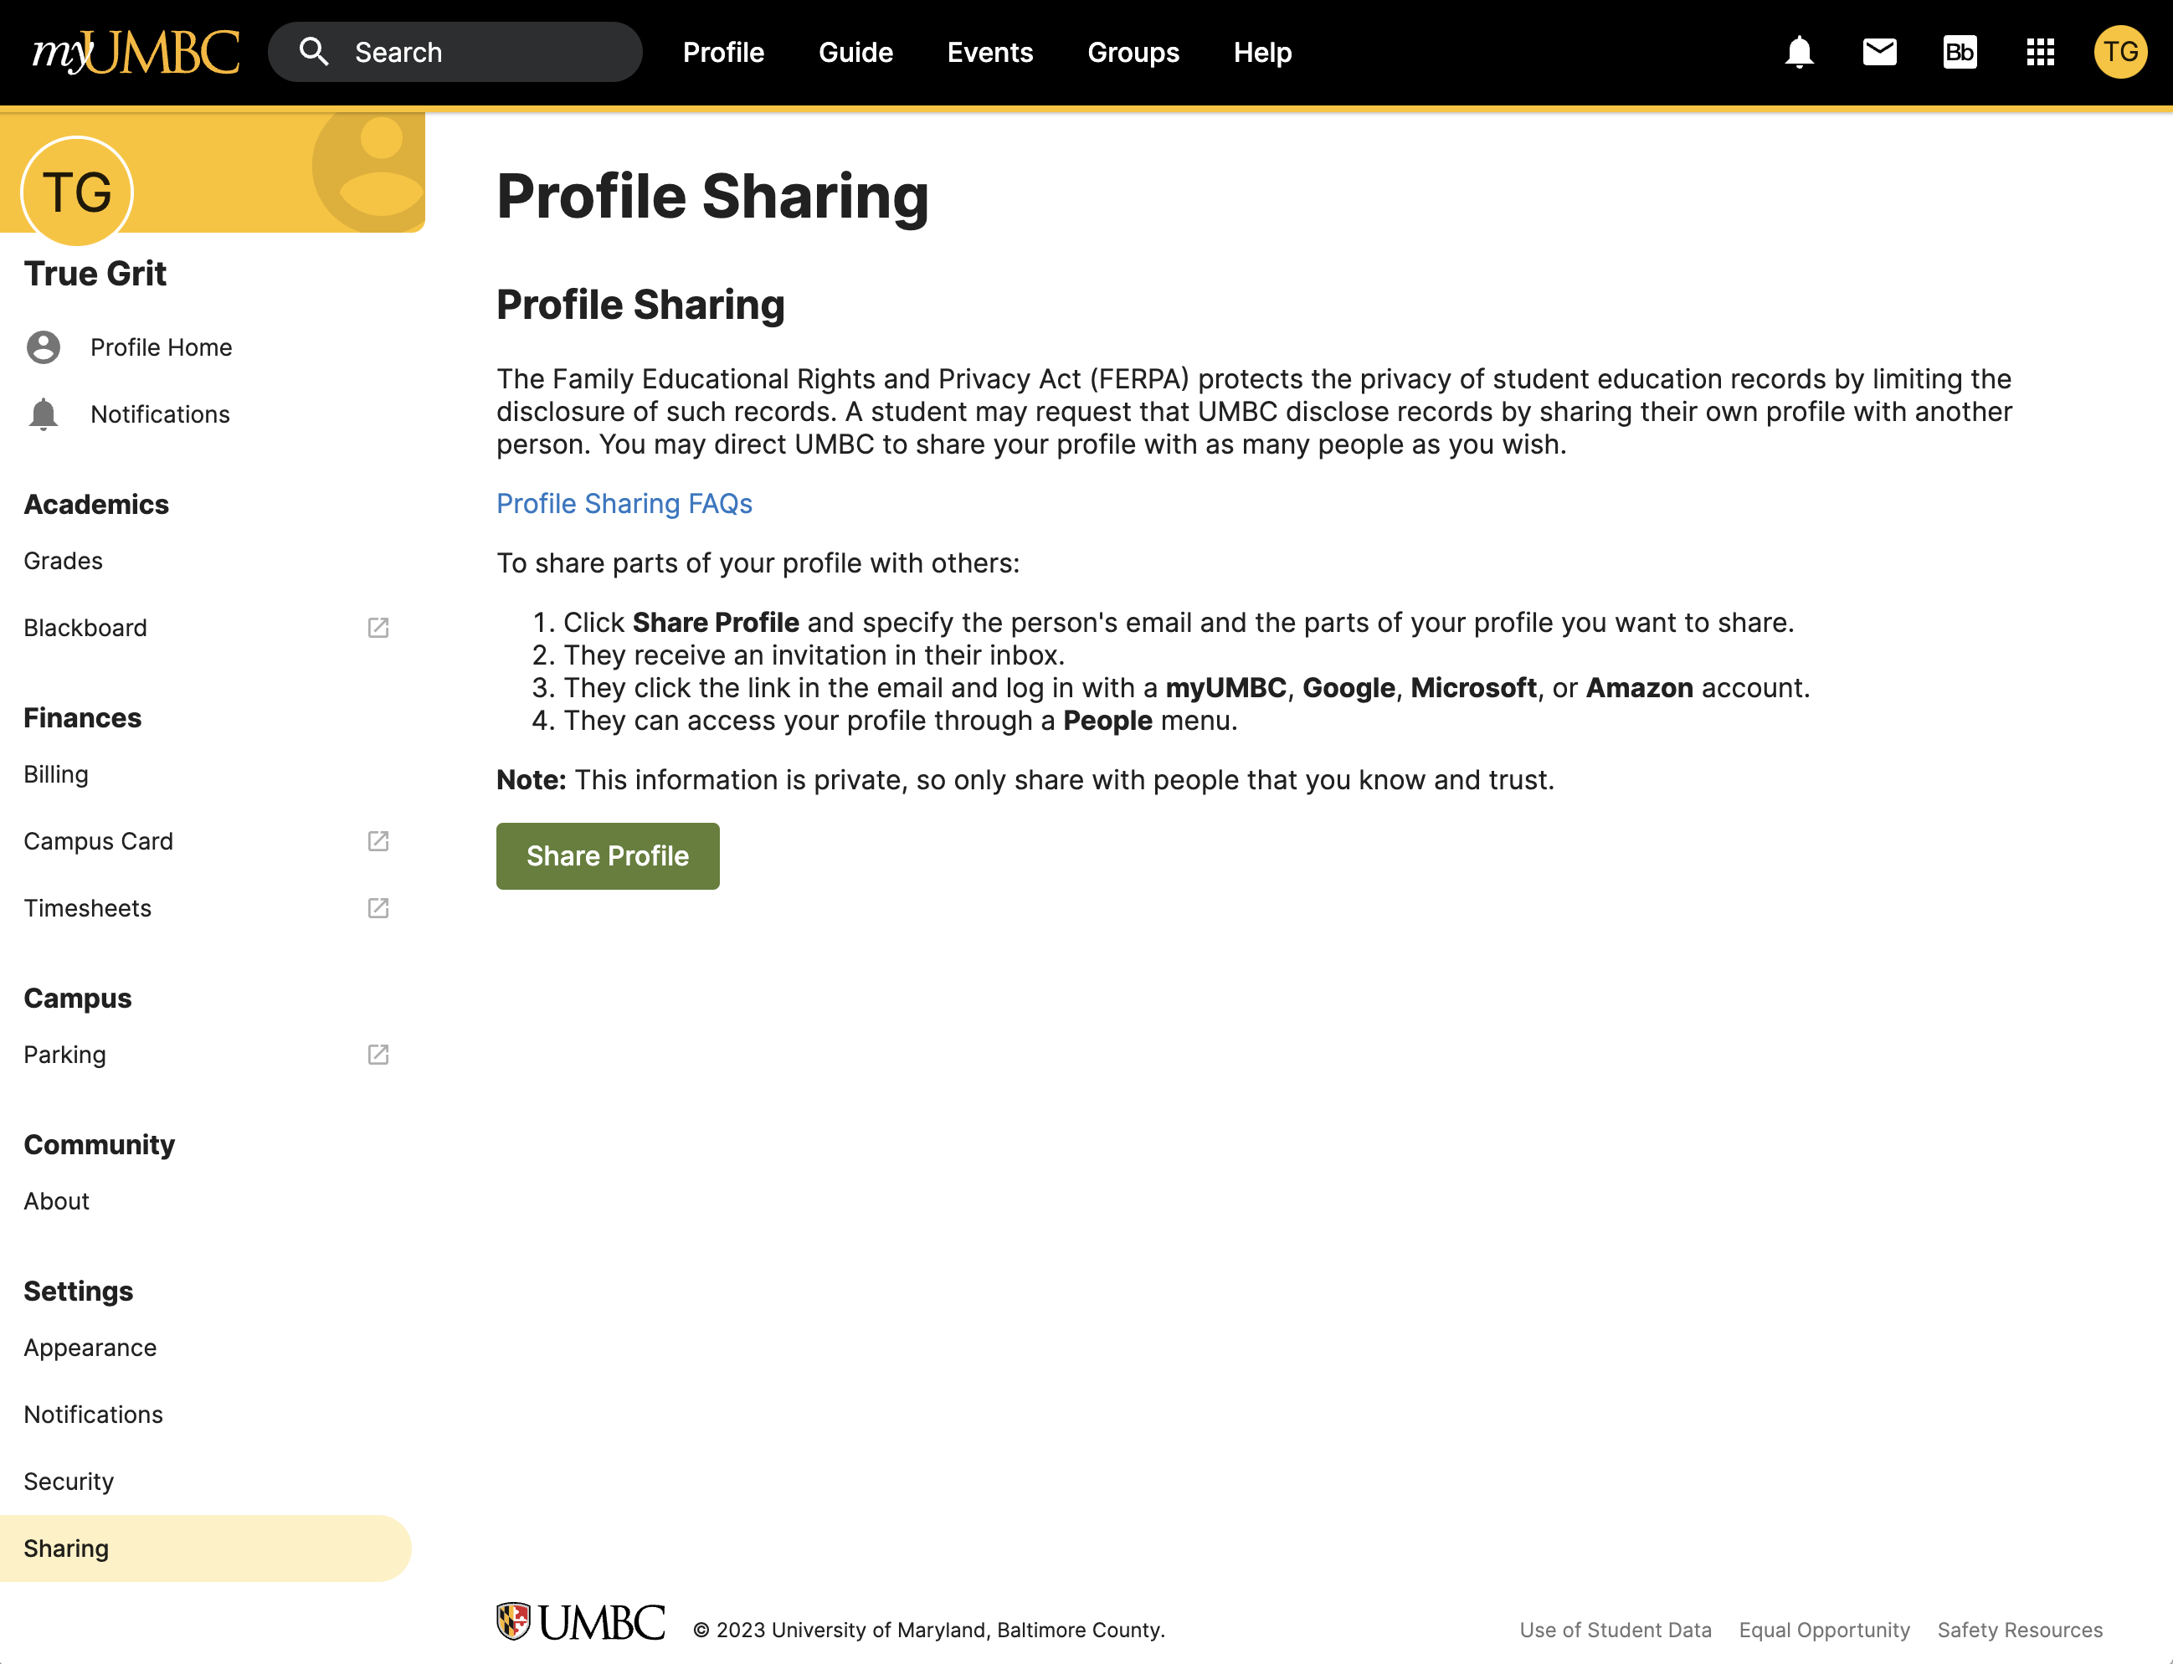

Slide 29
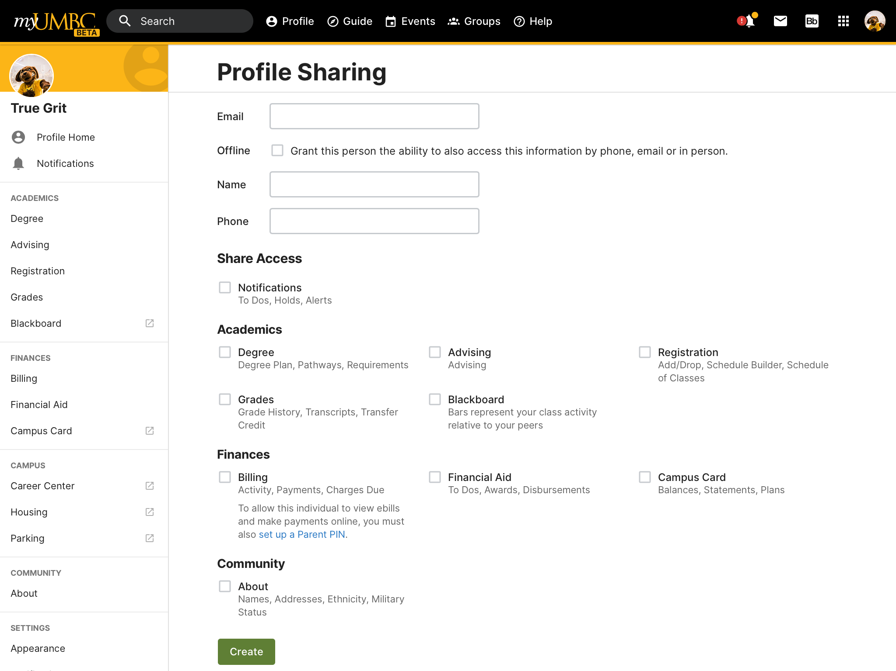

Slide 30
Tips…
Discuss profile sharing with your student prior to the start of the academic year.
Monitor activity frequently (weekly) during first year.
Avoid using information in a punitive manner.
Do ask student “How can I/we be supportive?”
Remind student about resources (faculty, academic advisor, tutoring, etc.) available to them.
Call us if you need assistance. We’re happy to help.

Slide 31
For more info on Profile Sharing, watch this video…. https://youtu.be/NR8fFsG_OfA

Slide 32
Questions?

