Slide 1
Commuter Life at UMBC: Conquer the Commute, Thrive on Campus!
‹#›
Notes:
Welcome to UMBC, and to Commuter Life at UMBC: Conquer the Commute, Thrive on Campus! We’re glad you picked this session, and we’re happy to see you today.
(Facilitators introduce themselves here)

Slide 2
1
About Commuter Connections
AGENDA
2
Major Takeaways
3
Carpool Conversations Activity
4
Commuter Thrive Guide

Slide 3
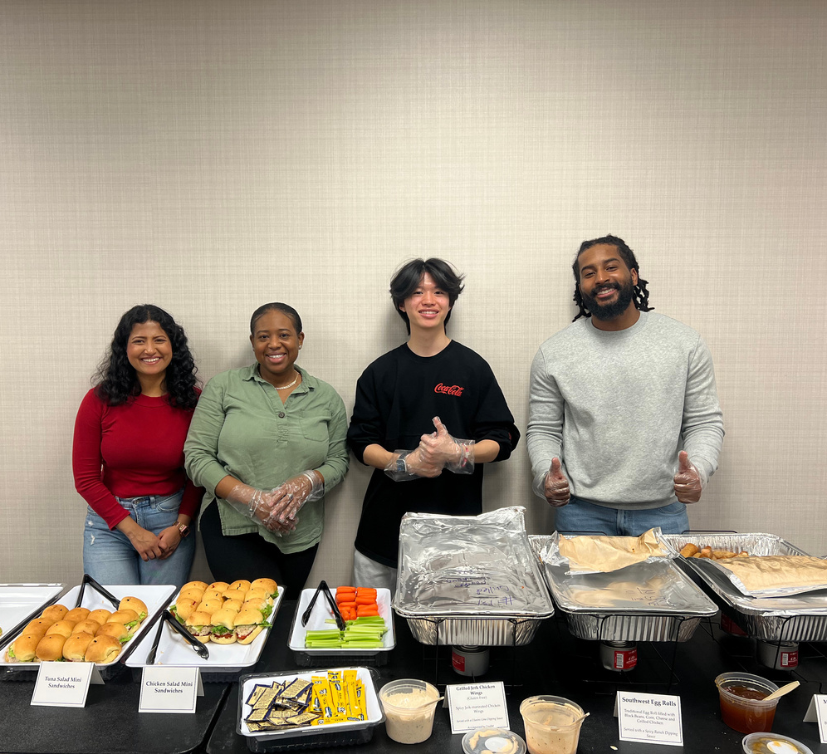
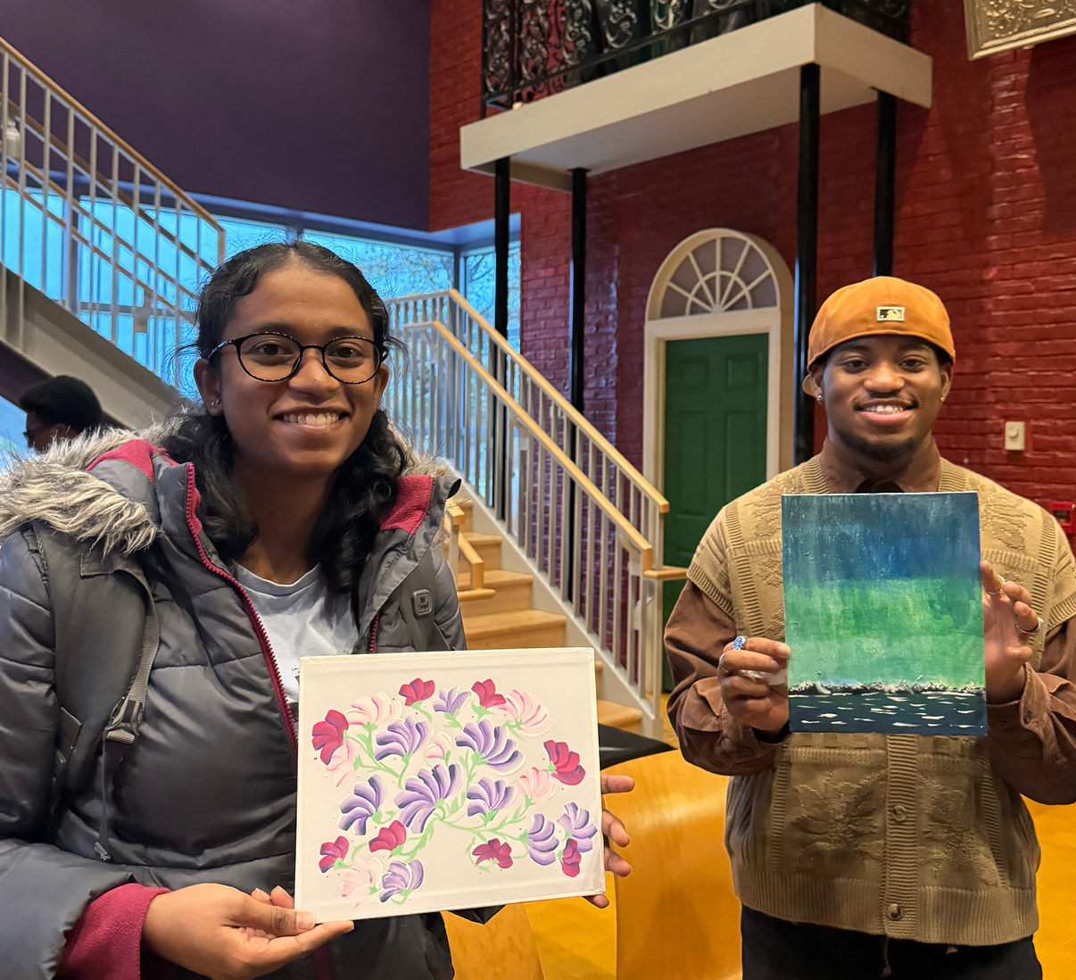
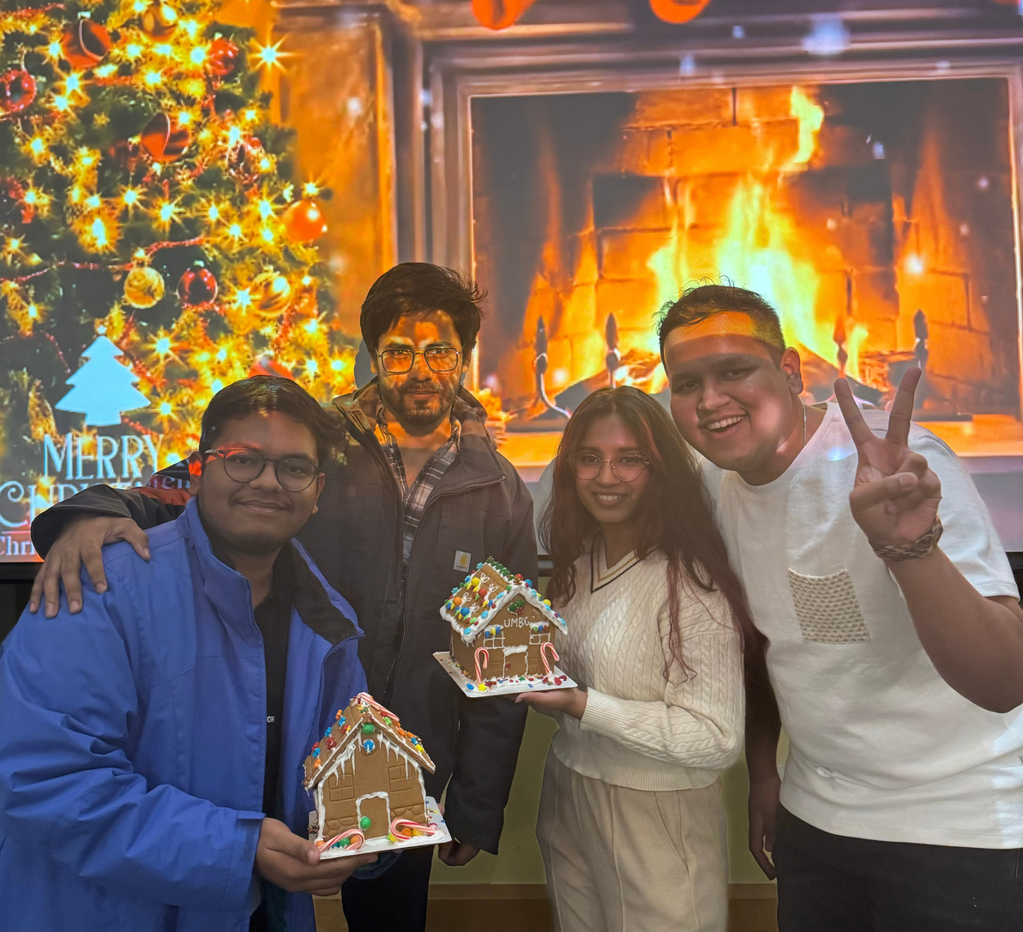
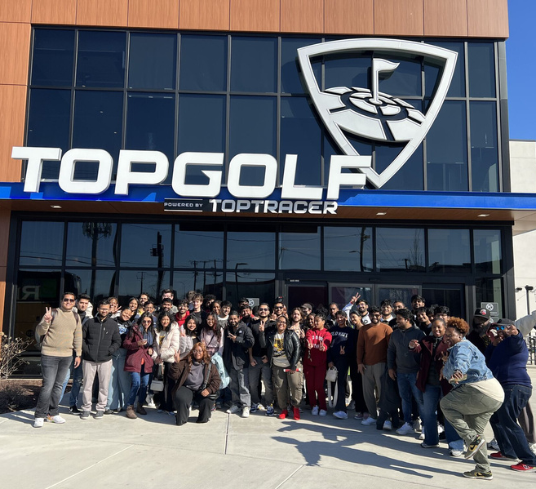
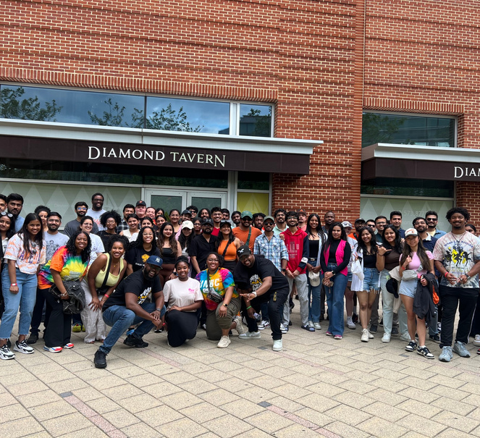
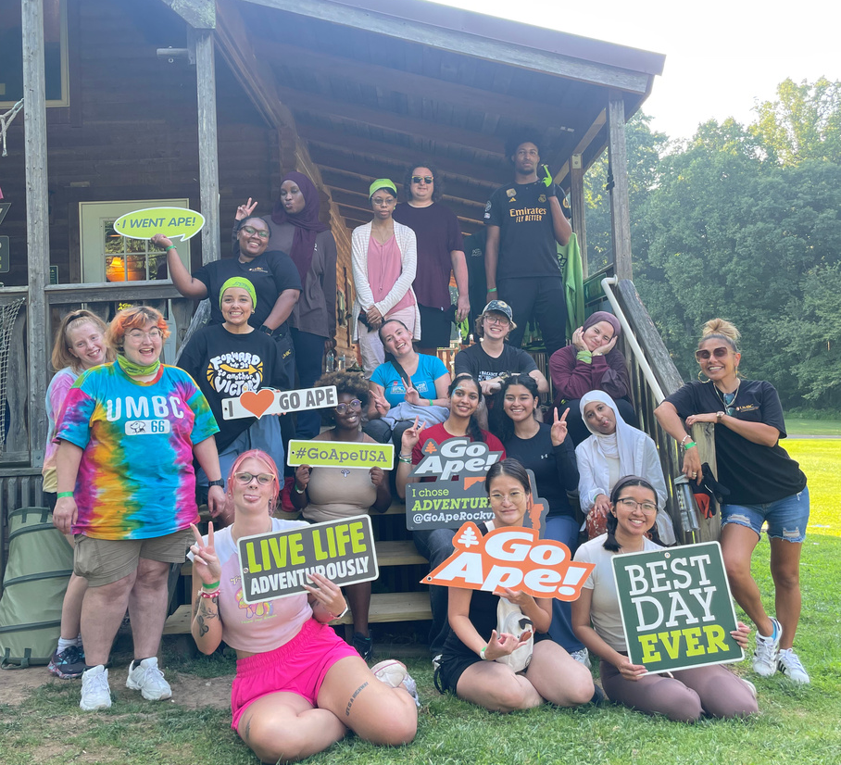
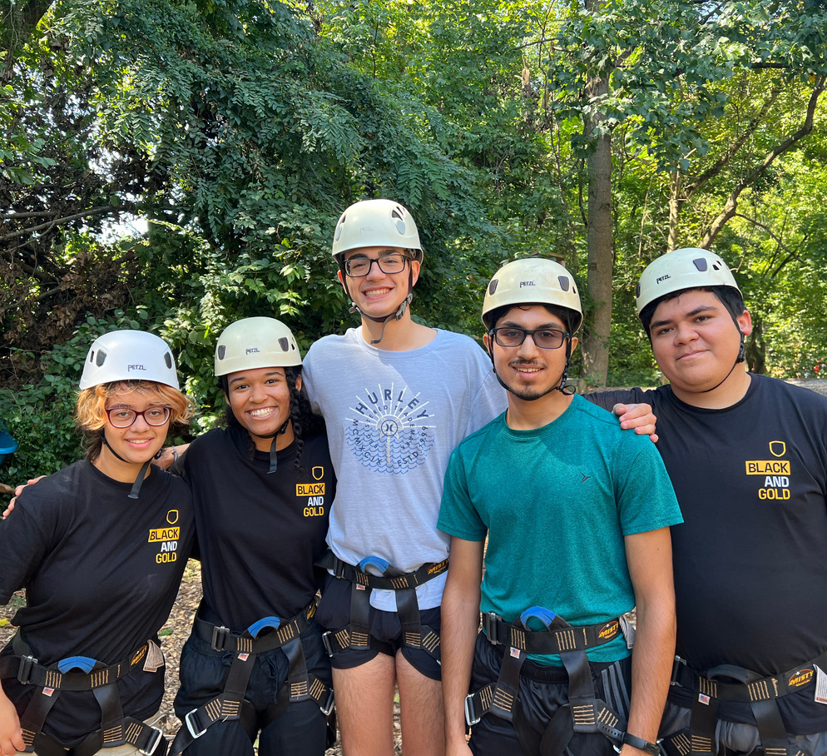
DIVISION OF STUDENT AFFAIRS
Unlocking Potential. Transforming Lives.
Notes:
Commuter Connections provides inclusive and engaging opportunities for commuting students to foster a strong sense of belonging, build a supportive community, and thrive both academically and personally. Through a variety of programs and events, we strive to ensure that every commuter feels connected, valued, and empowered to succeed—at UMBC and beyond!

Slide 4
DIVISION OF STUDENT AFFAIRS
Unlocking Potential. Transforming Lives.
Some of the most important lessons in college don’t happen in a classroom—they happen in the friendships you form, the events you attend, and the everyday moments on campus.

Slide 5
DIVISION OF STUDENT AFFAIRS
Unlocking Potential. Transforming Lives.
Notes:
Let’s also address the elephant in the room. This sounds a little scary, right?
The discomfort of experiencing new things is a common experience that many people encounter throughout their lives; especially when starting college. Despite the discomfort associated with starting somewhere new, it's important to recognize that growth and personal development often occur outside of one's comfort zone. What seems a little scary and foreign right now, can be the beginning of one of the most amazing journey’s of your life. Remember you are not alone and there are others in the same boat! So, we encourage you to walk into UMBC with an open mind, embracing the learning process and opportunities ahead!
Think of college as one big puzzle and you are a puzzle piece. There will be times when you think you fit in a place, you try it out and it doesn’t work…but rest assured there is a place you will fit in.
UMBC has over 260+ student organizations ranging from groups for hobbies and sports, service and volunteer activities, student government, and more than 20 fraternity and sorority chapters. There are many avenues for you to discover and even opportunities for you to create new spaces. Between the many departments and student organizations there are always events and workshops happening to keep you connected.
Let’s talk about how you can make friends through some of these opportunities.

Slide 6
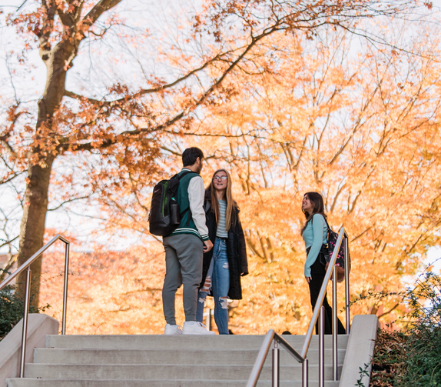
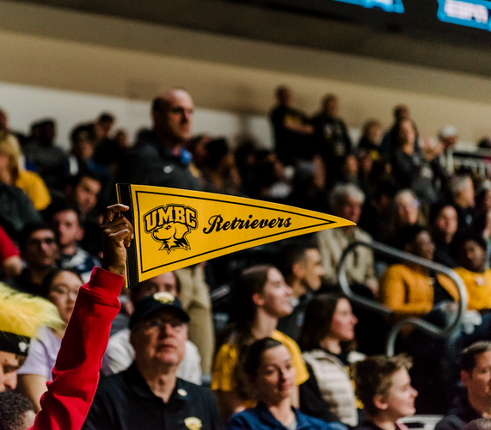
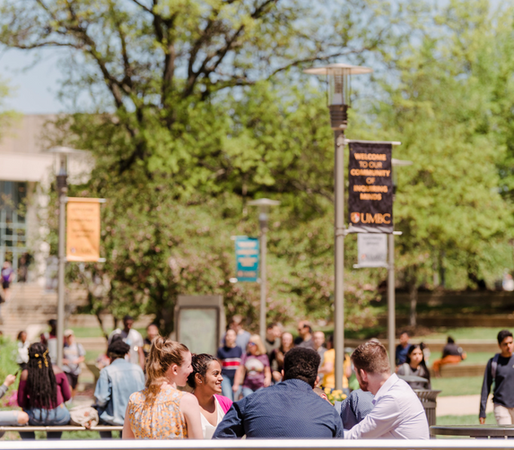
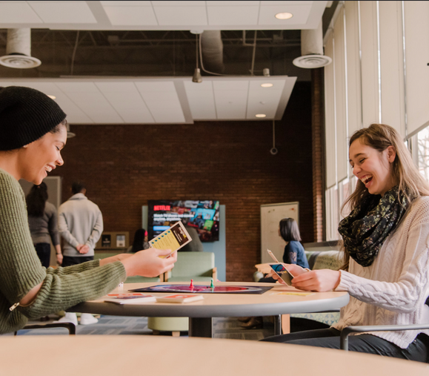
DIVISION OF STUDENT AFFAIRS
Unlocking Potential. Transforming Lives.
Build Your Commuter Community
Take initiative to connect with peers in your classes or shared spaces
Engage with commuter events to meet others with similar experiences
Make use of time between classes to socialize or join campus activities
Don’t hesitate to be the one who starts the conversation
Community isn’t built by location, it’s built by intention

Slide 7
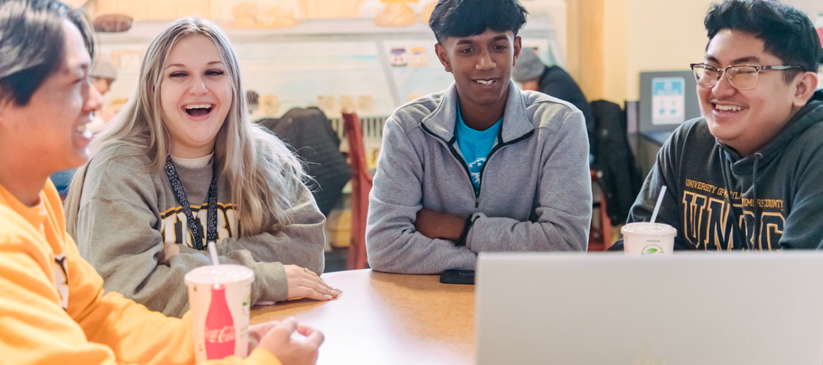
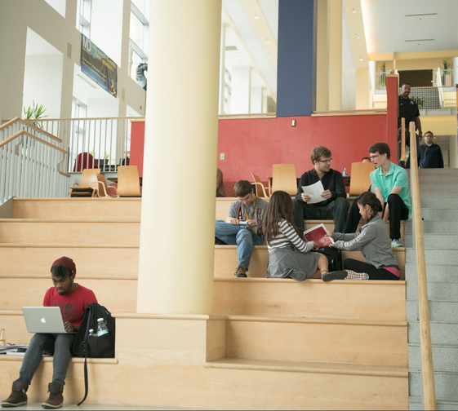
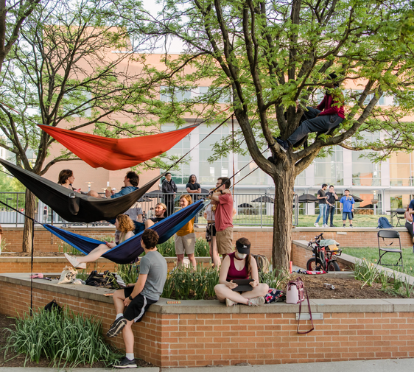
DIVISION OF STUDENT AFFAIRS
Unlocking Potential. Transforming Lives.
Maximize Your Time on Campus
Plan your schedule around your commute and class gaps
Use campus spaces to study, relax, or catch up with friends
Explore campus resources or attend an event
Try a new spot each week, explore lounges, quiet corners, and events
Being on campus is about building connections, discovering what brings you joy, and finding your rhythm in this community.
Notes:
Making connections is a fundamental piece to a great college experience. As human beings we are naturally social creatures. Some more than others but our connections with others play a significant role in our lives. The process of making friends can be overwhelming or intimidating at times but we believe that making connections can be a skill achieved by everyone.
It is important to first, find shared interests, hobbies, or experiences that serve as a foundation for your connection. You know, like finding that person who also loves art just as much as you do or that person who dislikes the Pittsburgh Steelers just as much as you do? You can find these connections on campus by attending events, joining clubs, hanging out in the commons, hanging out in the library… or volunteering with areas that resonate with you. This provides the chance for you to meet like-minded individuals but also gives you an opportunity to bond over shared passions. Use these opportunities to engage in meaningful conversations, ask questions, and show genuine interest in others' stories. You'll be amazed at how much you can learn and grow from each other.
Ask the students: How do you find your people?
Approaching people you don’t know can be intimidating but here are some tips:
*add to slide*
Notice other people's body language, and respond accordingly. For example, you can smile or make eye contact! This signals that you are friendly and open for conversation.
Positivity is contagious and will make others feel more comfortable approaching you!
Take initiative and approach others with a simple “hey, my name is ___” goes a long way!
Once you break the ice you both may feel comfortable to keep the conversation going.
Find a common interest you notice or story from your life that you can use as a conversation starter
As we shared earlier, common interests and stories are the foundation to connections. Use them as windows of opportunity to start a conversation about genuine interest or experience and the conversation should start to flow!
Be your authentic self!
The most important thing to remember is to be yourself! Do your best to let your personality shine. Some of us have experienced not feeling like we could show our authentic selves in certain spaces but here at UMBC we try to make being your authentic selves the norm! Authenticity is key to building genuine connections with others.

Slide 8
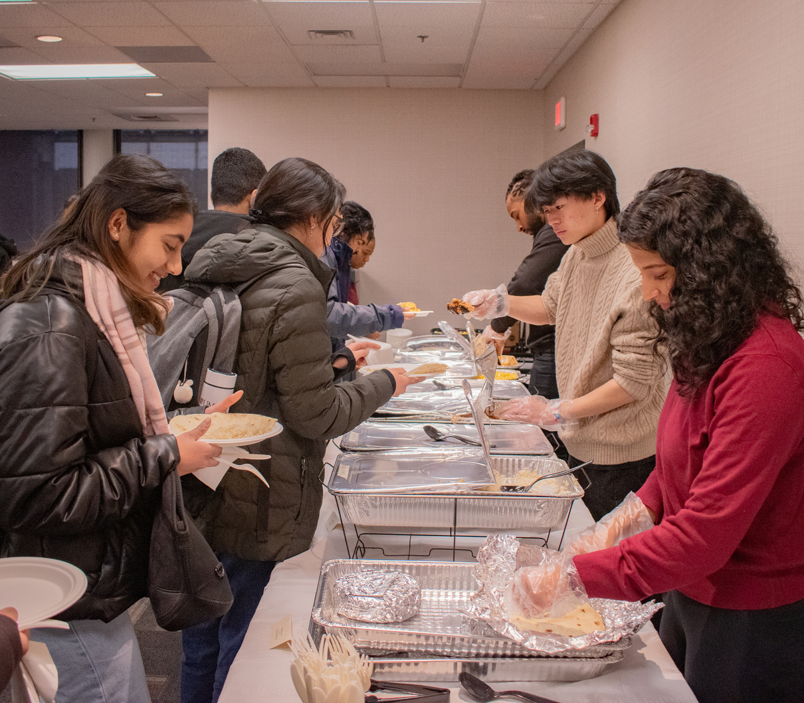
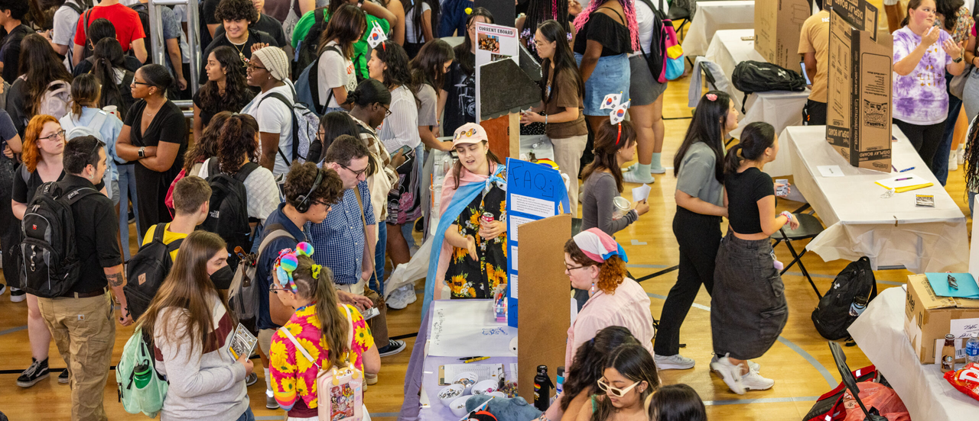
DIVISION OF STUDENT AFFAIRS
Unlocking Potential. Transforming Lives.
Stay in the Loop & Get Involved
Check your UMBC email and myUMBC daily
Follow campus departments and student organizations on social media
Attend involvement fairs to find campus organizations that interest you
The more you plug in, the more UMBC feels like home.
Notes:
Making connections is a fundamental piece to a great college experience. As human beings we are naturally social creatures. Some more than others but our connections with others play a significant role in our lives. The process of making friends can be overwhelming or intimidating at times but we believe that making connections can be a skill achieved by everyone.
It is important to first, find shared interests, hobbies, or experiences that serve as a foundation for your connection. You know, like finding that person who also loves art just as much as you do or that person who dislikes the Pittsburgh Steelers just as much as you do? You can find these connections on campus by attending events, joining clubs, hanging out in the commons, hanging out in the library… or volunteering with areas that resonate with you. This provides the chance for you to meet like-minded individuals but also gives you an opportunity to bond over shared passions. Use these opportunities to engage in meaningful conversations, ask questions, and show genuine interest in others' stories. You'll be amazed at how much you can learn and grow from each other.
Ask the students: How do you find your people?
Approaching people you don’t know can be intimidating but here are some tips:
*add to slide*
Notice other people's body language, and respond accordingly. For example, you can smile or make eye contact! This signals that you are friendly and open for conversation.
Positivity is contagious and will make others feel more comfortable approaching you!
Take initiative and approach others with a simple “hey, my name is ___” goes a long way!
Once you break the ice you both may feel comfortable to keep the conversation going.
Find a common interest you notice or story from your life that you can use as a conversation starter
As we shared earlier, common interests and stories are the foundation to connections. Use them as windows of opportunity to start a conversation about genuine interest or experience and the conversation should start to flow!
Be your authentic self!
The most important thing to remember is to be yourself! Do your best to let your personality shine. Some of us have experienced not feeling like we could show our authentic selves in certain spaces but here at UMBC we try to make being your authentic selves the norm! Authenticity is key to building genuine connections with others.

Slide 9
DIVISION OF STUDENT AFFAIRS
Unlocking Potential. Transforming Lives.
Carpool Conversations Activity
2
4
1
JOIN YOUR CARPOOL GROUP
3
TAKE TURNS RESPONDING
5
FIND YOUR COLOR PARKING LOT
CARPOOL CONVERSATION CARD
Everyone gets a chance to introduce theirselves answer at least two questions and learn about each other
BE READY TO SHARE
Each color group will form a small circle of 4–5 students
You should be seated in the color area of the room that matches the color sticker on the back of your card
We’ll invite a few volunteers to share something fun or relatable they learned in their group
Your group will receive a set of fun, get to know you -inspired prompts.

Slide 10
DIVISION OF STUDENT AFFAIRS
Unlocking Potential. Transforming Lives.
Let’s Recap: What Matters Most
1
2
3
Build Your Community
Maximize Your Time on Campus
Stay in the Loop & Get Involved
Make intentional connections, even small ones matter
Use breaks wisely, explore spaces, and
stay present
Check your UMBC email, follow key social media accounts, show up!

Slide 11
DIVISION OF STUDENT AFFAIRS
Unlocking Potential. Transforming Lives.
Commuter Thrive Guide

Slide 12
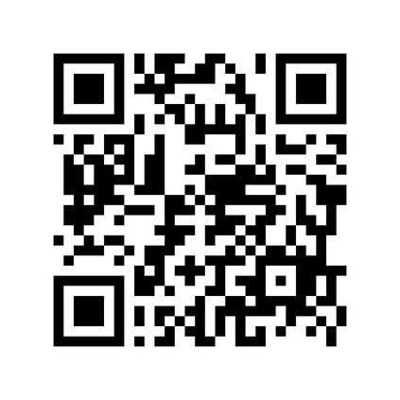
DIVISION OF STUDENT AFFAIRS
Unlocking Potential. Transforming Lives.
Follow Us to Stay in the Loop
Announcements
INSTAGRAM
Save the Date! Sign up for the Commuter Kick-off on Saturday, August 23, 2025
Enroll in UNIV 101-43 commuter cohort section on Tuesdays from 2:30-3:45pm.
umbc_offcampus
Notes:
Making connections is a fundamental piece to a great college experience. As human beings we are naturally social creatures. Some more than others but our connections with others play a significant role in our lives. The process of making friends can be overwhelming or intimidating at times but we believe that making connections can be a skill achieved by everyone.
It is important to first, find shared interests, hobbies, or experiences that serve as a foundation for your connection. You know, like finding that person who also loves art just as much as you do or that person who dislikes the Pittsburgh Steelers just as much as you do? You can find these connections on campus by attending events, joining clubs, hanging out in the commons, hanging out in the library… or volunteering with areas that resonate with you. This provides the chance for you to meet like-minded individuals but also gives you an opportunity to bond over shared passions. Use these opportunities to engage in meaningful conversations, ask questions, and show genuine interest in others' stories. You'll be amazed at how much you can learn and grow from each other.
Ask the students: How do you find your people?
Approaching people you don’t know can be intimidating but here are some tips:
*add to slide*
Notice other people's body language, and respond accordingly. For example, you can smile or make eye contact! This signals that you are friendly and open for conversation.
Positivity is contagious and will make others feel more comfortable approaching you!
Take initiative and approach others with a simple “hey, my name is ___” goes a long way!
Once you break the ice you both may feel comfortable to keep the conversation going.
Find a common interest you notice or story from your life that you can use as a conversation starter
As we shared earlier, common interests and stories are the foundation to connections. Use them as windows of opportunity to start a conversation about genuine interest or experience and the conversation should start to flow!
Be your authentic self!
The most important thing to remember is to be yourself! Do your best to let your personality shine. Some of us have experienced not feeling like we could show our authentic selves in certain spaces but here at UMBC we try to make being your authentic selves the norm! Authenticity is key to building genuine connections with others.

