Slide 1
Retriever Roadmap
HELPING YOUR STUDENT NAVIGATE AN HONORS UNIVERSITY
Dr. Laila M. Shishineh
Assistant Vice Provost & Assistant Dean
Undergraduate Academic Affairs

Slide 2
Welcome
Session Overview
  Understand how to help your student navigate the transition to UMBC
  Explore university expectations for new students
  Identify resources available for student success
  Introduce the advising process, academic transition opportunities, and key offices that support success in and out of the classroom

Slide 3
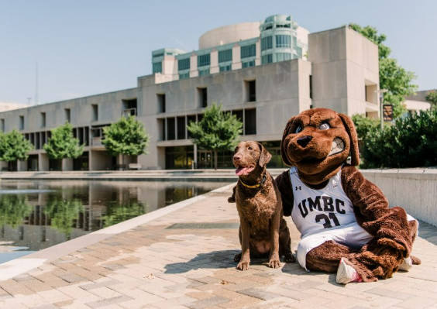
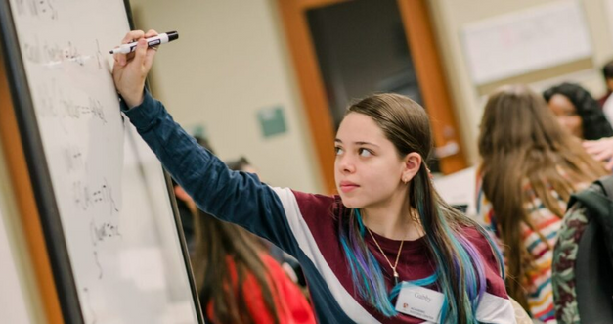
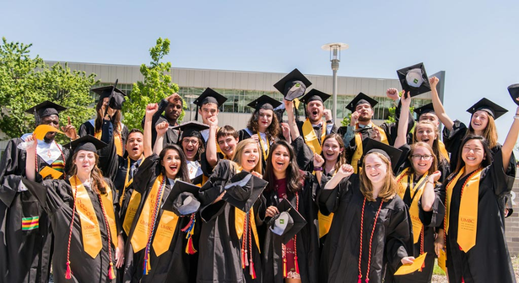
BEGIN WITH THE END IN MIND
Academic Success
Involvement
Graduation Plans

Slide 4
Skills
NEEDED FOR SUCCESS
Which of these are strengths?
Which of these are works in progress?
Other skills that come to mind?
ORGANIZATION
AUTONOMY
INITIATIVE
TIME MANAGEMENT
RESILIENCE
MOTIVATION

Slide 5
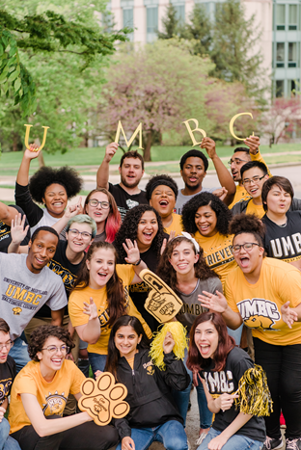
CAMPUS RESOURCES FOR SUCCESS
Academic Advising
Academic Transition Courses
Academic Support Resources
Campus Engagement
Applied Learning

Slide 6
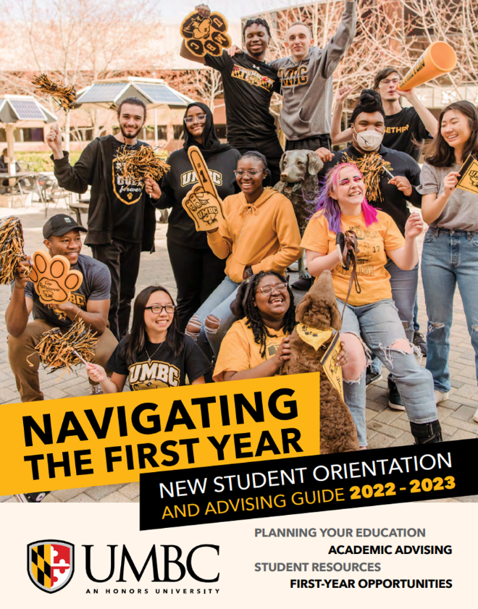
Academic
ADVISING
Required at UMBC every semester
Understanding the Advising Relationship
Starts at Orientation
Professional Advisors + Faculty Advisors
Office for Academic & Pre-Professional Advising (OAPA)

Slide 7
ACADEMIC TRANSITION COURSES
FYS
UNIV101
UNIV301
First-Year Seminar
Freshmen & Transfers
Intro to the University
For freshmen
Intro to the University
for transfers
3-Credit
Gen Ed Program (GEP) Designation
Small/Interactive Classroom
Faculty Led
2-Credit
Freshmen Transition Course
Small/Interactive Classroom
Instructor/Teaching Assistant Led
2-Credit
Transfer Transition Course
Small/Interactive Class
Instructor/Teaching Assistant Led

Slide 8
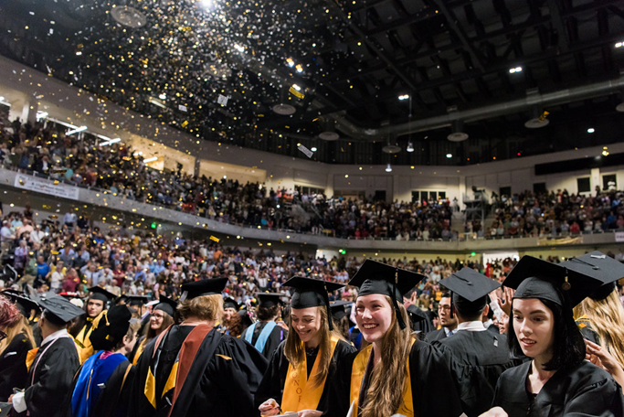
ACADEMIC SUPPORT RESOURCES
Academic Success Center:
  Writing Center
  Math/Science Tutoring Center
  Computing Success Center
  Academic Advocacy
  Early Academic Alerts
  Academic Policy
Additional Resources:
  Student Disability Services (SDS)
  Office Hours
  Study Groups
  Departmental Tutoring
Which resources will your student need the MOST?

Slide 9
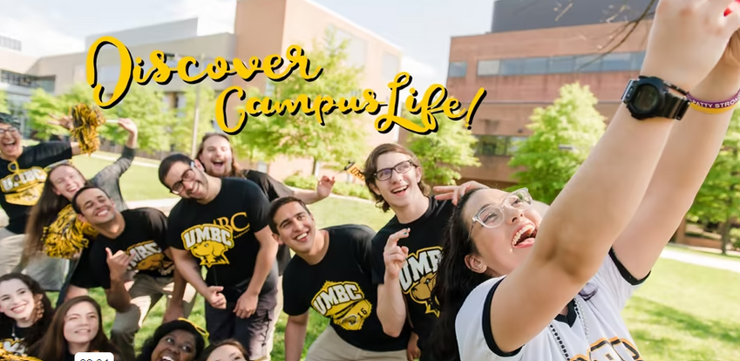
Campus
ENGAGEMENT
Welcome Week
Clubs & Orgs
Departmental Seminars
Residence Life & OCSS
Leadership Opportunities
Athletics & Club/Intramural Sports/RAC
Retriever Integrated Health (RIH)
Try Something New - Commit to 2-3 Opportunities

Slide 10
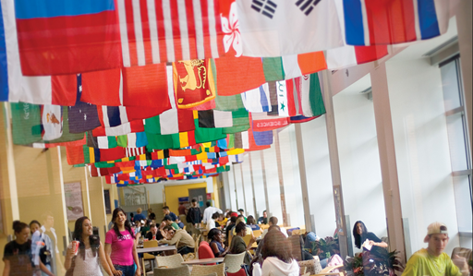
Applied
LEARNING
Career Center
Shriver Center
Education Abroad
Undergraduate Research & Prestigious Scholarships
On Campus Employment
82% of UMBC Grads Engage in Applied Learning
What will being involved on campus look like for your student??

Slide 11
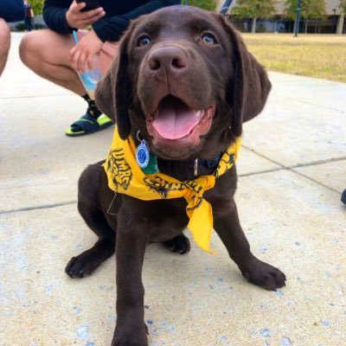
The UMBC Community
100+
17:1
Majors & Programs
Student to Faculty Ratio
250+
58
We are here to HELP! And we want to see your students succeed!
Encourage students to show up, check their email, ask questions, be responsible (for successes and struggles), and remind them just how many people are here to help them!
Student Organizations
Years Old
Mascot: Chesapeake Bay Retriever
Name: True Grit
School Colors: Black & Gold

Slide 12
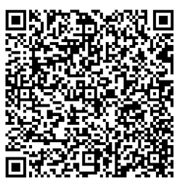
Contact Info:
Dr. Laila M. Shishineh
Assistant Vice Provost & Assistant Dean
Division of Undergraduate Academic Affairs
(410) 455 - 3737
lailams@umbc.edu
aetp.umbc.edu

