Slide 1
Financing Your Future with
Applied Learning
Financial aid and Scholarships
Library Pondside, Basement level.
CAREER CENTER
Math/Psychology Building 201
careers@umbc.edu

Slide 2
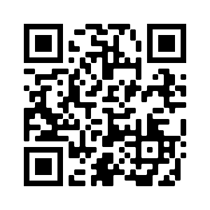
Office of Financial Aid and Scholarships
Lower level of the Library, pondside
Monday-Friday, 8:30am-4:30pm
Financial Aid: 410-455-2387
Merit Scholarships: 410-455-3813
Notes:
FinAid rep

Slide 3
Office of Financial Aid and Scholarships
Merit Scholarships
Financial Aid
Awarding of Merit Scholarships
Scholarship Retriever
Transfer Scholarships
Private Scholarship Notifications
FAFSA processing
Verification of Student accounts
MHEC award processing
Financial aid counseling
Financial aid awarding.
Notes:
The office is open Monday-Friday from 8:30am-4:30pm and is comprised of three separate units: Merit Scholarships, Financial Smarts, and Financial Aid.
Students are assigned financial aid counselors based on the first letter of their last name. Contact information for our offices and information on students counselors can be found on our contact page.

Slide 4
The 2024-2025 FAFSA
FAFSA questions reduced from 108 to 36.
Each FAFSA contributor must consent to their information being on the form.
The EFC is now the SAI.
Extended language accessibility.
The robust changes caused for a significant delay in FAFSA processing. As a result, several deadlines were extended for students and families. .

Slide 6
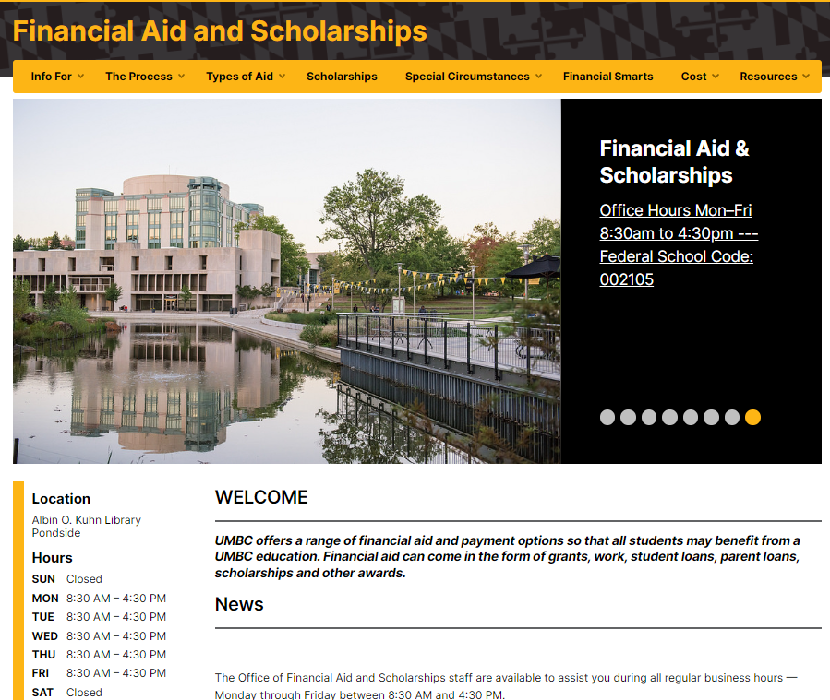
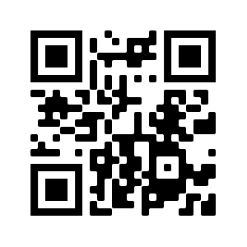
financialaid.umbc.edu
Notes:
FinAid Rep
Our website is a great resource for finding information on types of aid, timelines, and forms. The Cost tab houses our Cost Calculator tool that helps you estimate out of pocket expenses before charges are posted for your student!

Slide 7
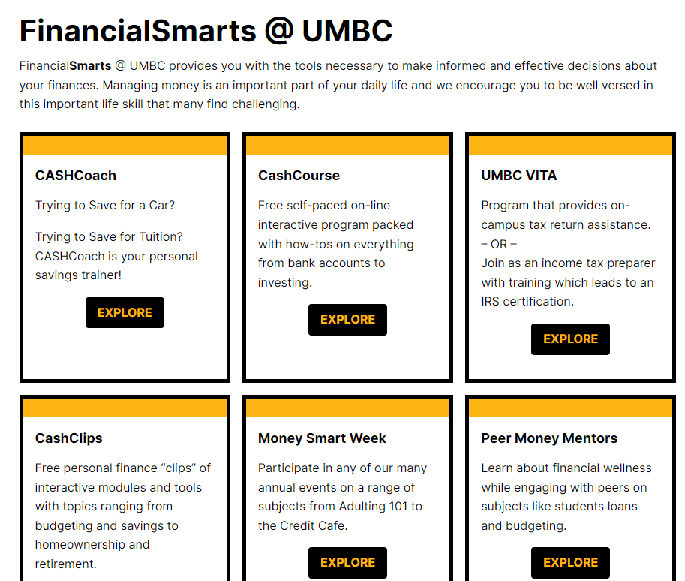
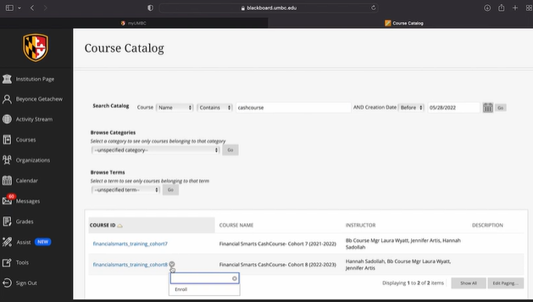
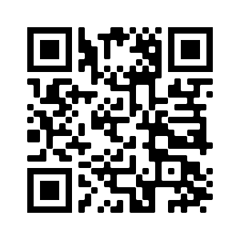
FinancialSmarts
financialsmarts.umbc.edu
Notes:
OFAS rep
FinancialSmarts helps provide students with the tools they need to make informed financial decisions. From skills like budgeting, saving, investing, and taxes to life goals like auto loans, home ownership or retirement, FinancialSmarts can help your student with life-long financial success.
You can partner with your student to help them understand and successfully navigate finances here at UMBC and beyond.

Slide 8
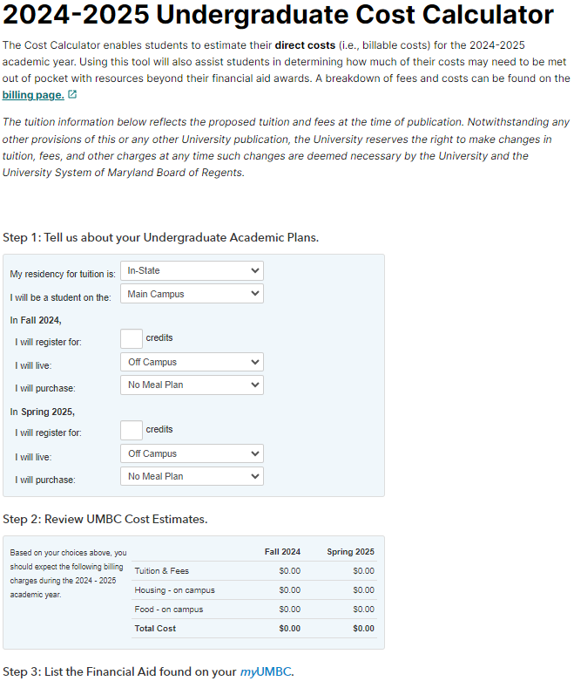
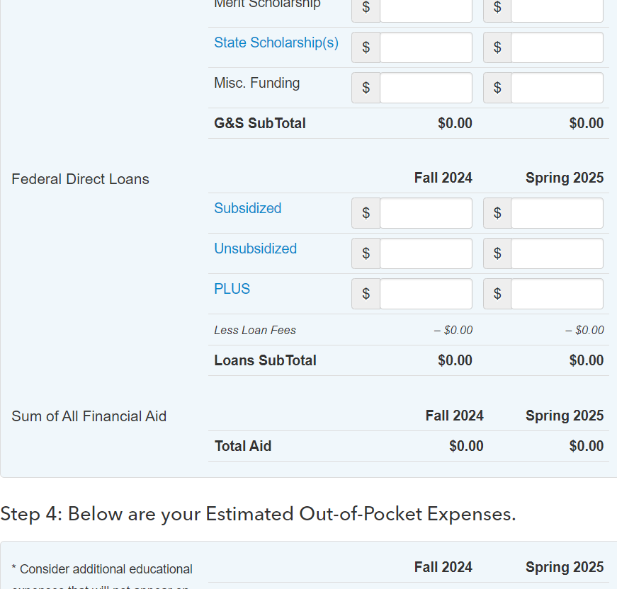
Notes:
Financial Aid Rep

Slide 9
Accept financial aid via “Financial Aid Inquiry” on myUMBC
Complete MPN/Entrance Counseling for Federal Direct Student Loan(s)
Complete (Parent PLUS/Alternative) loan requirements (optional))
Apply for Scholarships
Sign up for the Fall 2024 Monthly Payment Plan
Use Cost Calculator to estimate charges
Notes:
FinAid rep first 4 bullets
-Students who have a FAFSA on file should have an aid package. They can access this on myUMBC under their Financial Aid card or on the Financial Aid Inquiry.
-If your student is taking out Federal loans, they will need to complete the MPN (Master Promissory Note) and Entrance Counseling at studentaid.gov. This is required for all new borrowers.
-If you intend to take out additional loans beyond the Federal loans offered to the student such as Parent PLUS and alternative/private loans, we encourage you to complete this as soon as possible.
-If your student is receiving any scholarships from outside sources, report these to UMBC with the scholarship notification form. Students can apply for scholarship opportunities with Scholarship Retriever as well.
SBS rep:
-Sign Up for Monthly Payment Plans (billing and mpp schedule on next slide)
-Use Cost Calculator to estimate charges and sign up for a MPP

Slide 10
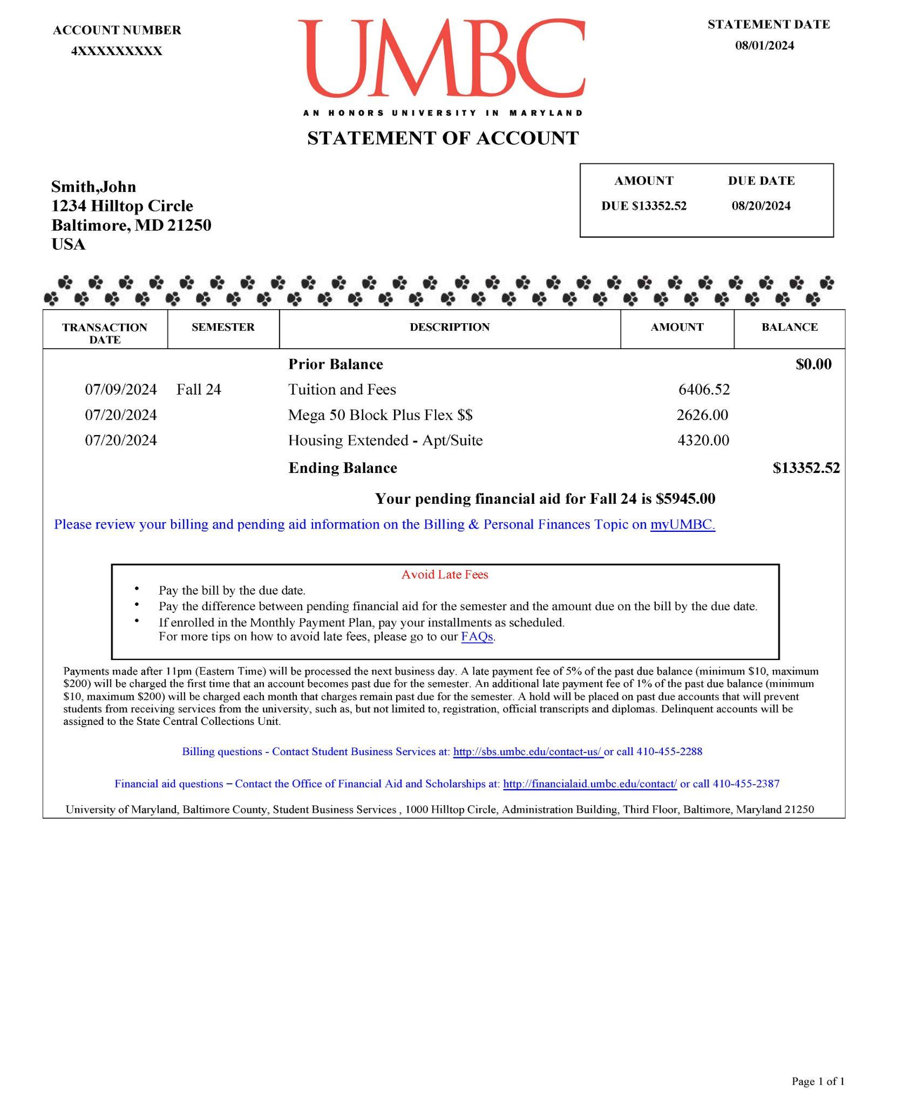

Slide 11
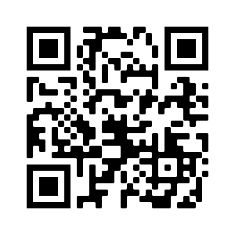
Aid Disbursement
Enrollment | First Disbursement Date
Full-time undergraduate students (12+ credits) | August 21
Part-time undergraduate students (1-11 credits) | September 19
The full disbursement calendar: financialaid.umbc.edu/calendar/
If pending financial aid is equal to or exceeds the balance due by the billing due date, students will not receive late fees.
Notes:
FinAid rep
Aid begins disbursing for students who are enrolled full time (12 or more credits) as early as August 21st. Students who are enrolled part time (less than 12 credits) will have aid begin disbursing as of September 19th.
The first disbursement date is after the billing due date for Fall 2023, however, students will not receive late fees if their pending financial aid equals or exceeds the balance due.

Slide 12
2024-2025 FAFSA is still available. Submit your application at studentaid.gov/h/apply-for-aid/fafsa
Remind your student to monitor myUMBC for To Do’s and alerts
Notes:
**link to FAFSA page?
Reminder that next semester registration opens shortly and they will want to make sure accts are in good standing
* Info about Managing my student acct page?

Slide 15
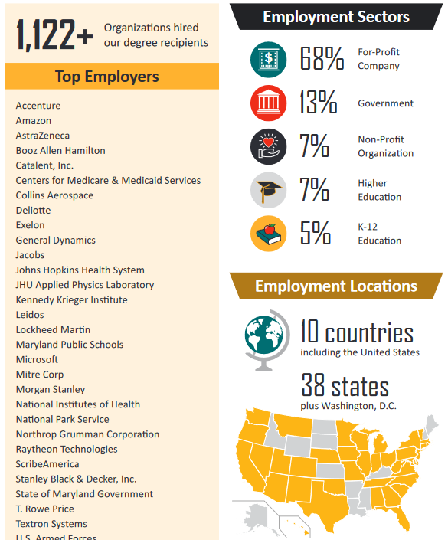
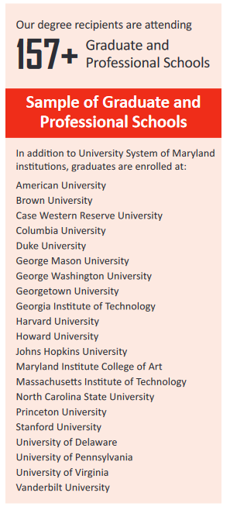
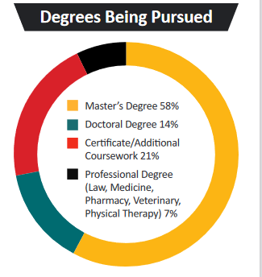

Slide 16
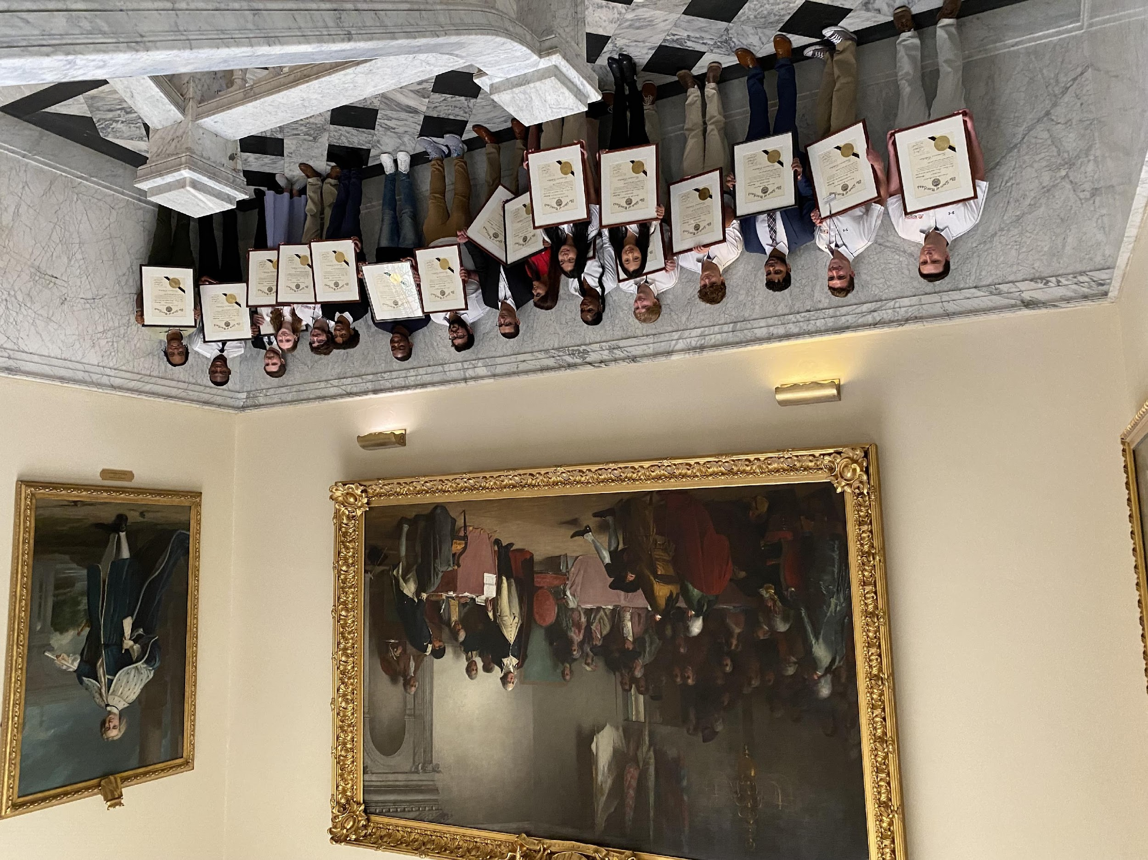
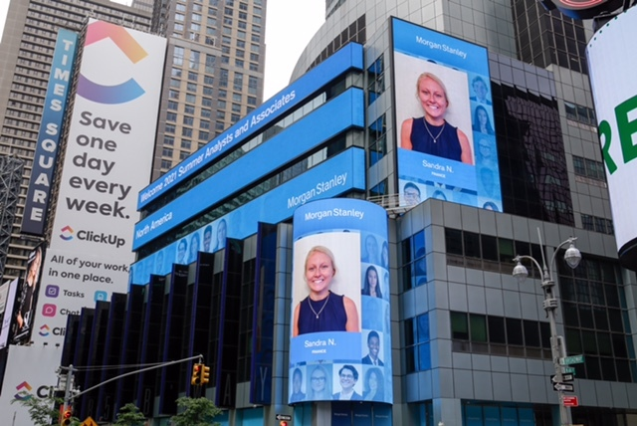
UMBC APPLIED LEARNING STATS

Slide 22
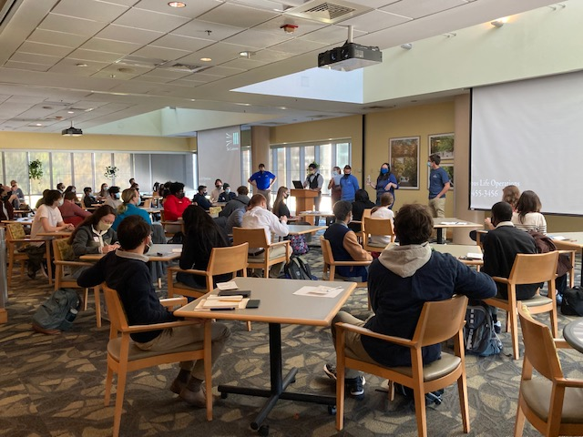
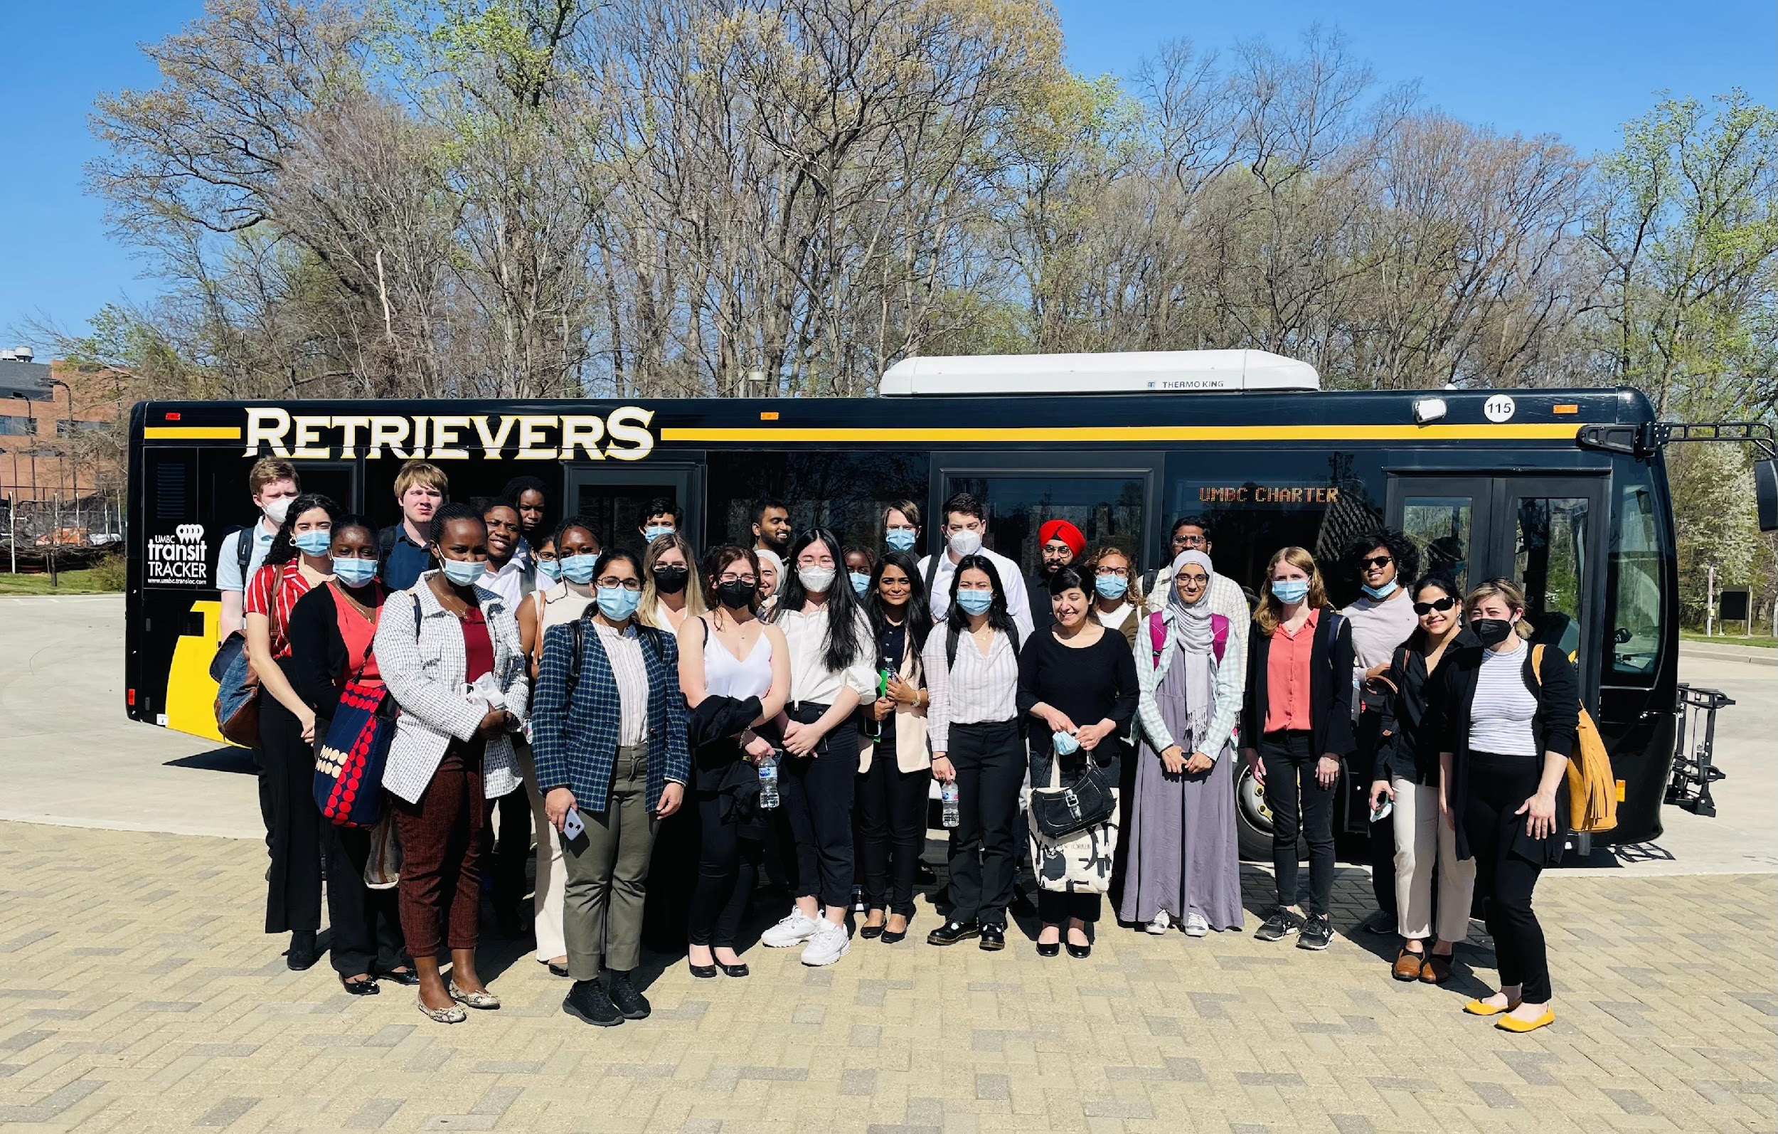
Core Services
In-Person & Remote Career & Internship Coaching
On the Road Series
Career & Internships Fairs
Industry Panels: Inside Scoops
Employer Info Sessions/Tables
UMBC Connects: Visibility Days
Diversity Recruitment Event
Grad School Prep Conference
Skills Building Webinars
Internship Success Conference
Intern & Service Fund

Slide 23
EMPLOYER
Handshake was created on the premise to make opportunities more accessible
Every student should have an equal chance to build the career they want, no matter who they know or where they go to school
Handshake removes the barriers of geography, socio-economic status, gender, and ethnicity. Recruiters can easily reach schools big and small, near or far

Slide 24
HOW HANDSHAKE HELPS STUDENTS
Get students career-ready—all in one place
Job Postings
Employer Network
Advising Appointments
Employer Messaging
Interviews & Info Chats
Events & Career Fairs
Alumni Ambassadors
Virtual Recruiting
Company Reviews
Career Profile

Slide 25
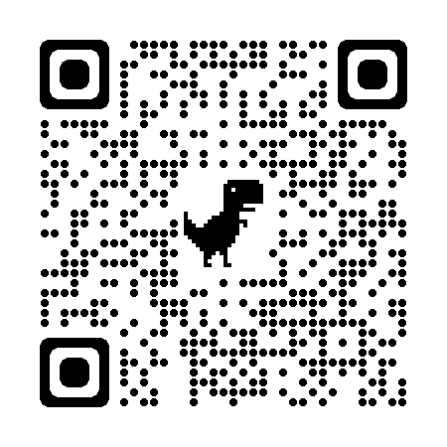
Access your profile today!
Handshake
is the #1-way college students find jobs

Slide 26
THANK YOU!
Connect with us through Handshake
UMBC Career Center
careers@umbc.edu
Math/Psych 201

