Slide 1
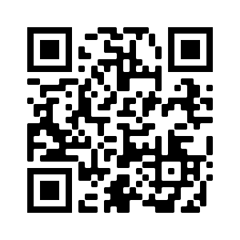
Office of Financial Aid and Scholarships
Lower level of the Library, pondside
Monday-Friday, 8:30am-4:30pm
Financial Aid: 410-455-2387
Merit Scholarships: 410-455-3813
Notes:
FinAid rep

Slide 2
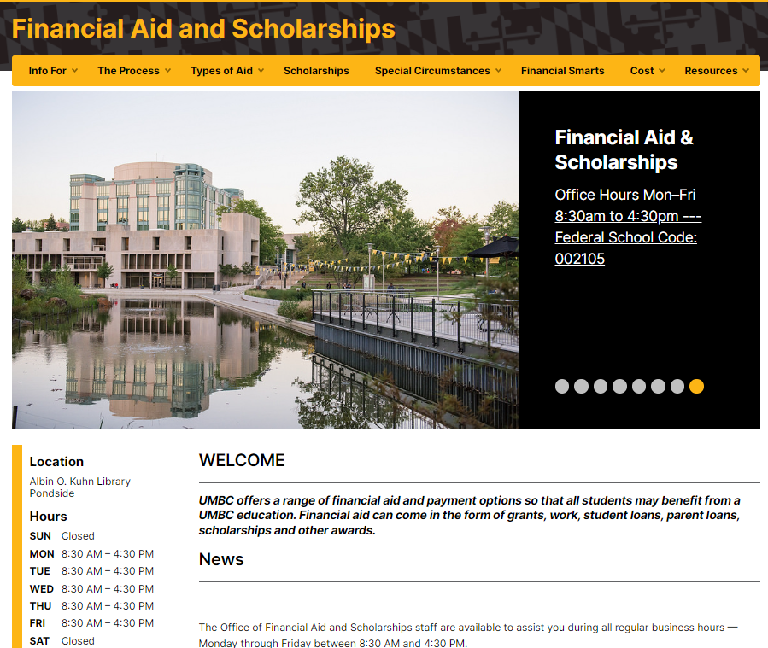
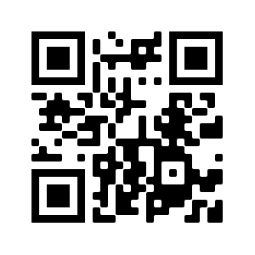
financialaid.umbc.edu
Notes:
FinAid Rep
Our website is a great resource for finding information on types of aid, timelines, and forms. The Cost tab houses our Cost Calculator tool that helps you estimate out of pocket expenses before charges are posted for your student!

Slide 3
Office of Financial Aid and Scholarships
Merit Scholarships
Financial Aid
Awarding of Merit Scholarships
Scholarship Retriever
Transfer Scholarships
Private Scholarship Notifications
FAFSA processing
Verification of Student accounts
MHEC award processing
Financial aid counseling
Financial aid awarding.
Notes:
The office is open Monday-Friday from 8:30am-4:30pm and is comprised of three separate units: Merit Scholarships, Financial Smarts, and Financial Aid.
Students are assigned financial aid counselors based on the first letter of their last name. Contact information for our offices and information on students counselors can be found on our contact page.

Slide 4
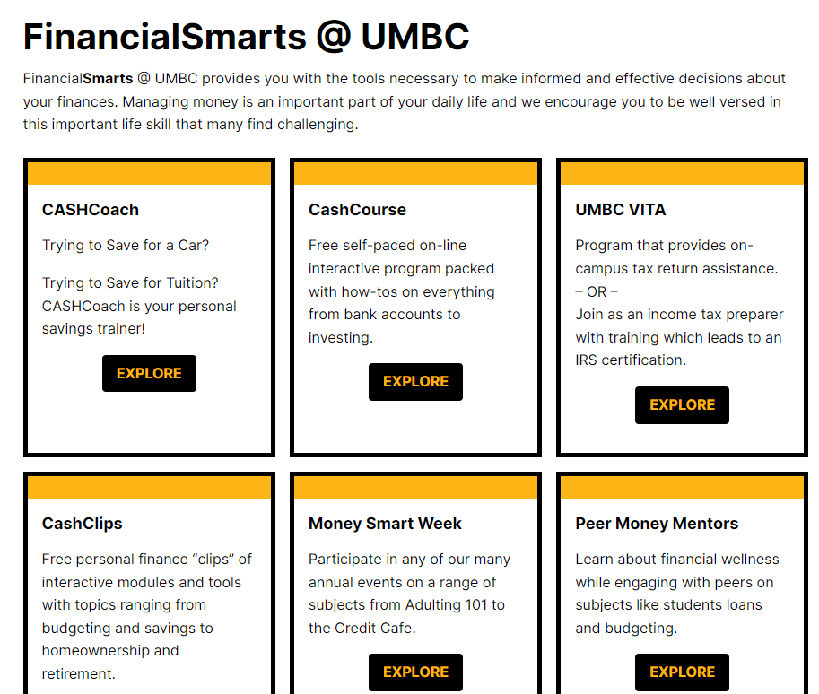
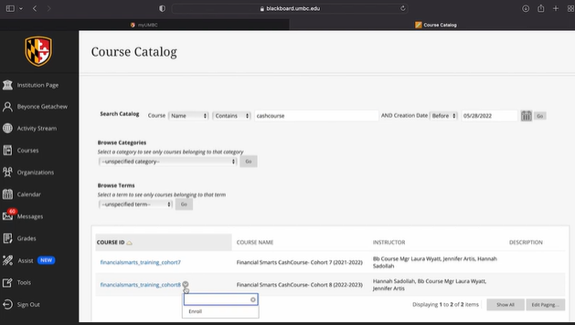
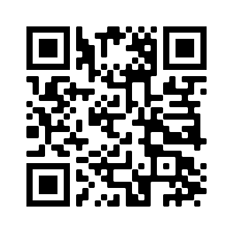
FinancialSmarts
financialsmarts.umbc.edu
Notes:
OFAS rep
FinancialSmarts helps provide students with the tools they need to make informed financial decisions. From skills like budgeting, saving, investing, and taxes to life goals like auto loans, home ownership or retirement, FinancialSmarts can help your student with life-long financial success.
You can partner with your student to help them understand and successfully navigate finances here at UMBC and beyond.

Slide 5
The 2024-2025 FAFSA
FAFSA questions reduced from 108 to 36.
Each FAFSA contributor must consent to their information being on the form.
The EFC is now the SAI.
Extended language accessibility.
The robust changes caused for a significant delay in FAFSA processing. As a result, several deadlines have been extended.

Slide 6
2024-2025 FAFSA is still available. If you have not already submitted your FAFSA please do so as soon as possible.
Monitor myUMBC for To Do’s and alerts
Notes:
**link to FAFSA page?
Reminder that next semester registration opens shortly and they will want to make sure accts are in good standing
* Info about Managing my student acct page?

Slide 7
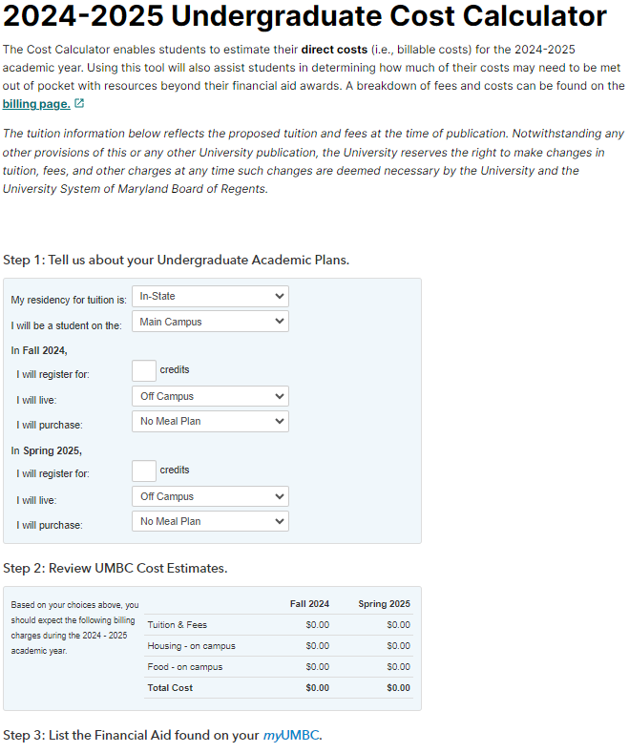
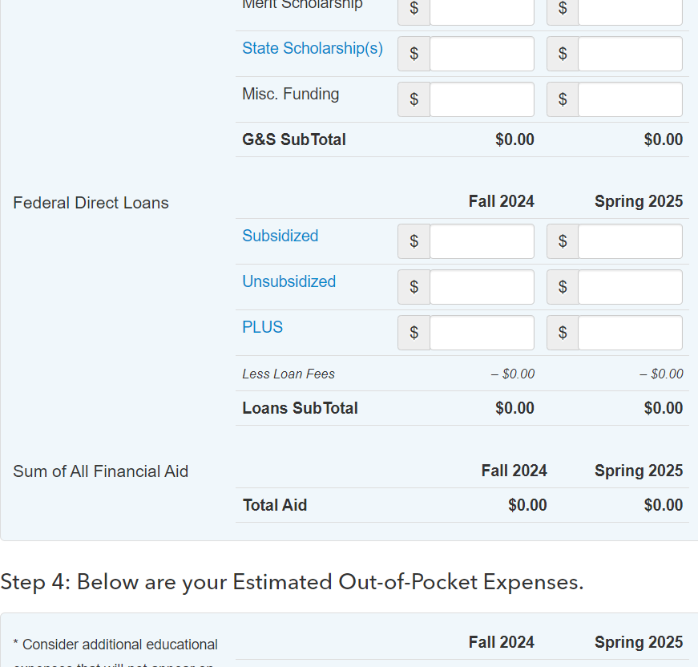
Notes:
Financial Aid Rep

Slide 8
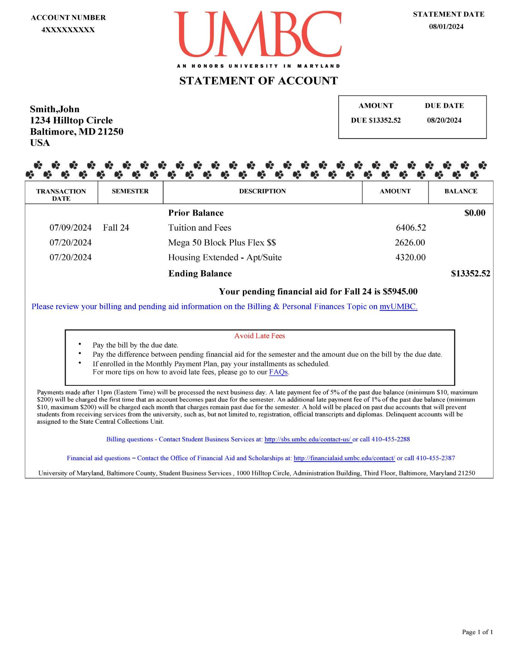

Slide 9
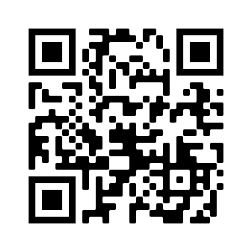
Aid Disbursement
Enrollment | First Disbursement Date
Full-time undergraduate students (12+ credits) | August 19th
Part-time undergraduate students (1-11 credits) | September 17th
The full disbursement calendar: financialaid.umbc.edu/calendar/
If pending financial aid is equal to or exceeds the balance due by the billing due date, students will not receive late fees.
Notes:
FinAid rep
Aid begins disbursing for students who are enrolled full time (12 or more credits) as early as August 21st. Students who are enrolled part time (less than 12 credits) will have aid begin disbursing as of September 19th.
The first disbursement date is after the billing due date for Fall 2023, however, students will not receive late fees if their pending financial aid equals or exceeds the balance due.

Slide 10
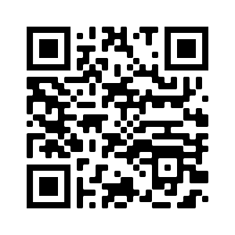
Questions
Financial Aid FAQs

Slide 11
Adulting 101_Reslife Section (Summer 2024)
orientation.umbc.edu
Notes:
Choosing to live on campus shows that you value living and engaging with other people. Within Residential Life we seek to co-create exceptional and innovative living-learning environments for our campus community as we foster the relational wellbeing of students.

Slide 12
What Reslife Values:
Clean & Safe Facilities
Quality Customer Service
Developing and Empowering Students
Promoting Education
Fostering Respectfully Diverse Communities
Restorative Practices

Slide 13
Residential Life Principle #1:
Prioritize connection before content
Community Staff
Resident Assistant
Intentional Conversations
Community Building
Desk Assistants
Maintenance Assistants
Community Directors
Notes:
Community Staff
Resident Assistant
Intentional Conversations
Community Building
Desk Assistants
Upholding Community Security (UMBC ID Checks, Guest & Visitation)
Maintenance Assistants
Community Directors

Slide 14
Residential Life Principle #2:
Lead “with”, not “for” or “to” others
Room Condition Report
FIXIT
Communal Resources
(Laundry, Equipment Sign-out, Study Spaces, Common Furniture)

Slide 15
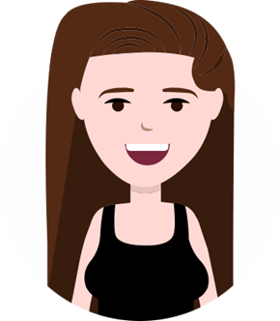
Residential Life Principle #3:
Promote responsibility by balancing high accountability and high support
Residential Life Rights & Responsibilities Guide and Student Code of Conduct
Promoting Personal Accountability
Support for Residents:
Faculty Mentors
LLCs
UMBC Police

Slide 16
Residential Life Principle #4:
Use fair process to make inclusive decisions
Community Council
Leadership Opportunity
Community Town Halls
Resident Student Association (RSA)
Events and Advocacy

Slide 17
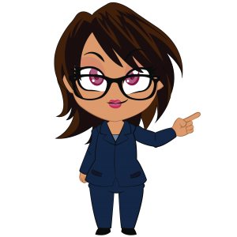
Residential Life Principle #5:
Value community, which requires a commitment to community standards
Roommate/Suitemate Agreements
Floor/Stack Community Standards
Floor Events and Social Programs

Slide 18
What to expect…
Everything a student needs…
Suite-style rooms in all communities
Semi private bathrooms
Study lounges
Free On-site laundry facilities
Community desks
Campus escorts and emergency blue light phones
WiFi
Xfinity Streaming (HBO)
Meal plans
On-campus employment
Walking distance to everything on campus
Short drive to DC, Baltimore, Amtrak and BWI

Slide 19
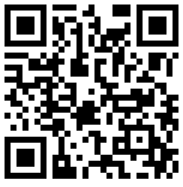
Before you arrive
What NOT to bring inside the Halls…
microwave (apartments excluded)
no more than 1 mini-fridge that does not exceed 4.3 ft^3
candles
halogen lamps
cords without surge protection
pets
motor-propelled vehicles (ie. scooters, boards, bikes, etc.)
more items located on the website…
View the Packing List

Slide 20
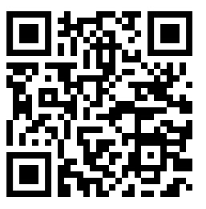
Important Dates
Applied Before June 1
June 15- Submit roommate requests via your Housing Application on the housing portal.
July 15- View your room & roommate information on the housing portal.
August 24- New Student Move-In Day
You will receive your specific move-in time in early August.
Applied/ing After June 1
Step 1- Complete the Waitlist Application on the housing portal, if you haven’t already.
Step 2- Check your UMBC email weekly to see if you’ve been issued a housing offer.
Offers are typically communicated on Mondays, as space permits.
Step 3- Accept your offer by the deadline.
Step 4- View your move-in, room & roommate information on the housing portal.
Access the Housing Portal
Notes:
July 15th - when students are informed of their living assignment and roommate

Slide 21
On the Waitlist?
Since we may be unable to accommodate all students on the waitlist prior to the start of the semester, we encourage students and families to explore additional housing and transportation options for the fall semester.
Campus Resources
Off-Campus Student Services
ocss.umbc.edu
Transit
transit.umbc.edu
Parking
parking.umbc.edu

Slide 22
A QUICK GUIDE TO PARKING AT UMBC
Take the Steps Now to Ensure Your Transition to Parking on Campus is a Smooth Process
UMBC Parking Services
900 Walker Avenue
Suite 107
Baltimore, MD 21250
410-455-2551/parking@umbc.edu
parking.umbc.edu

Slide 23
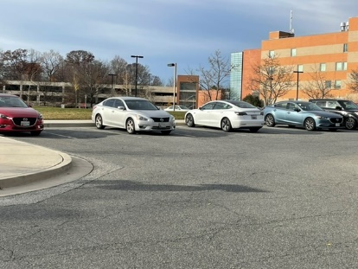
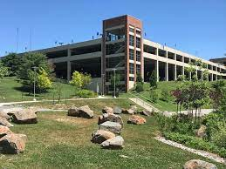
Getting Your Permit
UMBC Parking Permits are virtual. You no longer need a placard or sticker to display on your vehicle. Agents use License Plate Recognition technology to scan your plate and verify your permit. Parking permits for the 2024-2025 Academic Year will be available beginning on August 15.
What will you need to do to get your permit?
Where can you park?
How much does it cost?
The answers to all of your questions follow!
Need Help? Contact us at parking@umbc.edu

Slide 24
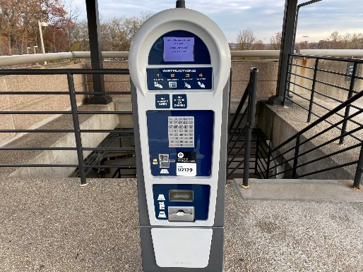
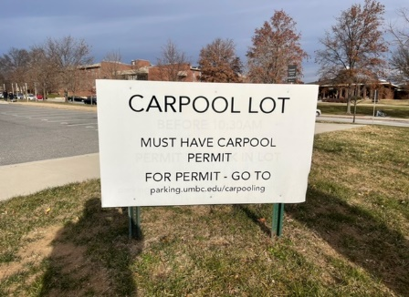
Securing Your Permit
Student permits are covered by the Transportation and Parking Fees in your tuition. Student Permits are good from August 15 - August 14 each year. You must renew your permit every August. How do you get your permit?
Step 1 – Go to umbc.nupark.com/portal and sign-in using your MyUMBC sign-in information. DO NOT CREATE A VISITOR ACCOUNT – You will not be able to get a permit with a visitor account.
Step 2 – Enter the vehicle information for up to three cars/motorcycles (make, model, color and plate.) You may have up to 3 vehicles on your account, but only one on campus at anytime.
Step 3 – Click on the “GET PERMIT” button on the right. Once you have done these three steps, you will have your permit and may park on campus.
Questions?
Please call 410-455-2551

Slide 25
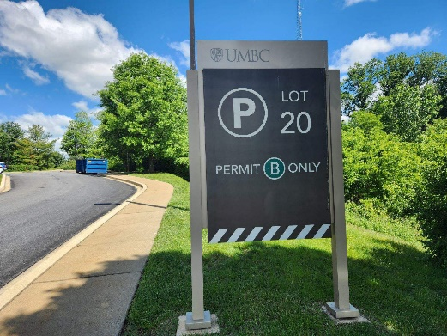
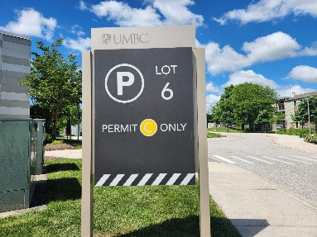
Where Can I Park?
A-Zones – Commuter Students
B-Zones – Walker Avenue Residents
C-Zones – Resident Students
Permits are enforced Monday thru Friday, 8 AM to 4 PM. Posted signs are enforced 24/7, 365 days per year. Visitors to campus during the 8 AM to 4 PM enforcement hours are expected to park in any of the Pay-to-Park Lots (Administration Garage – Top Level, Commons Garage – Ground Level, Walker Avenue Garage – Top Level, and Lots 7 and 9).
Pay to Park lots are $2 per hour and this fee can be paid at a pay station in the lot or on the Park Mobile App.
Visit the UMBC Parking Map at
parking.umbc.edu

Slide 26
Other Services Offered Through Parking Services
ZipCar® – Your student doesn’t have a car on campus but needs to run a quick errand? Students 18 and over can sign-up for ZipCar® and rent vehicles for as little as one hour. ZipCar® also includes a gas card for fill-ups and secondary insurance.
Bicycle/Scooter Registration – Register your bike with Parking Services to ensure the safety of your bike/scooter. You may also pick-up a free lock when you register your bike with us.
Bike the Campus Day – Join us in Late April/May for Bike the Campus Day. Games, prized and competitions are just a few of the highlights from this exciting day. More details to come as we get closer.
Carpool Permits – As we continue to work to reduce our carbon footprint, reducing trips to campus is vital. Commuter students who travel to campus together may apply for a carpool permit and park in Lot 4 – one of the best locations on campus.
parking.umbc.edu

Slide 27
Important Things to Remember
Permits are Available: August 15
Parking Portal Address: umbc.nupark.com/portal
Parking Information: parking.umbc.edu
Parking Services Contact Information:
parking@umbc.edu
410-455-2551

