Slide 1
Financing Your Student’s Education
Presented by:
Student Business Services &
The Office of Financial Aid & Scholarships
Notes:
Intro to program and names/titles of representatives

Slide 2
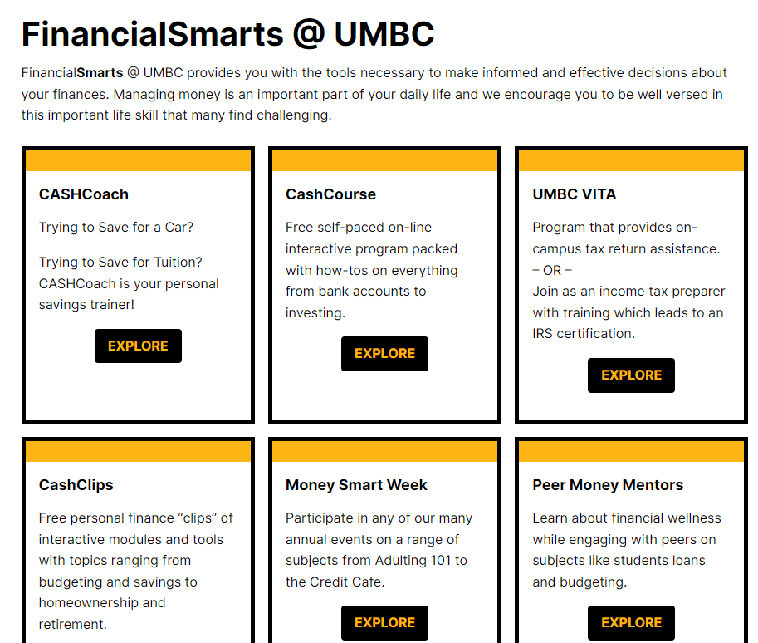
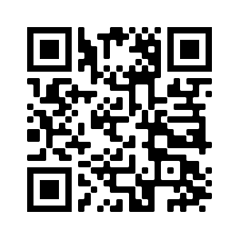
FinancialSmarts
financialsmarts.umbc.edu
Notes:
OFAS rep
FinancialSmarts helps provide students with the tools they need to make informed financial decisions. From skills like budgeting, saving, investing, and taxes to life goals like auto loans, home ownership or retirement, FinancialSmarts can help your student with life-long financial success.
You can partner with your student to help them understand and successfully navigate finances here at UMBC and beyond.

Slide 3
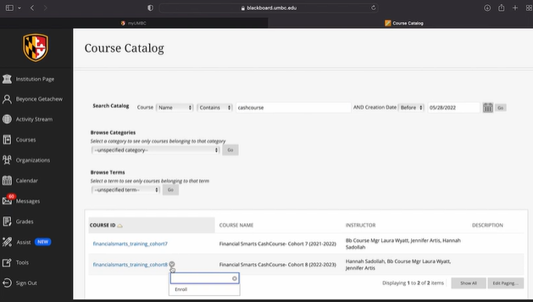
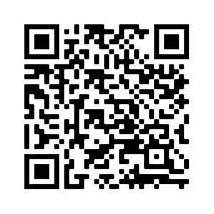
FinancialSmarts
Students that complete the CashCourse have a chance to win a $100, $300 or $500.
https://financialsmarts.umbc.edu/programs/cashcourse/
Notes:
OFAS rep
CashCourse is a free self-paced program students can complete via BlackBoard. It includes presentations, informational guides, games, and how-tos on everything from bank accounts to investing. Students who complete all course modules by September 15 are entered to win a $500 scholarship! Students who complete two modules are entered to win $300, and students who complete one module are entered to win $100. All prizes are delivered to students as scholarships.

Slide 4
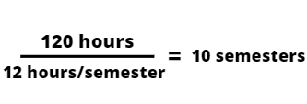
Cutting the Cost of College
The number of credit hours needed to receive a bachelor's degree is about 120.
The minimum full-time credit load per semester is 12 credits.
Notes:
OFAS rep
The benefits of Finish 15 are far reaching. By staying on track and completing your degree on time, you:
Lower your overall tuition/educational expenses.
Lower your student loan debt.
Maximize your financial aid by meeting state scholarship and other financial aid degree progress requirements.
Fast-track your path to employment/graduate school.
Establish early earnings & savings as opposed to paying tuition.

Slide 5
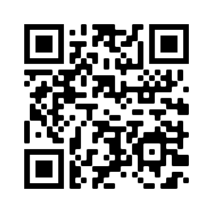
Student Business Services
Administration Building, 3rd floor
Monday-Friday, 8:30am-4:30pm (Payments until 4:00pm)
SBS Team: 410-455-2288
Notes:
SBS rep

Slide 6
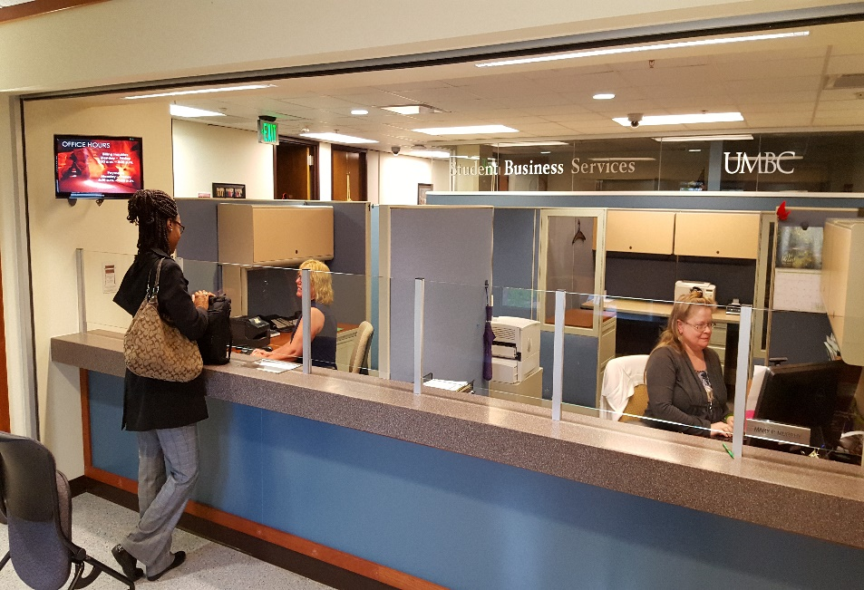
Student Business Services
Dedicated Service Reps
Monthly E-Bills
Payment Processing
Payment Plan Enrollment
E-refunds
Authorizing Additional Users
Notes:
SBS rep

Slide 7
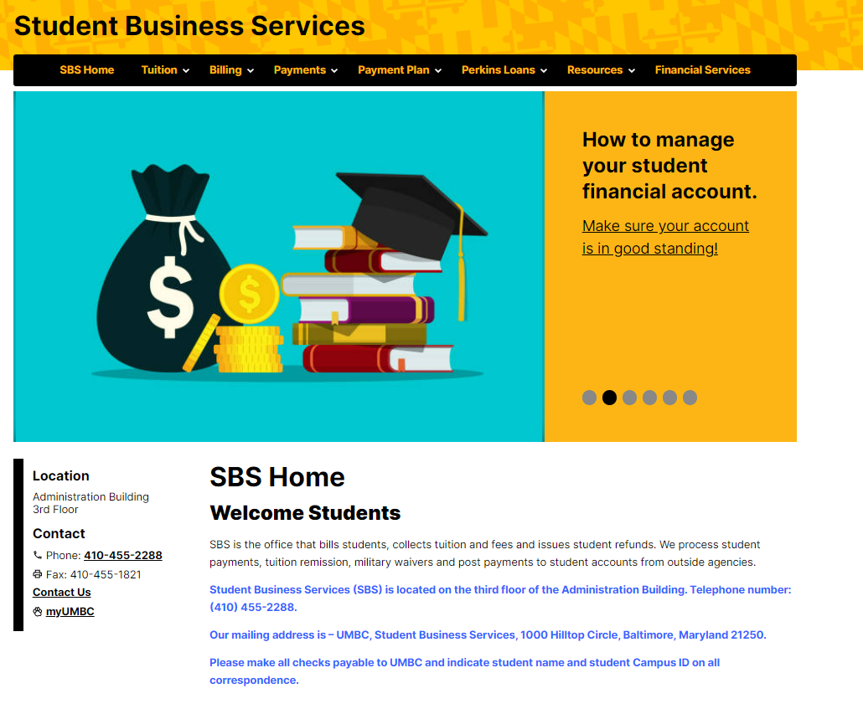
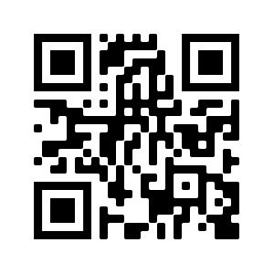
sbs.umbc.edu
Notes:
SBS rep

Slide 8
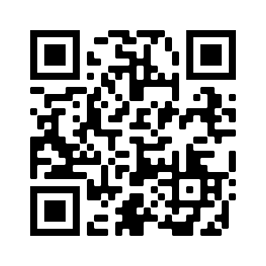
Office of Financial Aid and Scholarships
Lower level of the Library, pondside
Monday-Friday, 8:30am-4:30pm
Financial Aid: 410-455-2387
Merit Scholarships: 410-455-3813
Notes:
FinAid rep

Slide 9
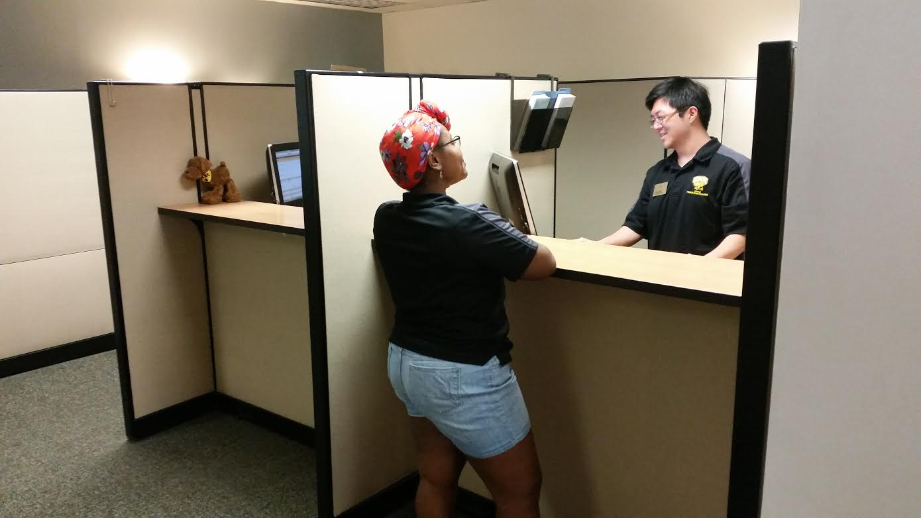
Office of Financial Aid and Scholarships
Awarding of Merit Scholarships
FAFSA Processing
Verification of student accounts
Financial Aid Awarding
Financial Aid Counseling
Notes:
The office is open Monday-Friday from 8:30am-4:30pm and is comprised of three separate units: Merit Scholarships, Financial Smarts, and Financial Aid.
Students are assigned financial aid counselors based on the first letter of their last name. Contact information for our offices and information on students counselors can be found on our contact page.

Slide 10
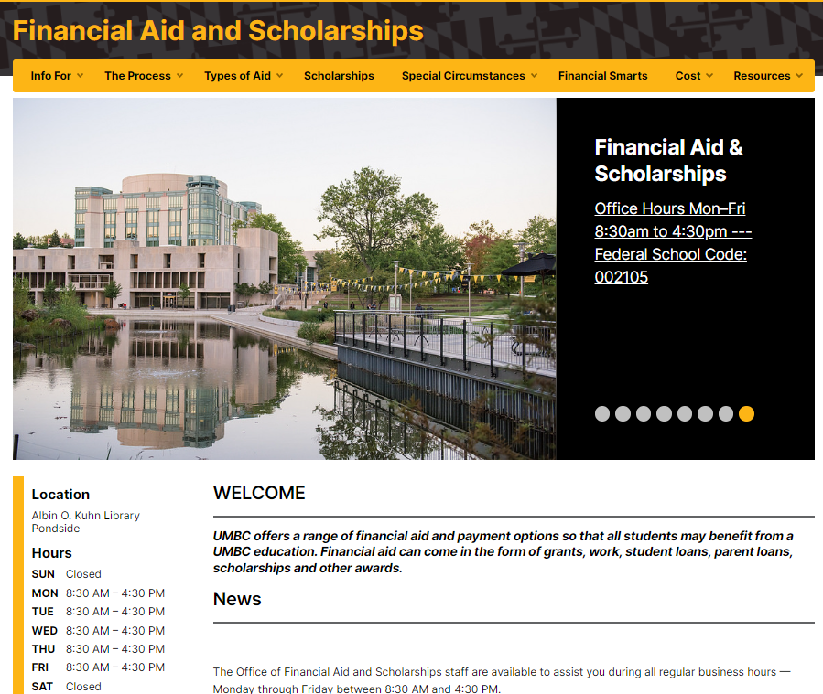
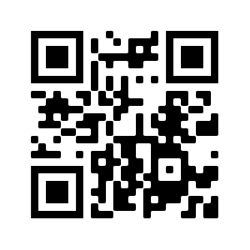
financialaid.umbc.edu
Notes:
FinAid Rep
Our website is a great resource for finding information on types of aid, timelines, and forms. The Cost tab houses our Cost Calculator tool that helps you estimate out of pocket expenses before charges are posted for your student!

Slide 11
Authorizing Additional Users (Parents/Others)
Profile Sharing
Sharing financial information via myUMBC
Online – students authorize access to view billing and financial aid details
Offline – students authorize access to receive information in-person, by telephone and email
Parent PIN
Students authorize access via myUMBC to:
View e-bills
Sign up for Monthly Payment Plan
Make online payments
Notes:
SBS rep

Slide 12
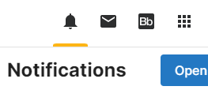
Remind your student to check myUMBC Notifications
Notes:
SBS rep

Slide 13
Complete MPN/Entrance Counseling for Federal Direct Student Loan(s)
Complete (Parent PLUS/Alternative) loan requirements (optional))
Apply for Scholarships
Sign up for the Fall 2023 Monthly Payment Plan
Use Cost Calculator to estimate charges
Accept financial aid via “Financial Aid Inquiry” on myUMBC
Notes:
FinAid rep first 4 bullets
-Students who have a FAFSA on file should have an aid package. They can access this on myUMBC under their Financial Aid card or on the Financial Aid Inquiry.
-If your student is taking out Federal loans, they will need to complete the MPN (Master Promissory Note) and Entrance Counseling at studentaid.gov. This is required for all new borrowers.
-If you intend to take out additional loans beyond the Federal loans offered to the student such as Parent PLUS and alternative/private loans, we encourage you to complete this as soon as possible.
-If your student is receiving any scholarships from outside sources, report these to UMBC with the scholarship notification form. Students can apply for scholarship opportunities with Scholarship Retriever as well.
SBS rep:
-Sign Up for Monthly Payment Plans (billing and mpp schedule on next slide)
-Use Cost Calculator to estimate charges and sign up for a MPP

Slide 14
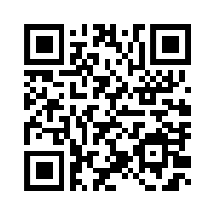
Billing Schedule
Register By | E-Bill Date | Due Date | Late Fee Charged
July 31 | August 1 | August 20 | August 25
August 31 | September 1 | September 20 | September 25
September 30 | October 1 | October 20 | October 25
Monthly Payment Plan (MPP)
MPP Installments | Deadline to Sign Up | 1st Payment Due
4 | July 19 | July 20
3 | August 19 | August 20
2 | September 19 | September 20
 |  | Final payment: October 20
Notes:
SBS rep

Slide 15
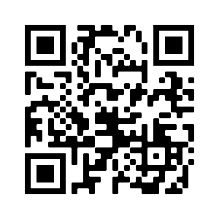
Aid Disbursement
Enrollment | First Disbursement Date
Full-time undergraduate students (12+ credits) | August 21
Part-time undergraduate students (1-11 credits) | September 19
The full disbursement calendar: financialaid.umbc.edu/calendar/
If pending financial aid is equal to or exceeds the balance due by the billing due date, students will not receive late fees.
Notes:
FinAid rep
Aid begins disbursing for students who are enrolled full time (12 or more credits) as early as August 21st. Students who are enrolled part time (less than 12 credits) will have aid begin disbursing as of September 19th.
The first disbursement date is after the billing due date for Fall 2023, however, students will not receive late fees if their pending financial aid equals or exceeds the balance due.

Slide 16
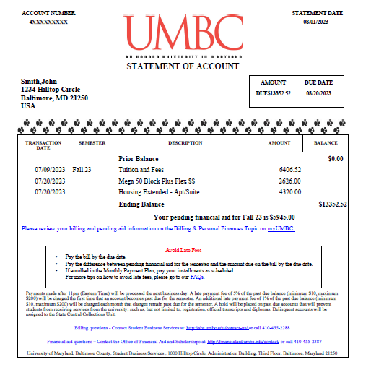

Slide 17
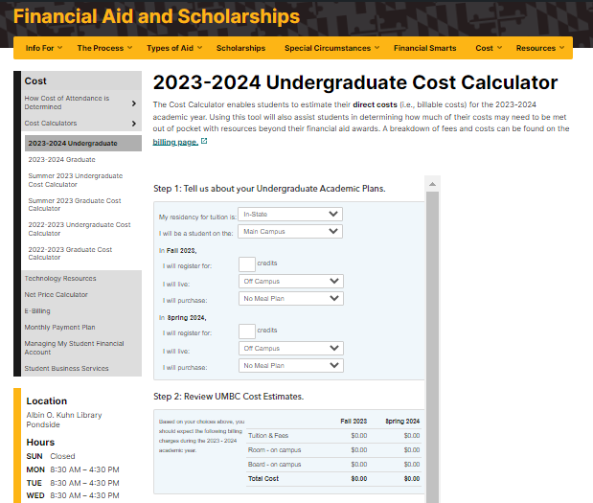
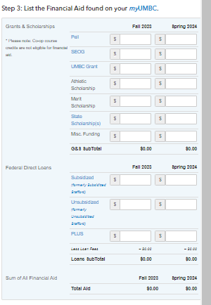
Notes:
Financial Aid Rep

Slide 18
Initiate or submit Third Party Payment Information (tuition assistance, tuition remission, VA, 529)
Tuition charges can be viewed mid-July on Account Inquiry
Notes:
SBS rep

Slide 19
2024-2025 FAFSA will become available by January 1st at studentaid.gov/h/apply-for-aid/fafsa
Remind your student to monitor myUMBC for To Do’s and alerts
Notes:
**link to FAFSA page?
Reminder that next semester registration opens shortly and they will want to make sure accts are in good standing
* Info about Managing my student acct page?

Slide 20
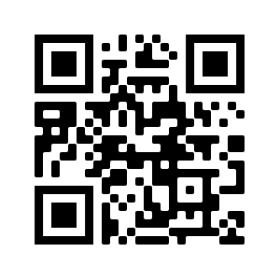
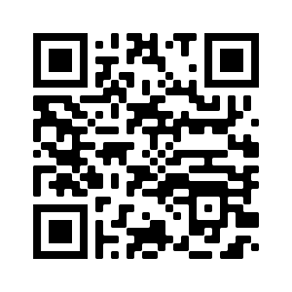
Questions
SBS FAQs
Financial Aid FAQs

