Slide 1
UMBC Family Orientation
Looking Back, Moving Forward
2022

Slide 2
2004
Notes:
Your college freshman was a newborn
Event: Gmail was launched
Song: Hey Ya! - OutKast
Movie: The Incredibles

Slide 3
2005
Notes:
Your student was about one
Event: YouTube was born
Song: Since U Been Gone- Kelly Clarkson
Movie: Star Wars: Episode III- Revenge of the Sith

Slide 4
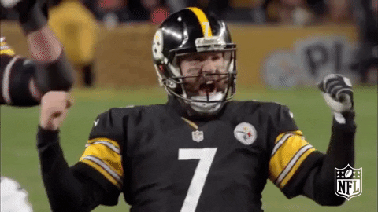
2006
Notes:
Your college freshman is two years old
Event: The Steelers win the Superbowl
Song: Hips Don’t Lie- Shakira
Movie: Pirates of the Caribbean- Dead Man’s Chest

Slide 5
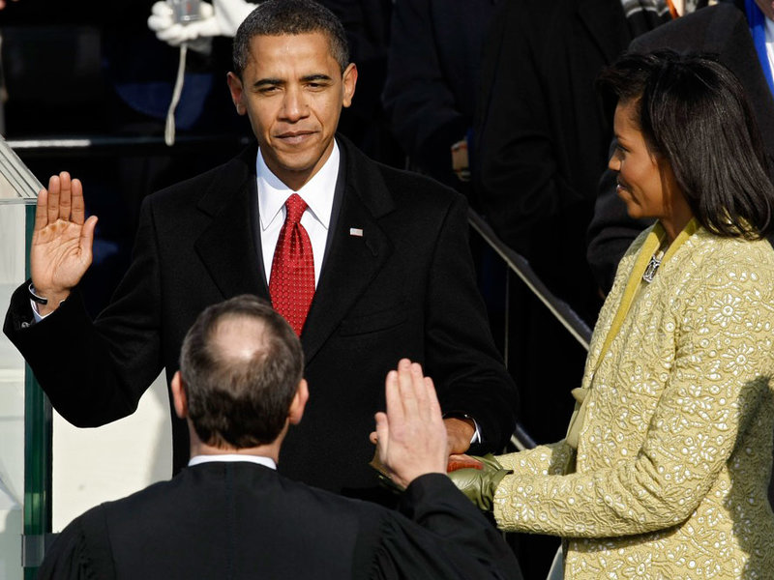
2009
Notes:
Your student was five years old
Event: Obama became president for the first time
Song: Single Ladies (Put a Ring on it)- Beyonce
Movie: The Hangover

Slide 6
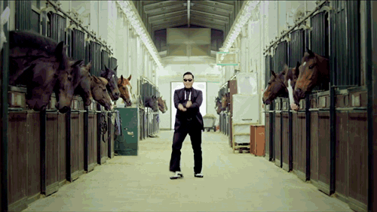
2014
Notes:
Your college freshman was ten
Event: Gangnam Style breaks the internet with 2 billion views on YouTube
Song: Shake It Off- Taylor Swift OR Gangnam style
Movie: Guardians of the Galaxy

Slide 7
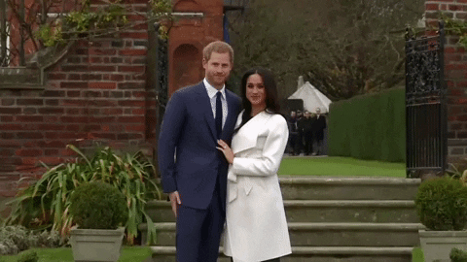
2018
Notes:
Your student was fourteen and beginning high school
Event: Meghan Markle and Prince Harry get married
Song: Havana- Camilla Cabello
Movie: Black Panther

Slide 8
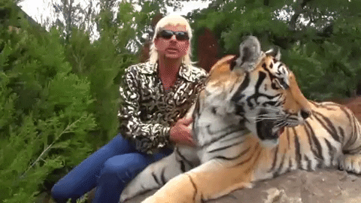
2020
Notes:
Your sixteen year old is driving!
Event: Tiger King premiered on Netflix
Song: Watermelon Sugar- Harry Styles
Movie: Parasite

Slide 9
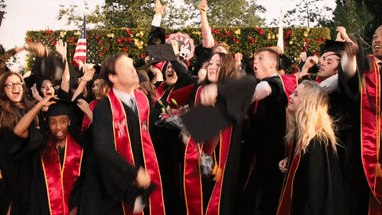
2022
Notes:
Your college freshman is seventeen or eighteen and just graduated high school
Event: In-person graduation starts up again for many schools
Song: Heatwave- Glass Animals
Movie: Spiderman- No Way Home

