Slide 1
Financing Your Student’s Education
Presented by:
Student Business Services &
The Office of Financial Aid & Scholarships
Notes:
Introductions

Slide 2
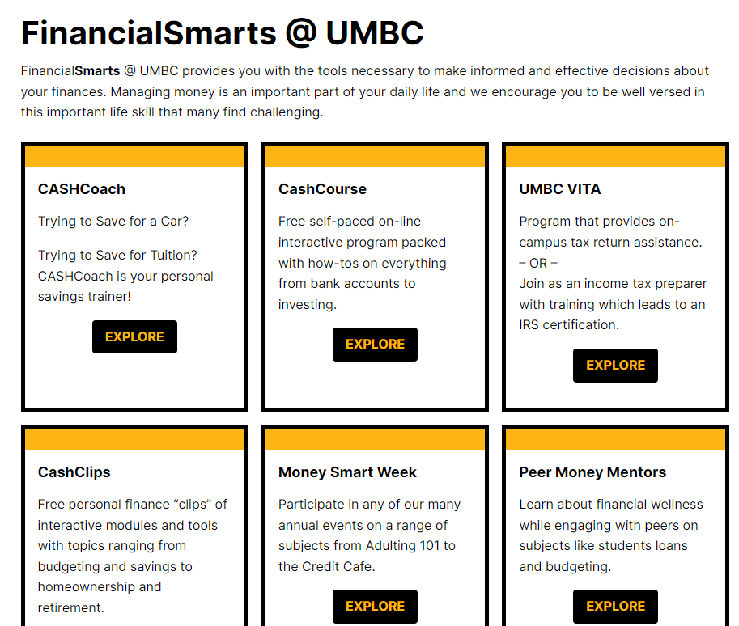
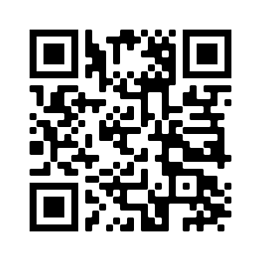
FinancialSmarts
financialsmarts.umbc.edu
Notes:
OFAS rep:
FinancialSmarts helps provide students with the tools they need to make informed financial decisions. From skills like budgeting, saving, investing, and taxes to life goals like auto loans, home ownership or retirement, FinancialSmarts can help your student with life-long financial success.
You can partner with your student to help them understand and successfully navigate finances here at UMBC and beyond.

Slide 3
FinancialSmarts
Students that complete the CashCourse have a chance to win a $100, $300 or $500.
Notes:
OFAS rep
CashCourse is a free self-paced program students can complete via BlackBoard. It includes presentations, informational guides, games, and how-tos on everything from bank accounts to investing. Students who complete all course modules by September 15 are entered to win a $500 scholarship! Students who complete two modules are entered to win $300, and students who complete one module are entered to win $100. All prizes are delivered to students as scholarships.

Slide 4
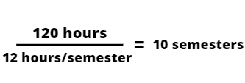
Cutting the Cost of College
The number of credit hours needed to receive a bachelors degree is about 120.
The minimum full-time credit load per semester is 12 credits.
Notes:
OFAS rep
Finish 15 is UMBC’s commitment to ensuring students graduate on time. Students who finish 15 credits per semester or, on average, 30 credits per year, remain on track to complete their degree within four years.
The benefits of Finish 15:
•Lower your overall tuition/educational expenses.
•Lower your student loan debt.
•Maximize your financial aid by meeting state scholarship and other financial aid degree progress requirements.
•Fast-track your path to employment/graduate school.
•Establish early earnings & savings as opposed to paying tuition.

Slide 5
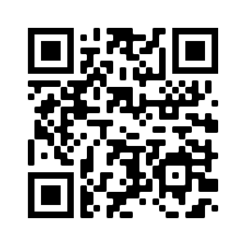
Student Business Services
Administration Building, 3rd floor
Monday-Friday, 8:30am-4:30pm (Payments until 4:00pm)
SBS Team: 410-455-2288
Notes:
SBS

Slide 6
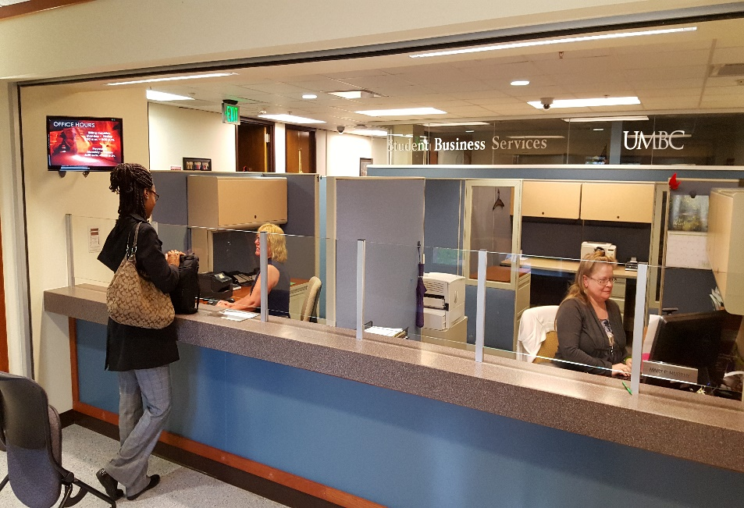
Student Business Services
Dedicated Service Reps
Monthly E-Bills
Payment Processing
Payment Plan Enrollment
E-refunds
Authorizing Additional Users
Notes:
SBS

Slide 7
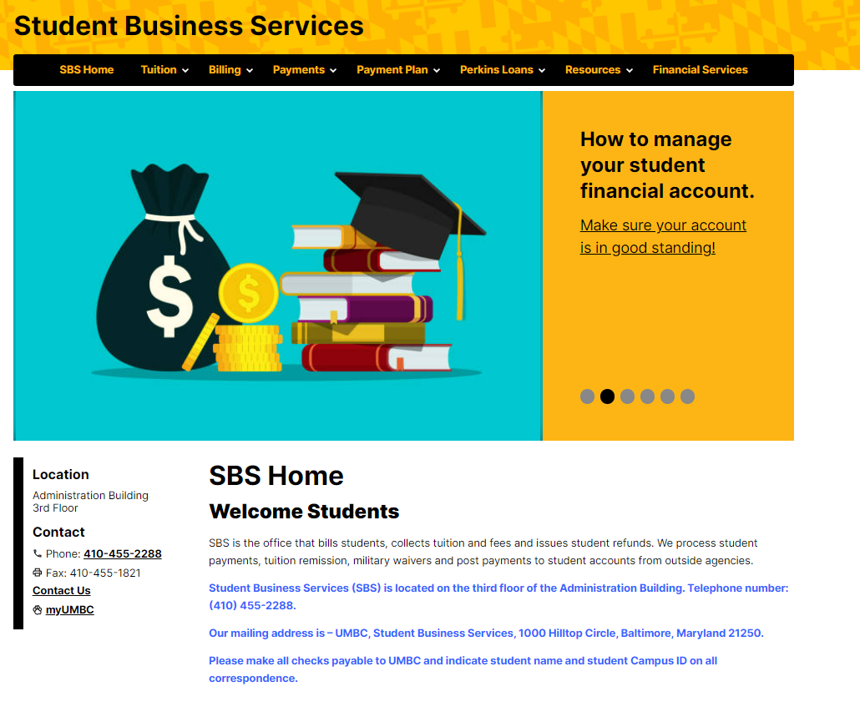
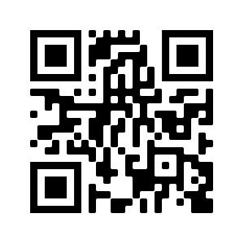
sbs.umbc.edu
Notes:
SBS

Slide 8
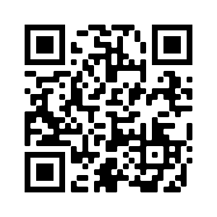
Office of Financial Aid and Scholarships
Lower level of the Library, pondside
Monday-Friday, 8:30am-4:30pm
Financial Aid: 410-455-2387
Merit Scholarships: 410-455-3813
Notes:
OFAS
The office is open Monday-Friday from 8:30am-4:30pm and is comprised of three separate units: Merit Scholarships, Financial Smarts, and Financial Aid.
Students are assigned financial aid counselors based on the first letter of their last name. Contact information for our offices and information on students counselors can be found on our contact page.

Slide 9
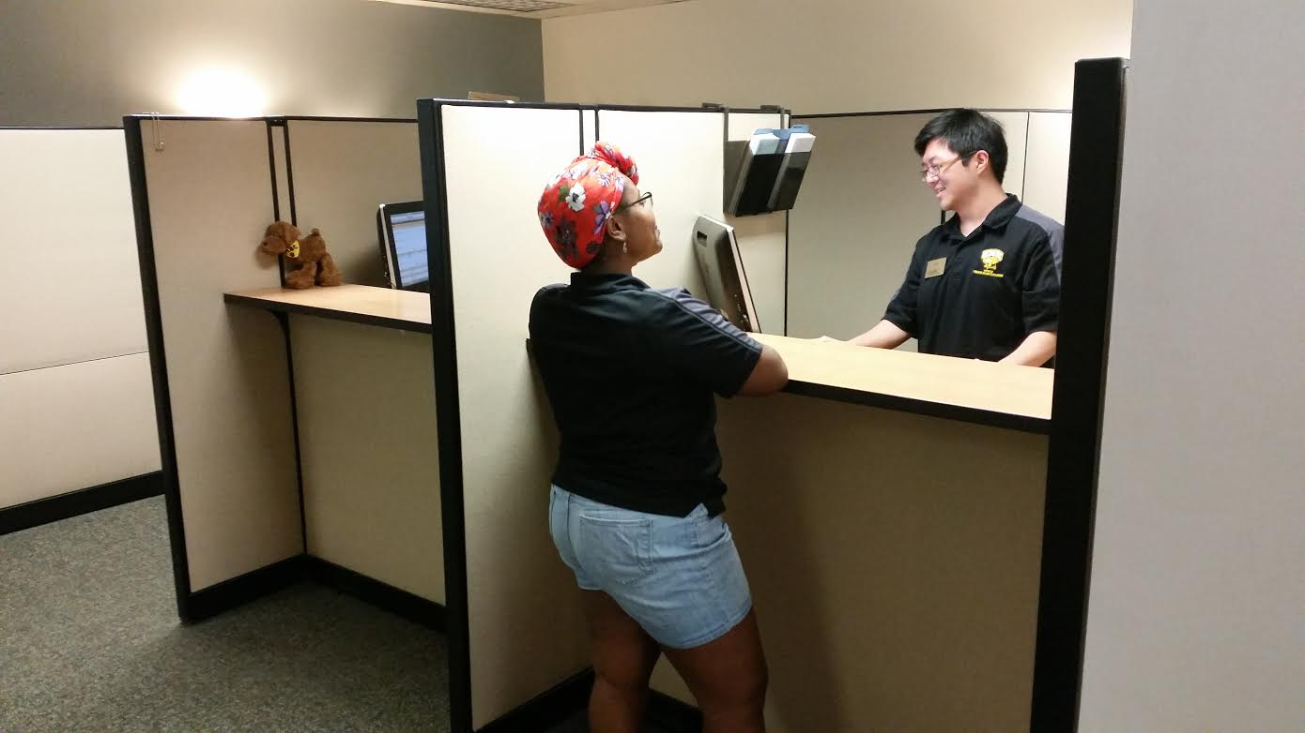
Office of Financial Aid and Scholarships
Awarding of Merit Scholarships
FAFSA Processing
Verification of student accounts
Financial Aid Awarding
Financial Aid Counseling
Notes:
OFAS

Slide 10
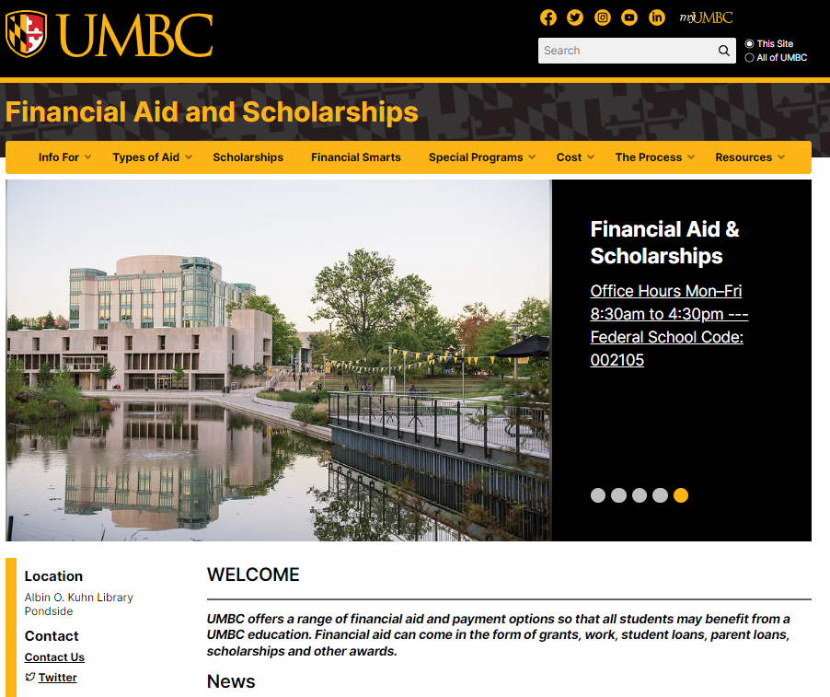
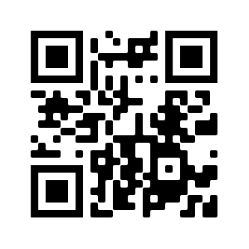
financialaid.umbc.edu
Notes:
OFAS

Slide 11
Authorizing Additional Users (Parents/Others)
Profile Sharing
Sharing financial information via myUMBC
Online – students authorize access to view billing and financial aid details
Offline – students authorize access to receive information in-person, by telephone and email
Parent PIN
Students authorize access via myUMBC to:
View e-bills
Sign up for Monthly Payment Plan
Make online payments
Notes:
SBS

Slide 12
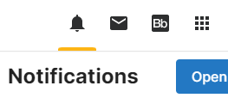
Remind your student to check myUMBC
notifications and email
Notifications
Updates
Document Requests
Notes:
SBS

Slide 13
June
Complete MPN/Entrance Counseling for Stafford Loan(s)
Complete (Parent Plus/Alternative) loan requirements (optional)
Complete Private Scholarship Notification Form (if required)
Fall 2022 Monthly Payment Plan enrollment now open
Use Cost Calculator to estimate charges
Accept financial aid via “Financial Aid Inquiry” on myUMBC
Notes:
The Cost Calculator tool enables families to estimate total costs for the year and deduct any current financial aid. The out of pocket cost calculated can be used to assess additional aid options such as loans and can also be used to determine installments for the monthly payment plan.

Slide 14
July
Initiate or submit Third Party Payment Information (tuition assistance, tuition remission, VA, 529)
July 19th: Deadline to enroll in 4-installment Monthly Payment Plan
July 20th: First payment of 4-installment plan due
Tuition charges can be viewed mid-July on Account Inquiry

Slide 15
August
August 1st: E-bill available
(charges posted through July 31st )
August 22nd : First Fall 2022 financial aid disbursement to full-time student accounts
August 20th : August 1st E-bill/Monthly Payment Plan installment due
August 19th : Deadline to enroll in 3-installment Monthly Payment Plan
Notes:
Financial aid for student enrolled in 12+ credits will apply to their accounts on August 22nd. Students are responsible for any portion of their bill not covered by pending financial aid.

Slide 16
September
September 1st: E-bill available
(charges posted through August 31st )
September 19th: Deadline to enroll in 2-installment Monthly Payment
September 20th: First Fall 2022 financial aid disbursement to part-time student accounts
September 20th: September 1st E-bill /Monthly Payment Plan Installment due

Slide 17
October
October 1st - 2023-2024 FAFSA available at studentaid.gov/h/apply-for-aid/fafsa
October 1st – E-bill available
(for charges posted in September)
October 20th – October 1st E-bill/Final MPP Installment due

Slide 18
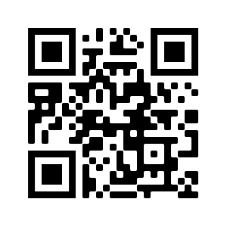
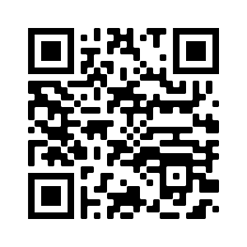
Questions
SBS FAQs
Financial Aid FAQs

