Slide 1
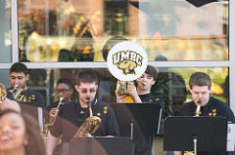
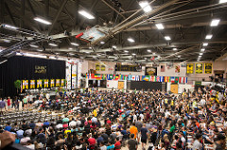
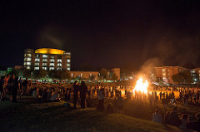
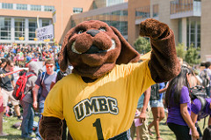
Life Outside the Classroom
SUMMER ORIENTATION 2018
Notes:
Welcome and good afternoon! My name is __________ and position tile. It is my pleasure to welcome you to our presentation.
Hopefully your orientation experience has been enjoyable and informative thus far. This session has a couple of overall goals. First is to introduce and highlight the Division of Student Affairs and our campus Partners.
Next is to have a panel of experts from different functional areas briefly introduce themselves and provide a snap shot of their services.

Slide 2
The Commons 336 | 410-455-1097
campuslife@umbc.edu
Campus Life
Activities/
Student Organizations
Civic Engagement/
Service
Leadership
Fraternities & Sororities
Identity and Spirituality
There is lots to do at UMBC!
EVENTS.UMBC.EDU
Notes:
Civic Engagement/Service
We host day-long volunteer projects as well as Alternative Spring Break service trips to Baltimore, Panama, and more!
Activities/Student Organizations
There are over 200 organizations dedicated to academics, culture, governance, media, religion, sports, service, arts, careers, and hobbies
Leadership
UMBC hosts leadership courses and has a leadership development retreat
Fraternities & Sororities
UMBC has chapters in the National Panhellenic Council, Multicultural Greek Council, Interfraternity Council, Panhellenic Council, and Professional Council
Diversity and Inclusion
We have the Mosaic Center for diversity, inclusion and social justice education and outreach; the Interfaith Center for religious and spiritual gatherings and connection; and the Queer Student Lounge for LGBTQ community-building and resources.

Slide 3
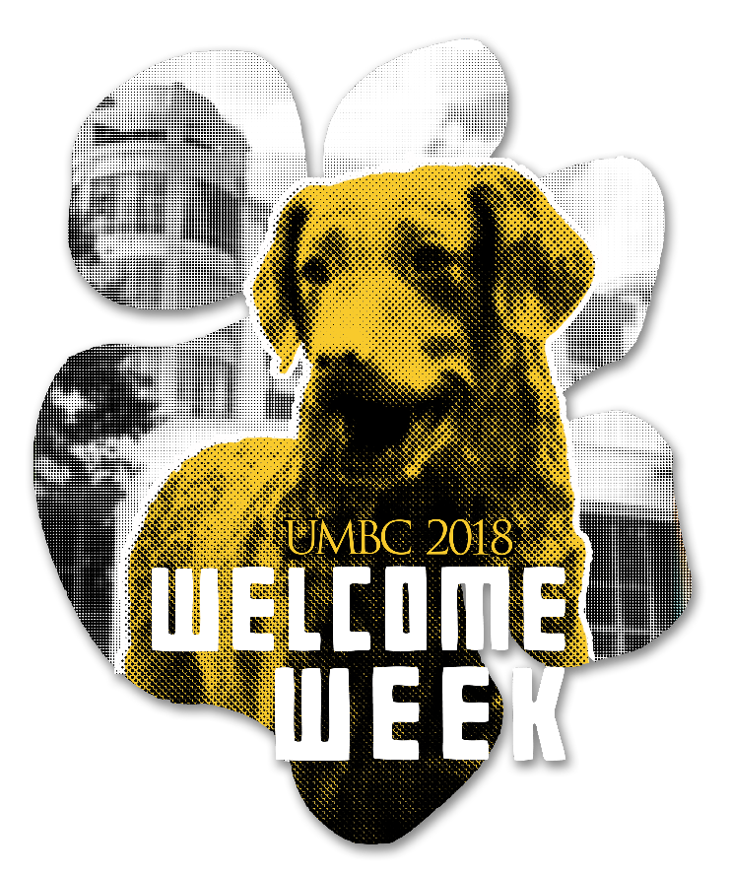
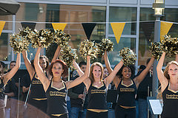
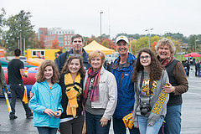
Welcome Week
August 25 – September 2, 2018
welcomeweek.umbc.edu
Common Book Experience
Student Organizations Fair
UMBC Values and Culture
Academic Success Tips
Convocation
On Campus Job Fair
Get to know campus and each other
Notes:
Please save the date for these great family events. We hope you will be able to join us.

Slide 4
HOMECOMING
October 3 - 13, 2018
homecoming.umbc.edu
Notes:
Please save the date for these great family events. We hope you will be able to join us.

Slide 5
Campus Health & Safety
Making healthy choices about drugs and alcohol.
Taking initiative to mange physical and mental health.
Creating a community of caring and active bystanders.
Fostering relationships that are mutually beneficial and healthy.
Learning about how choices and behavior impact the community.
Engaging faculty, staff, and families when students are in need.
Jacki Stone
Community Health and Safety Specialist
Office of the Vice President for Student Affairs
Commons 319
j.stone@umbc.edu
410-455-2393
8:30 a.m. - 5:00 p.m. Monday-Friday
Be Your Best Self Week, September 24-28

Slide 6
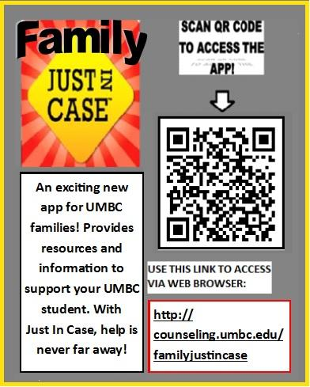
Student Development and Success Center
counseling.umbc.edu | 410-455-2472
Counseling Center
Fosters students’ psychological development and emotional well-being and supports students in attaining their academic and personal goals.
Free and Confidential
Short-term Individual Counseling
Group Counseling
Psychiatric Consultation
Crisis Management
Assistance with Referrals
Services Include:
Outreach
Consultation with students, families, faculty and staff
Training of Graduate Students
Monday-Friday ~ 8:30 a.m. - 5:00 p.m.

Slide 7
Office Of Accessibility & Disability Services Student Disability Services (SDS)
Math/Psychology Building, Room 212 | 410-455-2459
sds.umbc.edu | disABILITY@umbc.edu
Mission: To ensure that enrolled students with disabilities are afforded an equal opportunity to participate in all campus programs and services through the coordination of accommodations .
Goal: To provide a welcoming, encouraging, inclusive, and empowering environment to all students with disabilities. SDS encourages focusing on a student’s abilities to see them achieve success!

Slide 8
Human Relations /Title IX Office
Administration Building, Room 901 | 410-455-1606
humanrelations.umbc.edu/sexual-misconduct
bhoye@umbc.edu
Responsible for coordinating the University’s efforts and initiatives to prevent and address incidents of sexual misconduct through:
Facilitating and Receiving Reports of Sexual Misconduct
Providing Resources and Support
Education and Training
Comprehensive Policies and Procedures
Respect Boundaries
Get Consent
Engage in Healthy Relationships
Seek Help
UMBC Title IX Coordinator
Bobbie L. Hoye
Email: bhoye@umbc.edu
Phone: 410–455-1606

Slide 9
Questions?
families@umbc.edu
Notes:
Now we will be turning the session over to you. Since we have many of you in the room, it will be difficult to get to your questions individually. So I am going to ask you to work together at your tables to come up with questions. If you have less than three at your table, I ask that you please join another table.
Please come up with 2 questions. One is your top question that you think will be extremely important for fellow family members to hear. The second question, will serve as your back up question in case your first question gets asked before I can get to your table.
Also please choose a representative for your table to ask your question. I will be coming around to the tables with the microphone. Take approximately 2 minutes to come up with your questions and then we will get started.

