Slide 1
UMBC Family Orientation
2018

Slide 2
2000
Notes:
Your college freshman was a newborn
Precision GPS navigation became available to the public

Slide 3
2001
Notes:
Your student was about one
9/11 terrorist attacks are largest attacks on American soil in U.S. history

Slide 4
2002
Notes:
Your college freshman is two years old
Justin Timberlake and Britney Spears split up

Slide 5
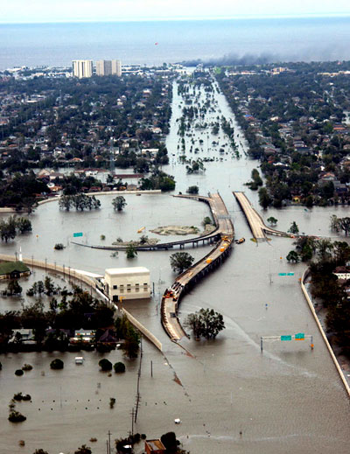
2005
Notes:
Your student was five years old
Hurricane Katrina struck the Gulf Coast of the United States

Slide 6
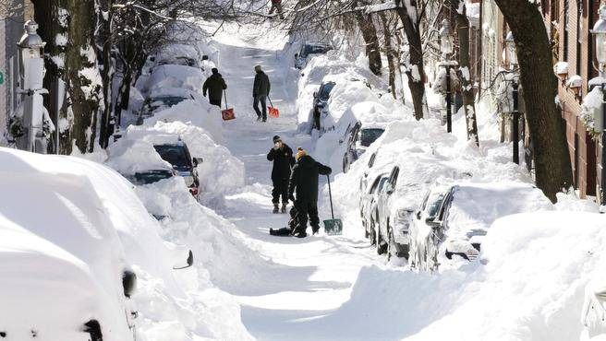
2010
Notes:
Your college freshman was ten
Snowmaggedon in the Northeast

Slide 7
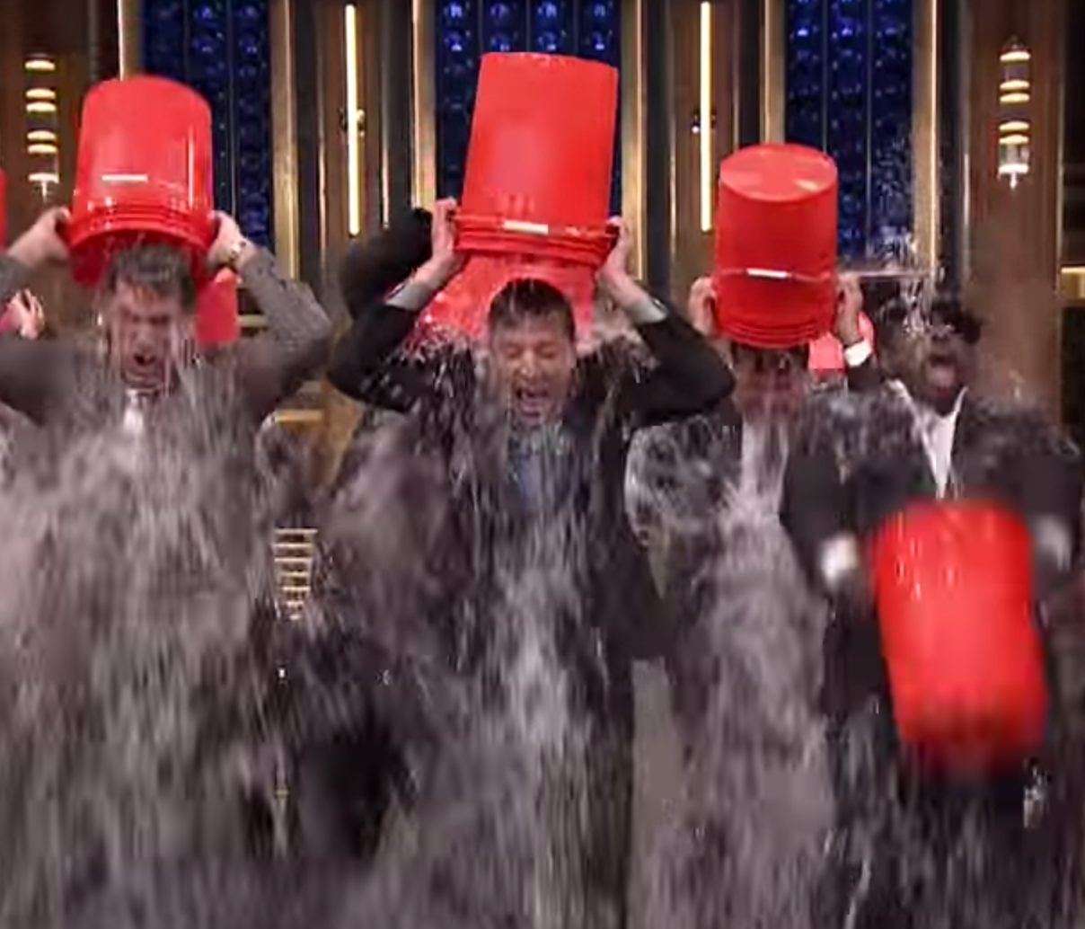
2014
Notes:
Your student was fourteen and beginning high school
ALS Ice Bucket Challenge raises $115 Million Dollars

Slide 8
2016
Notes:
Your sixteen year old is driving!
Summer Olympics in Brazil

Slide 9
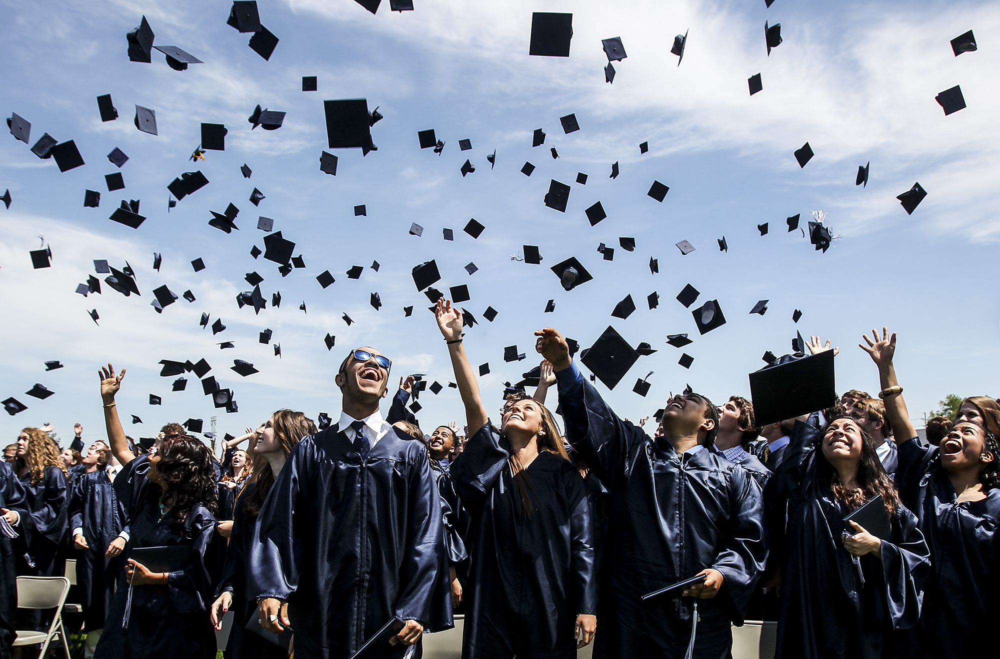
2018
Notes:
Your college freshman is seventeen or eighteen and just graduated high school

