Slide 1

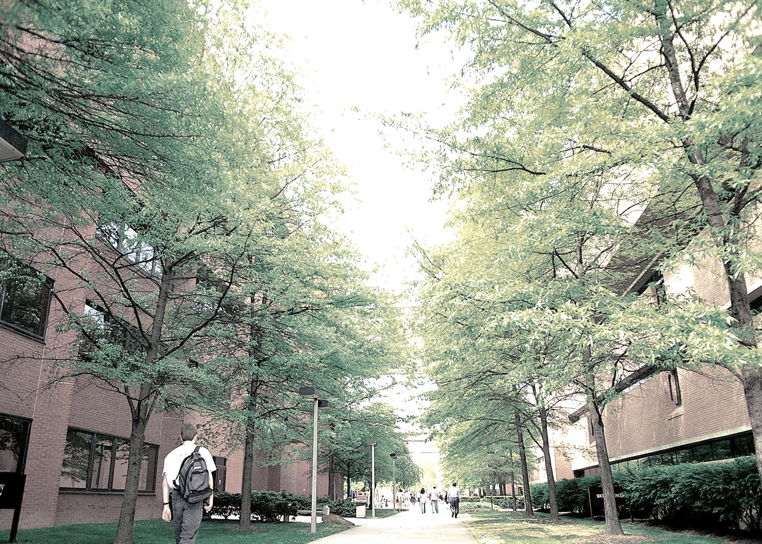
Financing Your Student’s Education
Presented by:
The Office of Financial Aid and Scholarships
Student Business Services
And
Bob Carpenter, Associate Provost for Analytics
orientation.umbc.edu

Slide 2
College by the Numbers
orientation.umbc.edu

Slide 3
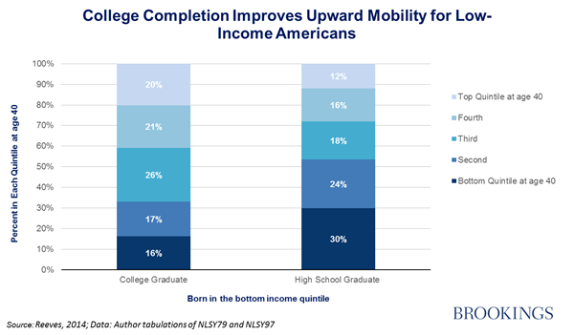
College is critical for social mobility
orientation.umbc.edu

Slide 4
But here’s the thing.....
There’s no payoff from going to college.
orientation.umbc.edu

Slide 5
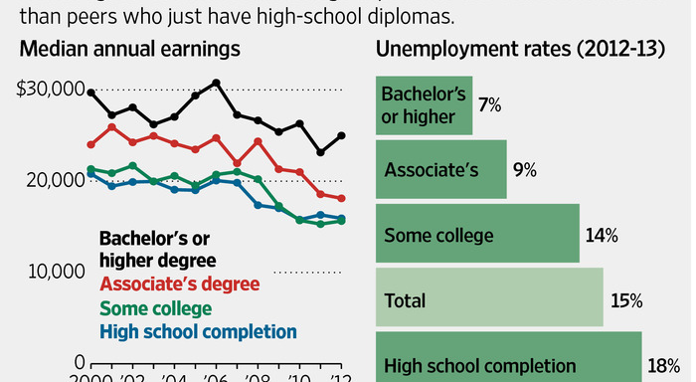
The Payoff is from FINISHING
orientation.umbc.edu

Slide 6
The Bottom Line
Universities like this one perform a critical social function that changes the lives of the people that pass through our doors (but they need to finish!)
The benefits span generations
Maintaining access and affordability is going to require looking for ways to become more efficient
orientation.umbc.edu

Slide 7
Cutting the Cost of College
The number of credit hours needed to receive a bachelors degree is about 120
The minimum number of credit hours a student must take to be classified as a full time student is 12 per semester
120 hours / 12 hours per semester is 10 semesters (or five years)
If your student takes 15 credit hours per term then, 120 hours / 15 hours per semester is 8 semesters (or four years)
orientation.umbc.edu

Slide 8
What’s the Dollar Value of the Cost Savings?
Tuition, fees, room and board for in state students was $23,244 last year (I used our tuition calculator)
The average salary of a UMBC graduate was $50,300 in 2013 (also from our website)
The opportunity cost (college costs plus foregone wages) of an additional year in college can be roughly $73,500. That’s big.
orientation.umbc.edu

Slide 9
Student Business Services
Administration Building, 3rd floor
Monday-Friday, 8:30am-4:30pm
(Payments until 4:00pm)
SBS Team: 410-455-2288
Fax: 410-455-1821
orientation.umbc.edu

Slide 10
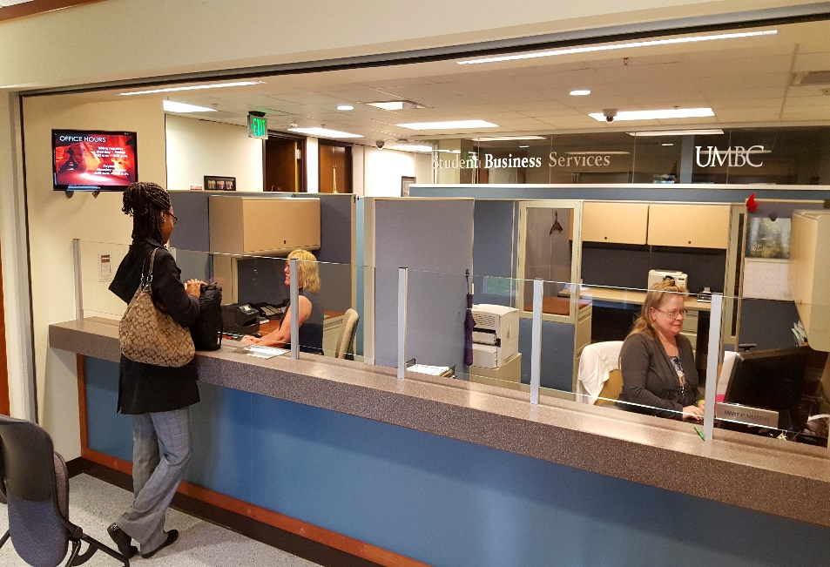
Student Business Services
Dedicated Service Reps
Monthly E-Bills
Payment Processing
Payment Plan Enrollment
E-refunds
Authorizing Additional Users
orientation.umbc.edu

Slide 11
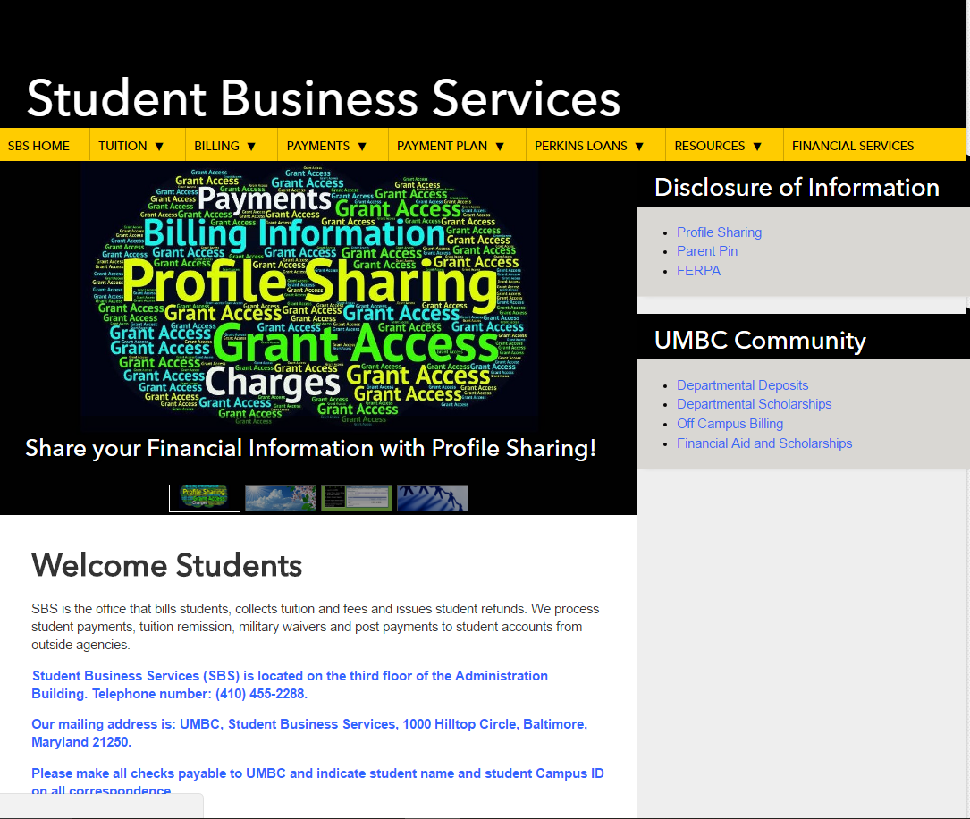
Contact Information
Tuition & Fees
Profile sharing and Parent Pin
Monthly Payment Plan
sbs.umbc.edu
orientation.umbc.edu

Slide 12


Authorizing Additional Users
(Parents/Others)
Profile Sharing
  Students share financial information via myUMBC
    Online - Grants access to view student billing and financial aid details
    Offline - Grants access to receive information in-person, by telephone and email
Parent PIN
  Students grant access via myUMBC to:
    View e-bills
    Sign up for Monthly Payment Plan
    Make online payments

Slide 13
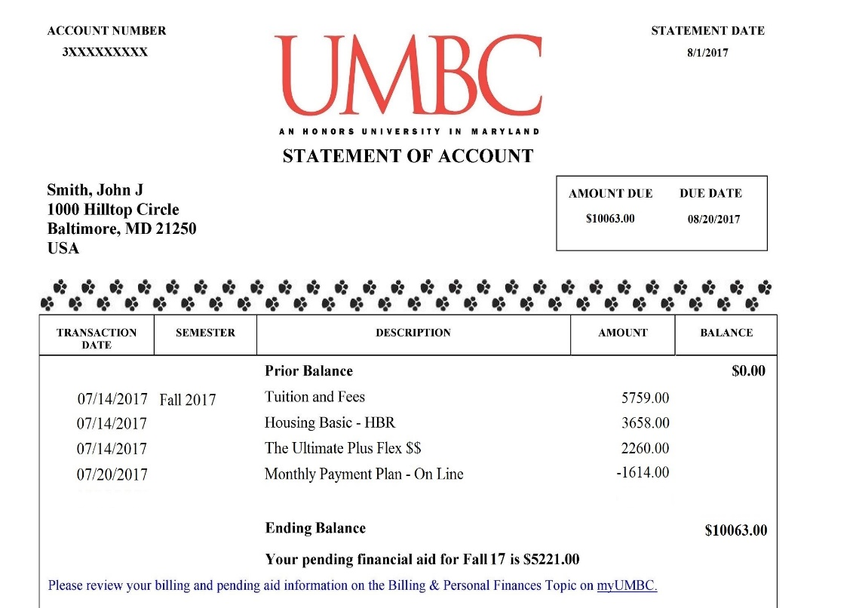
E-Billing Information
E-Bills – No paper bills
Spring 2018 e-bills available 1/2/18
Electronic notification
Check UMBC e-mail often!
The tuition information below reflects the proposed tuition and fees at the time of publication. Notwithstanding any other provisions of this or any other University publication, the University reserves the right to make changes in tuition, fees and other charges at any time such changes are deemed necessary by the University and the University System of Maryland Board of Regents.

Slide 14

Online Payments
Cashier’s Office
ACH (E-check) & Campus Card (no fee)
Credit Cards (2.75% convenience fee )
International Wires
Cash & Checks only
No Credit Cards in-person
Available 8:30am – 4:00pm for payments
    8:30am – 4:30pm for questions
Drop box (located in the Cashier’s Office) available after hours for checks
$5,632
orientation.umbc.edu

Slide 15
Other Payment Options
Agency Payments
College Pre-Paid Funds
Tuition Remission
Third Party Agency Payments
Please visit:
sbs.umbc.edu/payments/agency-payments/
VA Tuition Benefits
The process for applying and obtaining VA tuition benefits begins in the Registrar’s Office
VA Certifying Official
Michael Driscoll—driscoll@umbc.edu
410-455-2375
Please visit:
www.umbc.edu/veterans
$5,632
orientation.umbc.edu

Slide 16

Monthly Payment Plan
Make payments for tuition and fees in equal installments
Enroll in the plan and make payment via myUMBC and Parent Pin
Minimal enrollment fee per term; no interest on installments
The plan is offered Spring, Summer and Fall only
Spring 2018 Dates
Enroll by | Installments | Due Date
12/19/17 | 4 | 12/20/17
1/19/18 | 3 | 1/20/18
2/19/18 | 2 | 2/20/18
Final Payment |  | 3/20/18
$5,632
sbs.umbc.edu/payment-plan/
Monthly Payment Plan enrollment for Spring 18 began November 1, 2017
orientation.umbc.edu

Slide 17

E-Refunds
Student refunds issued electronically
Look for green envelope in the mail
Select e-refund preference:
  Direct Deposit to a bank of your choice
  Direct Deposit to BankMobile Vibe account
  Mailed paper check

Slide 18
Reminders
Plan Ahead! Utilize helpful tools to plan your finances
Discuss Parent PIN and Profile Sharing
Anticipate the e-bill: 1/2/18
Enroll in Spring 2018 Monthly Payment Plan - Beginning in November!
Look for green envelope in the mail; Students select e-refund preference
Remind students to monitor all campus communications
Subscribe to Family Connection – E-mail parents@umbc.edu
We’re here to help! Contact us, if you need assistance!

Slide 19
Office of Financial Aid and Scholarships
Lower level of the Library, pondside
Monday-Friday, 8:30am-4:30pm
Financial Aid: 410-455-2387
Merit Scholarships: 410-455-3813
Fax: 410-455-3322
orientation.umbc.edu

Slide 20
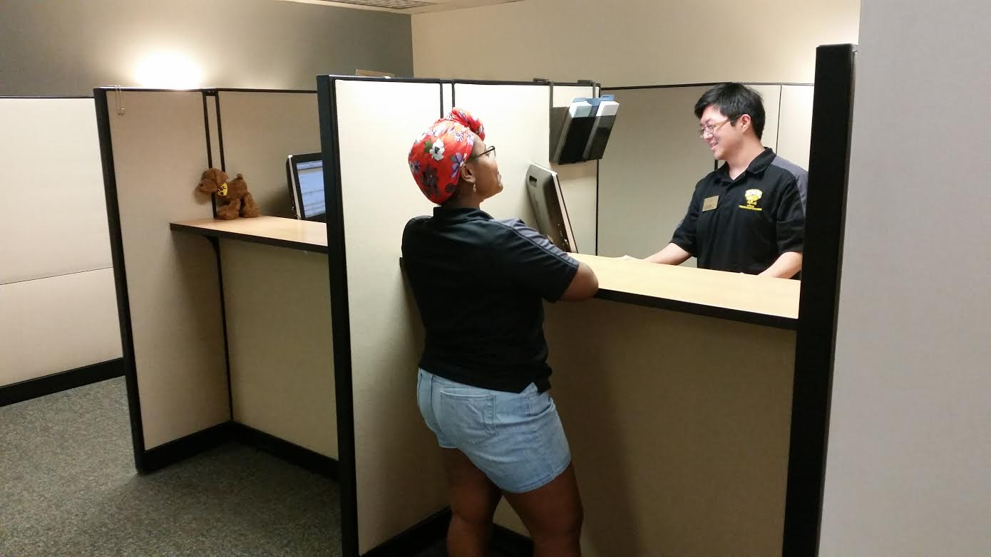
Our Services
Awarding of Merit Scholarships
FAFSA Processing
Verification of student accounts
Financial Aid Awarding
Financial Aid Counseling
orientation.umbc.edu

Slide 21
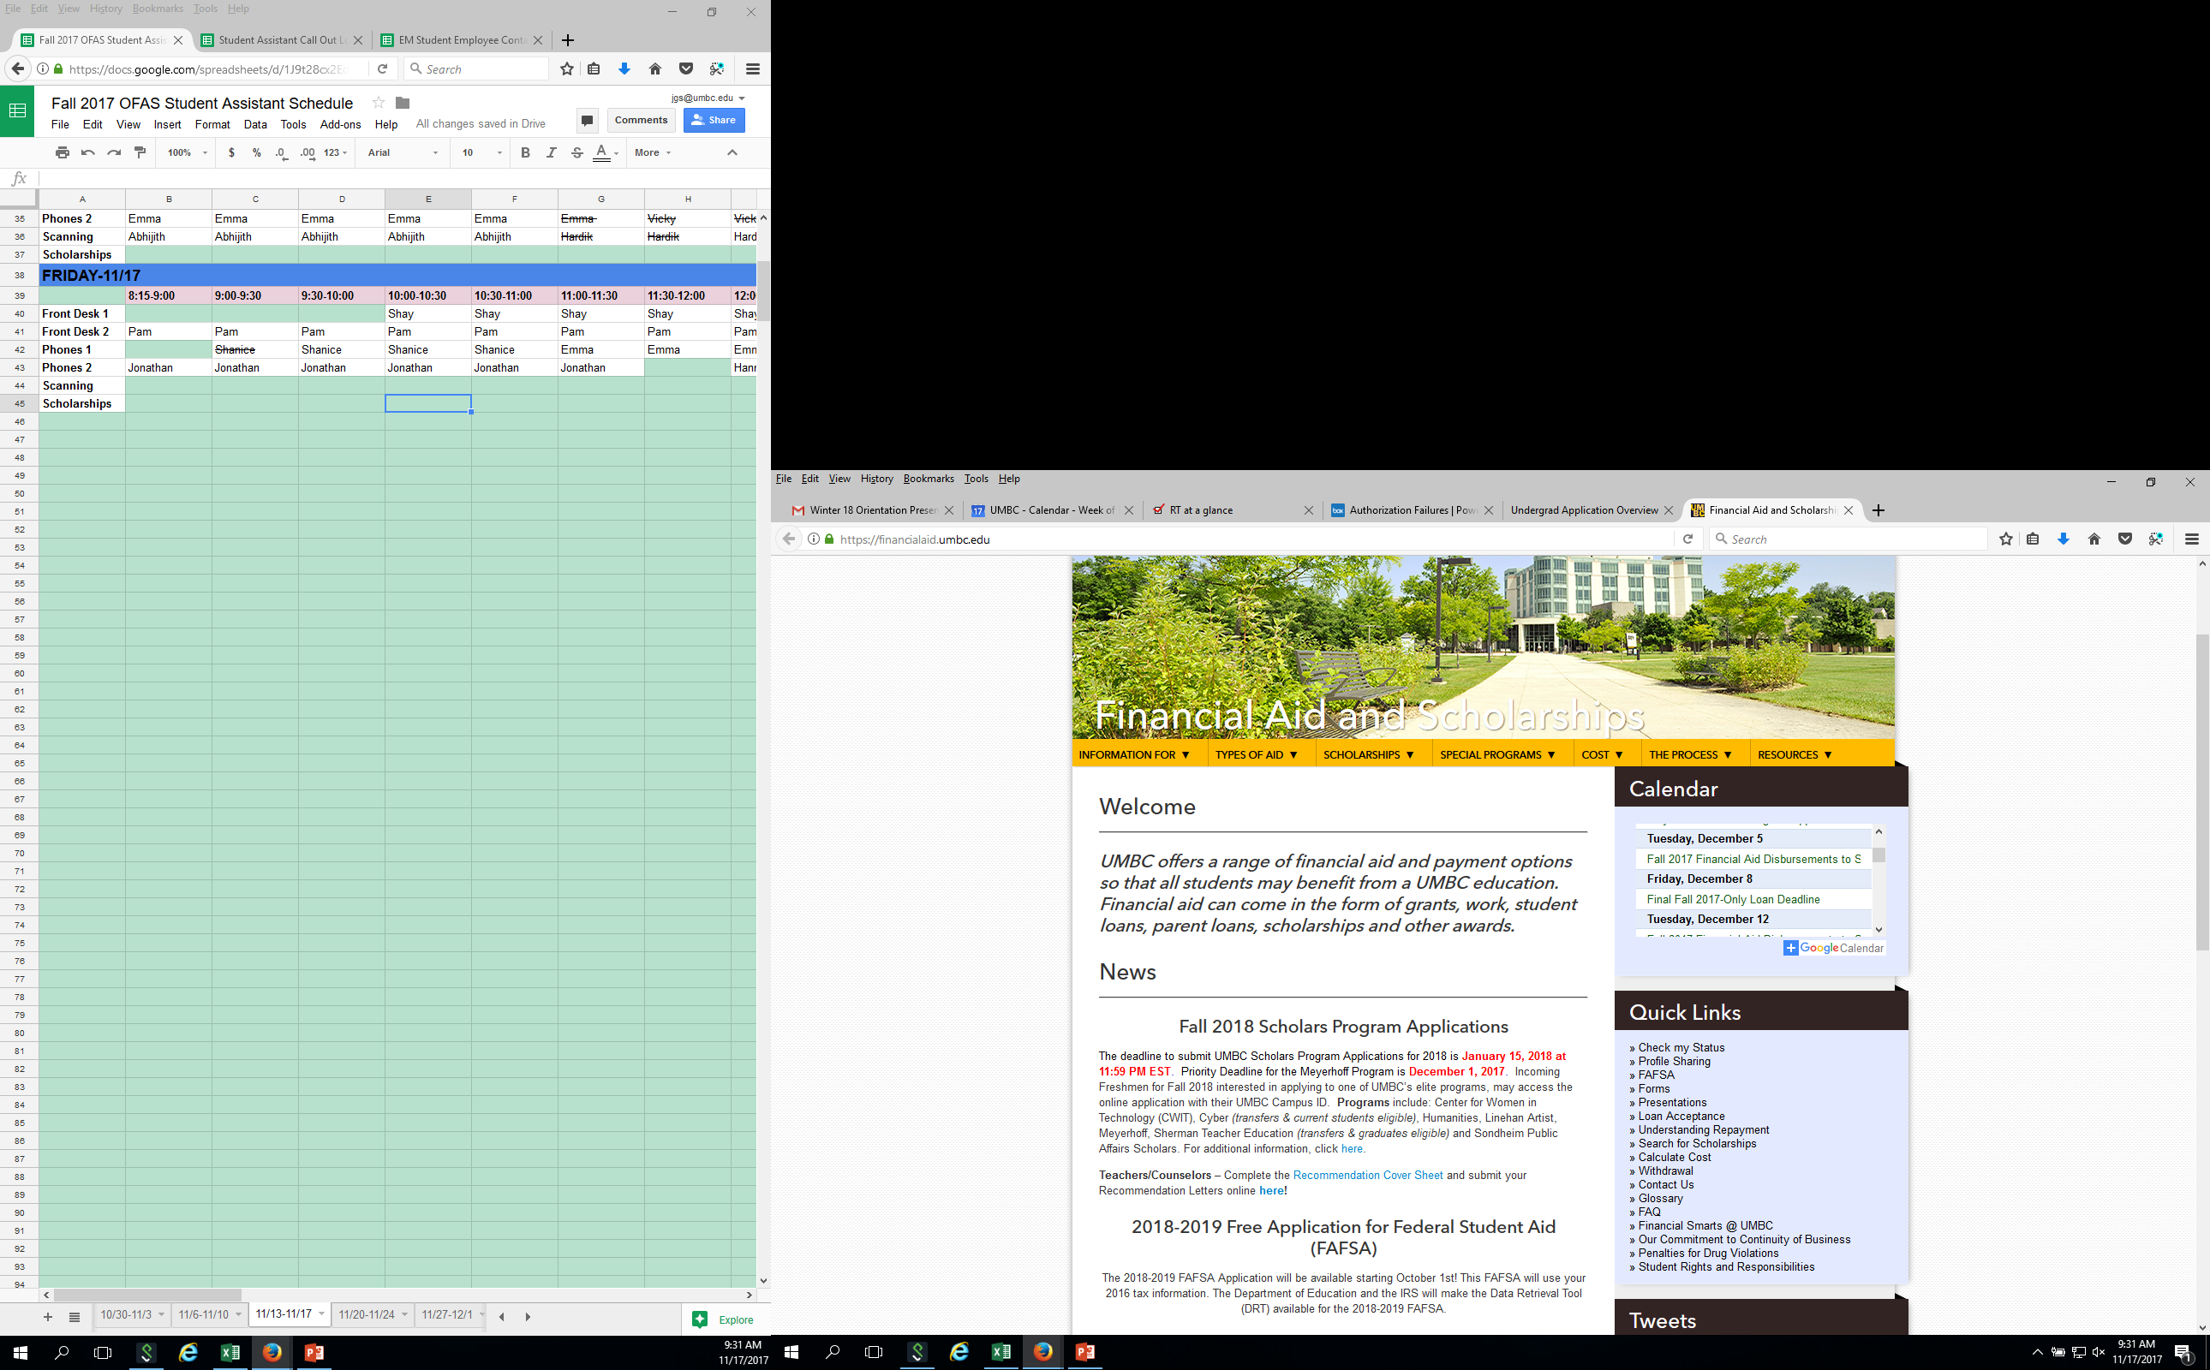
financialaid.umbc.edu
orientation.umbc.edu

Slide 22

Application Process for Financial Aid
Complete the 2017-2018 FAFSA at fafsa.ed.gov
UMBC School Code: 002105
Students must submit a new FAFSA each Academic Year!
Anticipate electronic notification via myUMBC
orientation.umbc.edu

Slide 23
Financial Aid Awards
The initial award package is based on the following:
  Full-time enrollment
  Student’s housing status as reported on the FAFSA
  Maximum Stafford Loan eligibility
Students will decide if they want to accept the loan offer, and if so, how much
  First-time borrowers must complete Entrance Counseling and a Master Promissory Note (MPN) at www.studentloans.gov
  More information on loan acceptance can be found at
  http://financialaid.umbc.edu/types-of-aid/federal-loans/acceptance/
orientation.umbc.edu

Slide 24
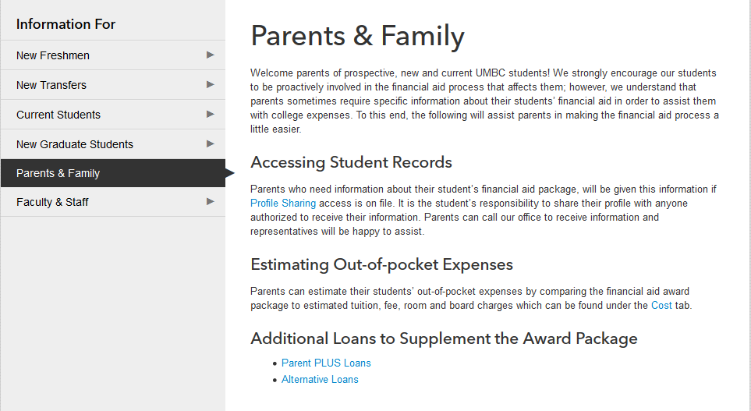
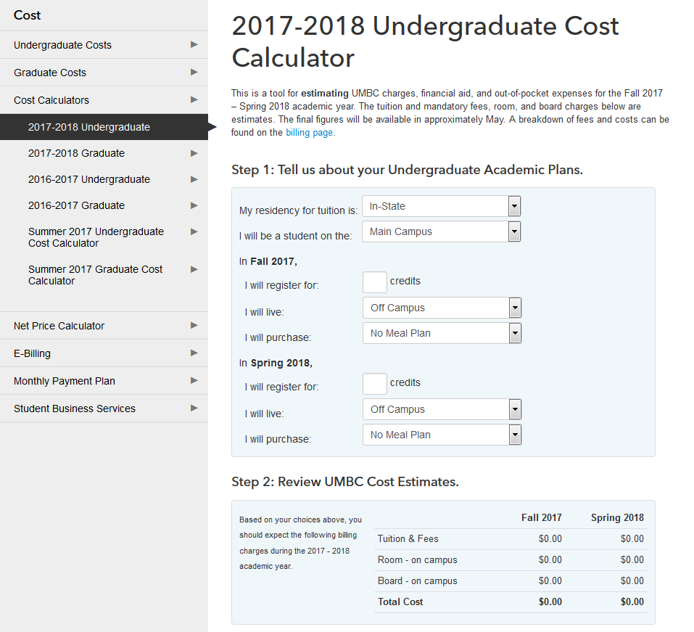
Helpful Tools
Information For…..
All the information you will need to ensure that your student is on the right track to receive
their aid
Cost Calculator
Determine your student’s expenses, and how much their financial aid will cover
orientation.umbc.edu

Slide 25


Financial Smarts @UMBC
More than Educated,
Financially SMART!
financialsmarts.umbc.edu
orientation.umbc.edu

Slide 26
QUESTIONS?
orientation.umbc.edu

