Slide 1
UNIV 301: Introduction to the Honors University
Orientation Course Selection Day
Dr. Jason Schiffman

Slide 2
There are moments you remember all your life.
This is one of those moments.

Slide 3
Your face here
UMBC

Slide 4
Life at UMBC
UMBC philosophy
Academic performance
Opportunities
Maintaining integrity
Other stuff

Slide 5
1. UMBC Philosophy

Slide 6
UMBC Vision Statement
UMBC seeks to become the best public research university of our size by combining the traditions of the liberal arts academy, the creative intensity of the research university, and the social responsibility of the public university. We will be known for integrating research, teaching and learning, and civic engagement so that each advances the other for the benefit of society.

Slide 7
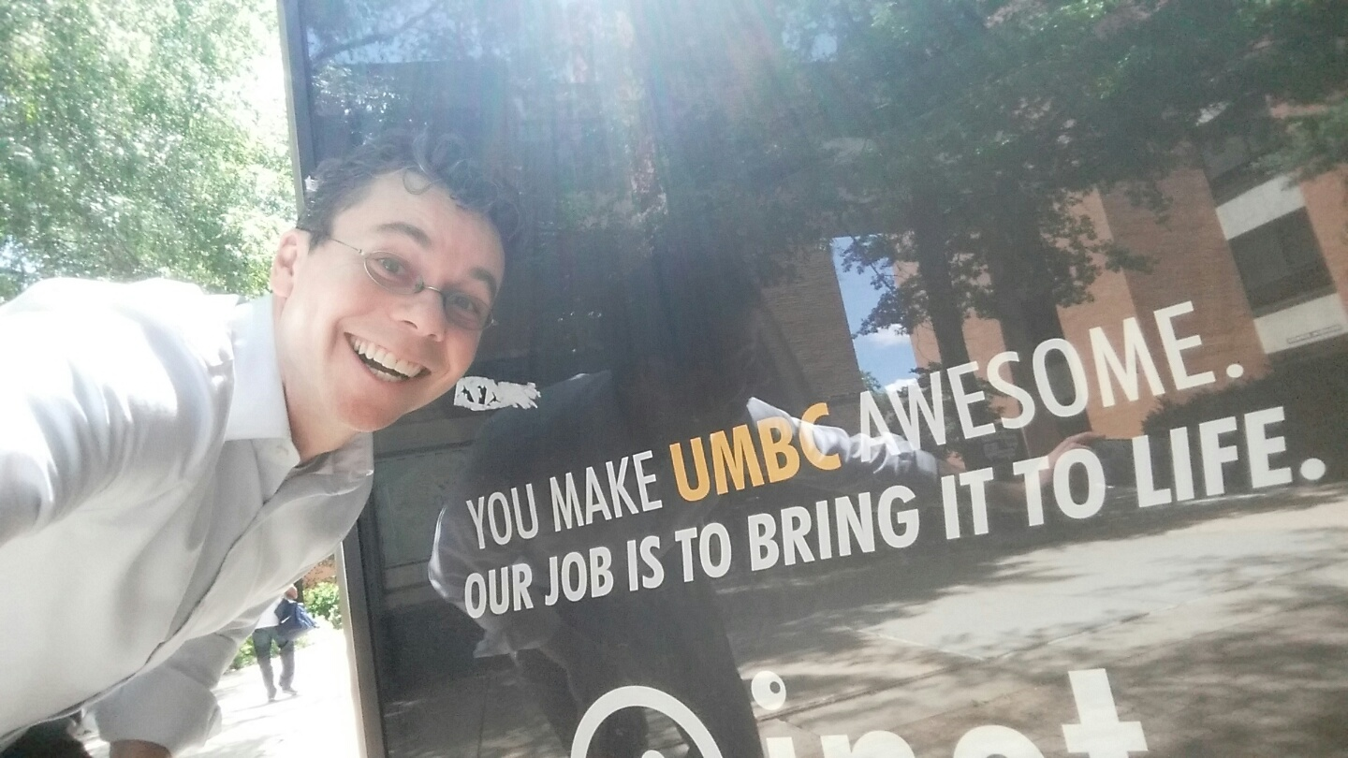
You

Slide 9
UMBC Vision Statement
UMBC seeks to become the best public research university of our size by combining the traditions of the liberal arts academy, the creative intensity of the research university, and the social responsibility of the public university. We will be known for integrating research, teaching and learning, and civic engagement so that each advances the other for the benefit of society.

Slide 10
Schiffman Philosophy: Intersection
UMBC
Like
Good At
Makes a Difference

Slide 11
Why I came to UMBC
Opportunities
Community
To share my passion
UMBC is a good fit for me

Slide 12
UMBC Philosophy
It’s cool to care
It’s cool to be positive
It’s cool to be smart
It’s cool to discover new things
It’s cool to be different
It’s cool to make a difference
It’s cool to wear your phone on your belt

Slide 13
2. Academic Performance

Slide 14
What do you think your first semester GPA will be at UMBC?
4.0
3.5-3.9
3.0-3.4
2.5-2.9
2.0-2.4
Below 2.0

Slide 15
What does it take to do the best work you can?
What do you need?
A quiet environment
More time
More discipline
Less stress
Other

Slide 16
UMBC is hard… So, what are you going to do about it?
Partner with someone you don’t know
Make a concrete plan

Slide 17
2 minutes
Notes:
These timers appear initially as a cream, coloured circle. The timer is initiated by clicking on, at which point the circle will fill up in a clockwise direction with the colour you see above.
At the end of the time, a bell will sound.
It is possible to change the timings of the timers by entering the animation settings and changing the timings of the relevant ‘Oval’. Note the timings have to be entered in seconds.
It is possible to have multiple timers on the same slide as these work independently of each other.

Slide 18
What professors like…
but might not tell you
In class
Be curious
Show your curiosity
Be prepared for meetings
Know your faculty
Proof read your emails

Slide 19
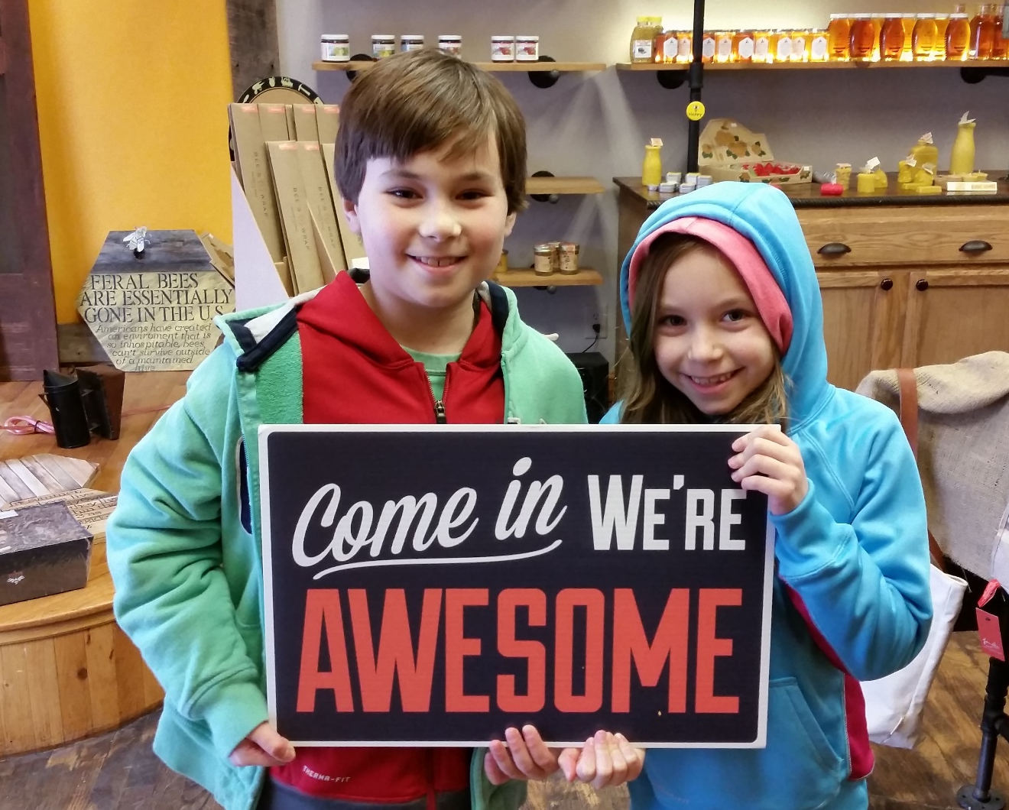
3. Opportunities

Slide 20
Opportunities
There is a lot going on at UMBC…
Internships…
Entrepreneurship…
Resources on campus…
Organizations…
Research…
Each other…

Slide 21
Diversity: So much to learn from others
UMBC is committed to diversity at all levels and seeks to create a campus community rich in intellectual, cultural, and ethnic diversity. Diversity is defined in its fullest scope embracing racial and ethnic identity, gender identity, sexual orientation, religious affiliation, disability, foreign nationality, non-traditional student status, family income, body size, and other important characteristics.
Strive to create an atmosphere that welcomes, encourages, and respects all, and that allows you to grow.

Slide 22
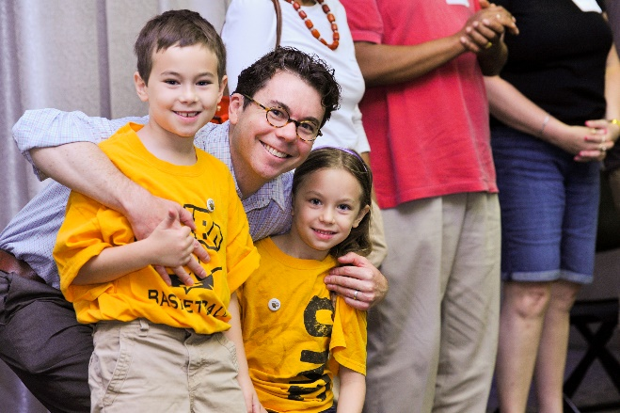
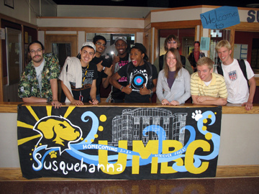
Organizations
Hobbies? Sports? Clubs? Philanthropy? Ping Pong? Weekly Retriever? Major Definition?
Residential Life

Slide 23
Research
Generation of new knowledge
Key to growth, life … and your own future

Slide 24
4. Maintaining integrity

Slide 25
ACADEMIC INTEGRITY
Have you ever seen anyone cheating?
Yes
No

Slide 26
4. Maintaining integrity
What is integrity?
BEING TRUE…
in everything you do.
“The true test of a person’s character is what she/he does when no one is watching.” ― John Wooden (oft said by Dr. Hrabowski)

Slide 27
Academic Integrity
By enrolling in this course, each student assumes the responsibilities of an active participant in UMBC’s scholarly community in which everyone’s academic work and behavior are held to the highest standards of honesty. Cheating, fabrication, plagiarism, and helping others to commit these acts are all forms of academic dishonesty, and they are wrong. Academic misconduct could result in disciplinary action that may include, but is not limited to, suspension or dismissal.

Slide 28
Allow yourself to grow!

Slide 29
5. Other stuff….

Slide 30
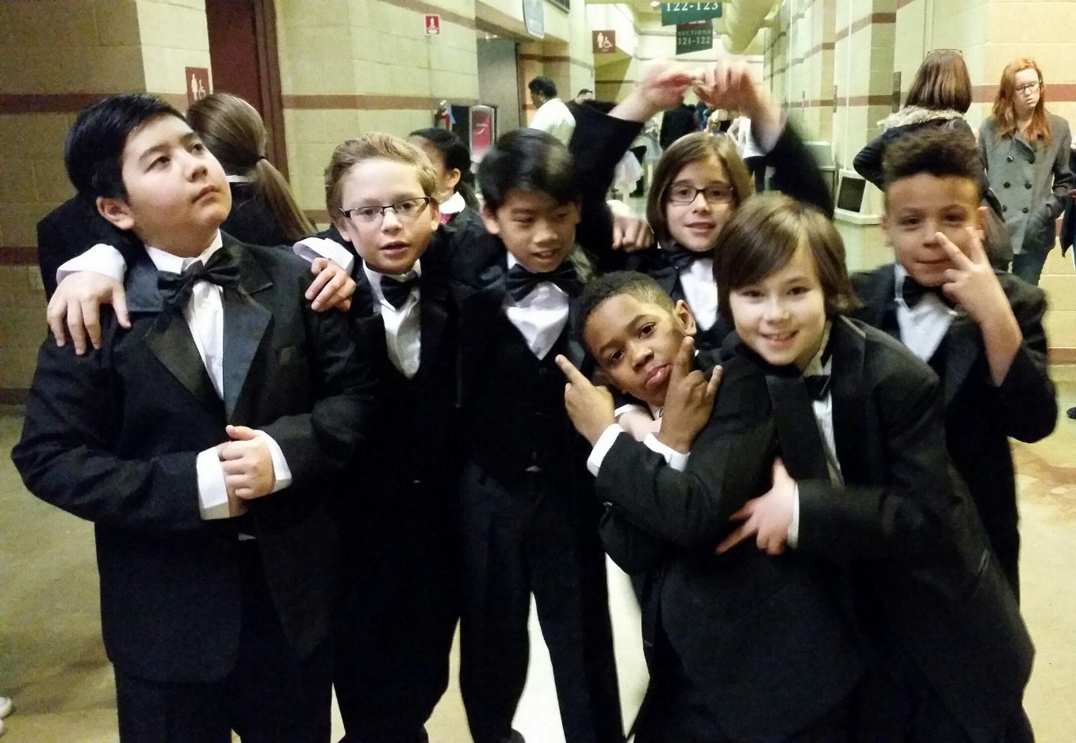
Make friends
Just like 4th grade

Slide 31
You can make more of a difference with a team: Collaborative learning

Slide 32
Ask for / lend a hand

Slide 33
Ask for / lend a hand
Office hours of your profs
TAs
RAs / CDs
Counseling Center
OIT
Library
Health Center
Disability Services
You can both get and give

Slide 34
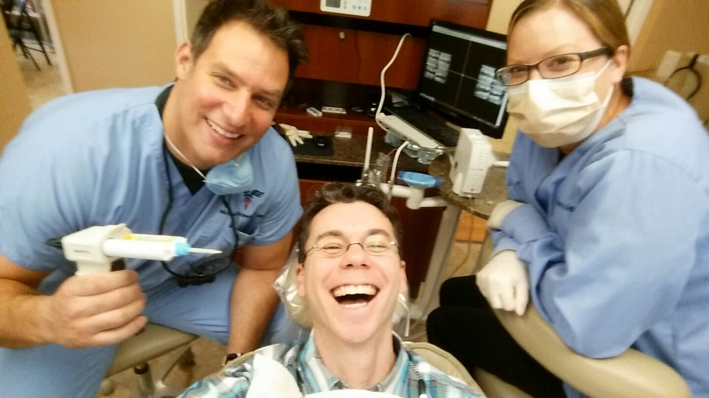
Stay healthy
…floss

Slide 35
Put yourself out there

Slide 36
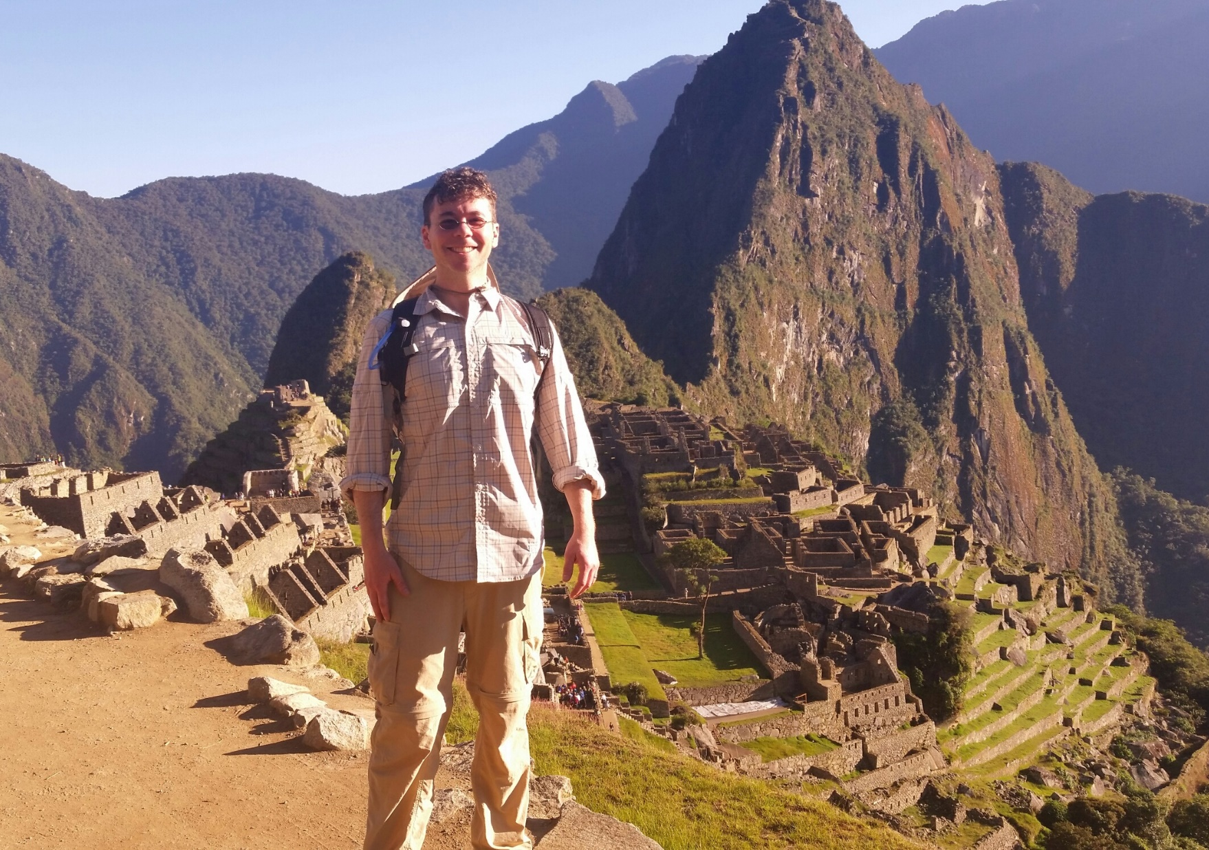
It’s the journey…but the destination can be nice too

Slide 37
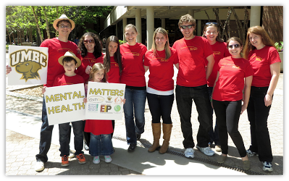
Try to make a difference
…it doesn’t hurt if it’s fun too!

Slide 38
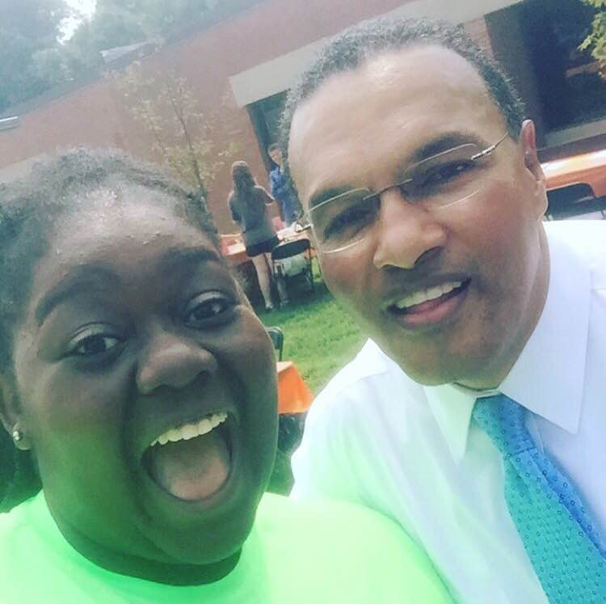
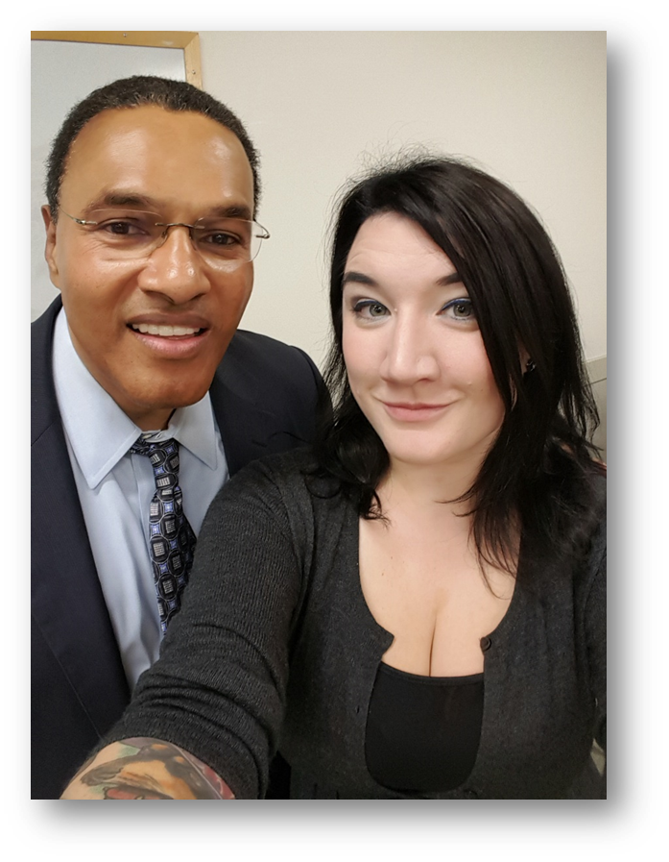
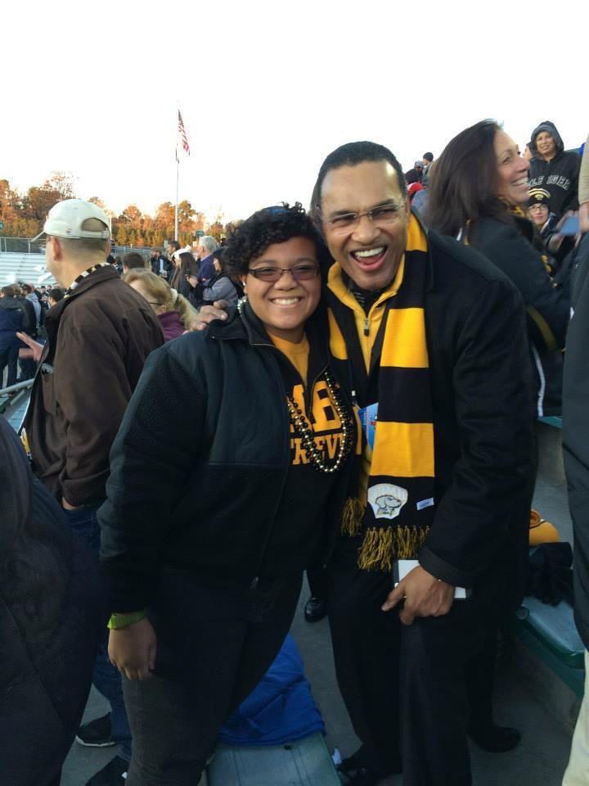
Take your work seriously, but don’t take yourself too seriously
Andrea
Liberty
Kaitlin
The Hrabowski Selfie Challenge!

Slide 39
If you work hard, good luck will follow.
Make a difference!
schiffma@umbc.edu
Email your Hrabowski Selfies!

