Slide 1

Living on & Off Campus
John Fox
Director
Dan Barnhart Director
Transfer Students

Slide 2

Co-CREATING THE UMBC EXPERIENCE
Regardless of where your student lives, we want them to be:
  Safe
  Connected
  Successful

Slide 3
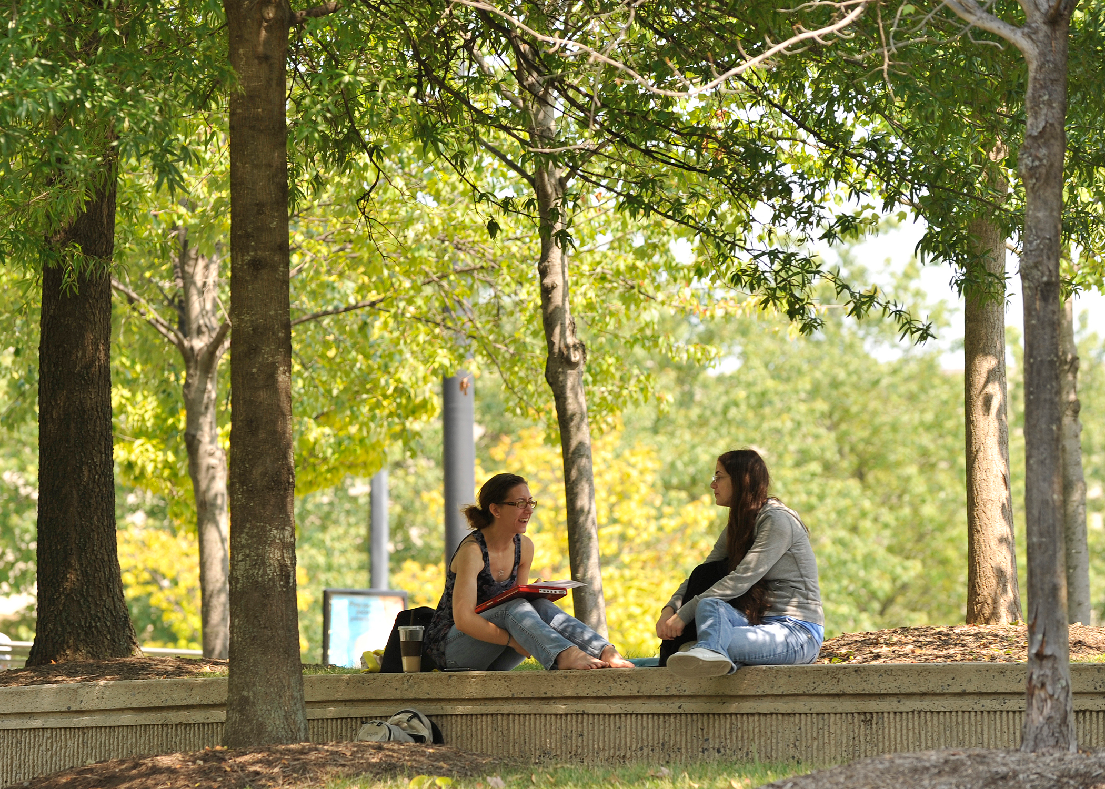
Off campus living
Living Off Campus:
  Apartment listings
  Roommates
  Bus Routes
  Carpooling

Slide 4

Off campus living
Opportunities for Involvement
  Transfer Welcome Day
    August 28
  Welcome Week
  Transfer Student Network
  Good Morning Commuter Breakfast

Slide 5
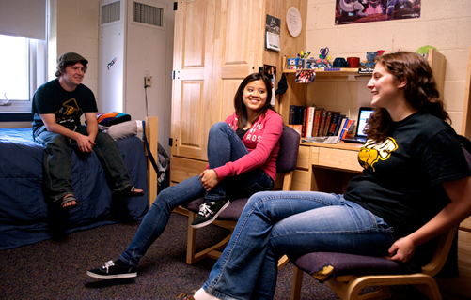
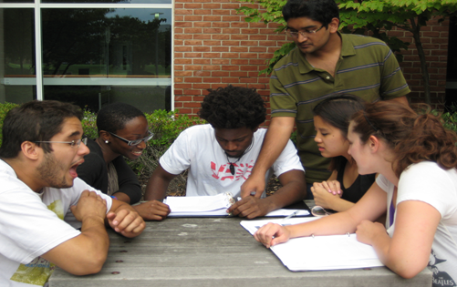
Residential Life - Living on Campus
75% of residential students reported living on campus contributed
positively to both their personal
growth and academic performance.
Source: Skyfactor Resident Assessment Survey Fall 2015
Location, Location, Location
On-campus living enhances opportunities for:
      Student Leadership
      Campus Employment & Internships
      Study groups
      Student engagement
24-hour staffing support and services
orientation.umbc.edu

Slide 6
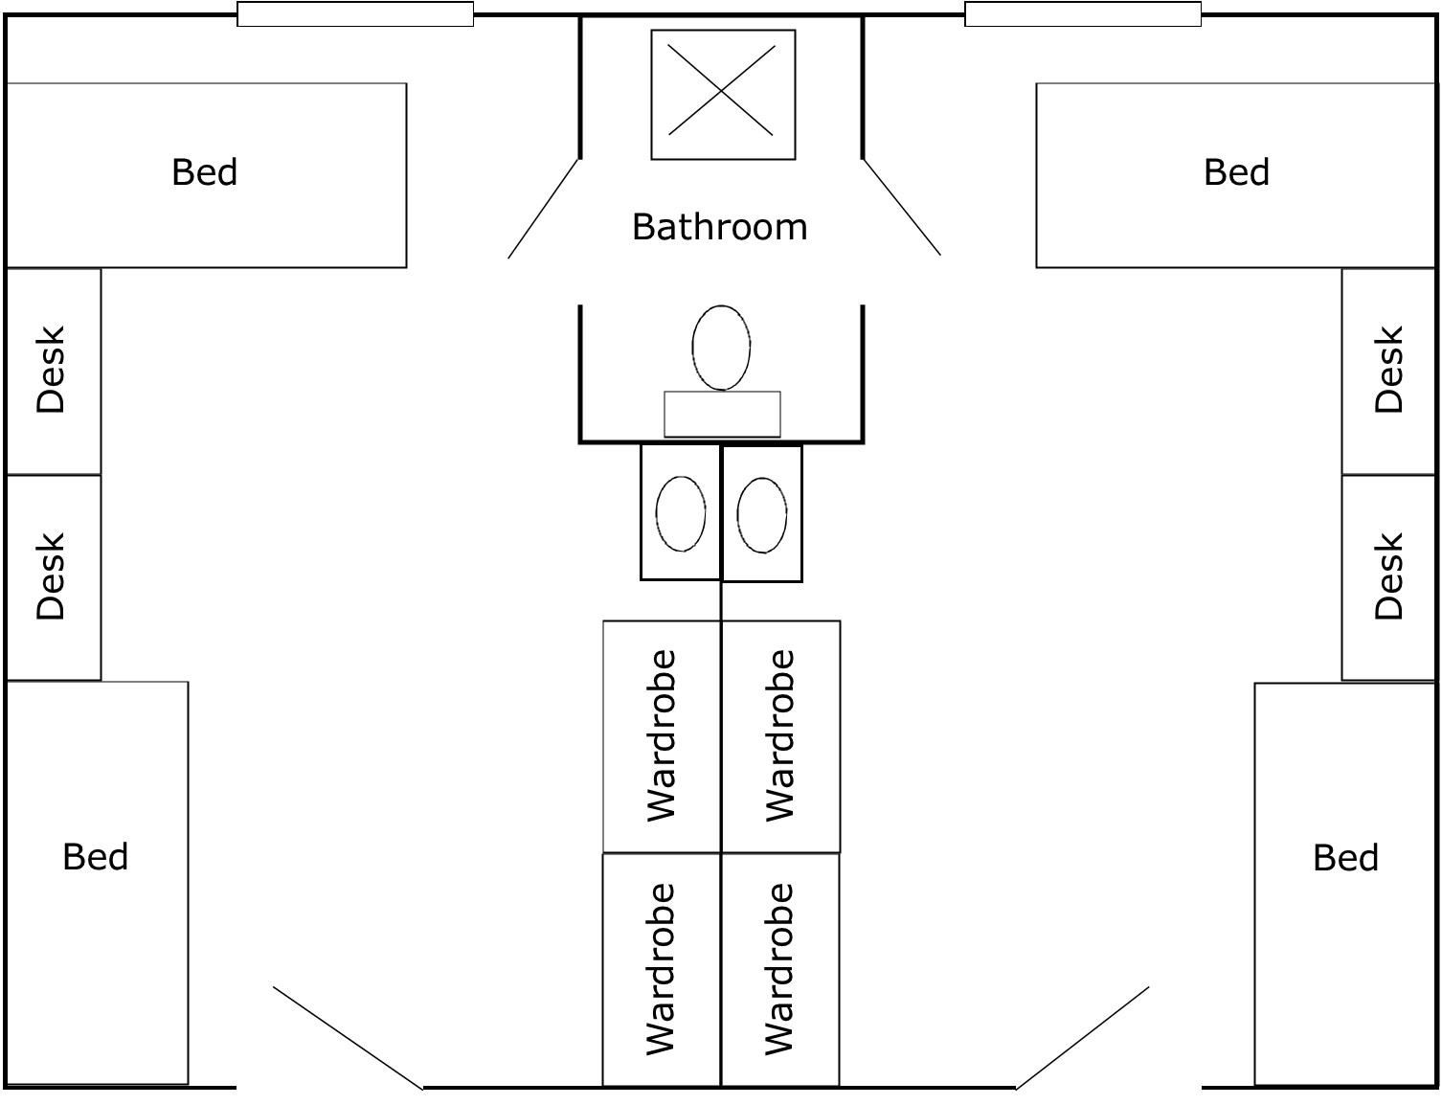

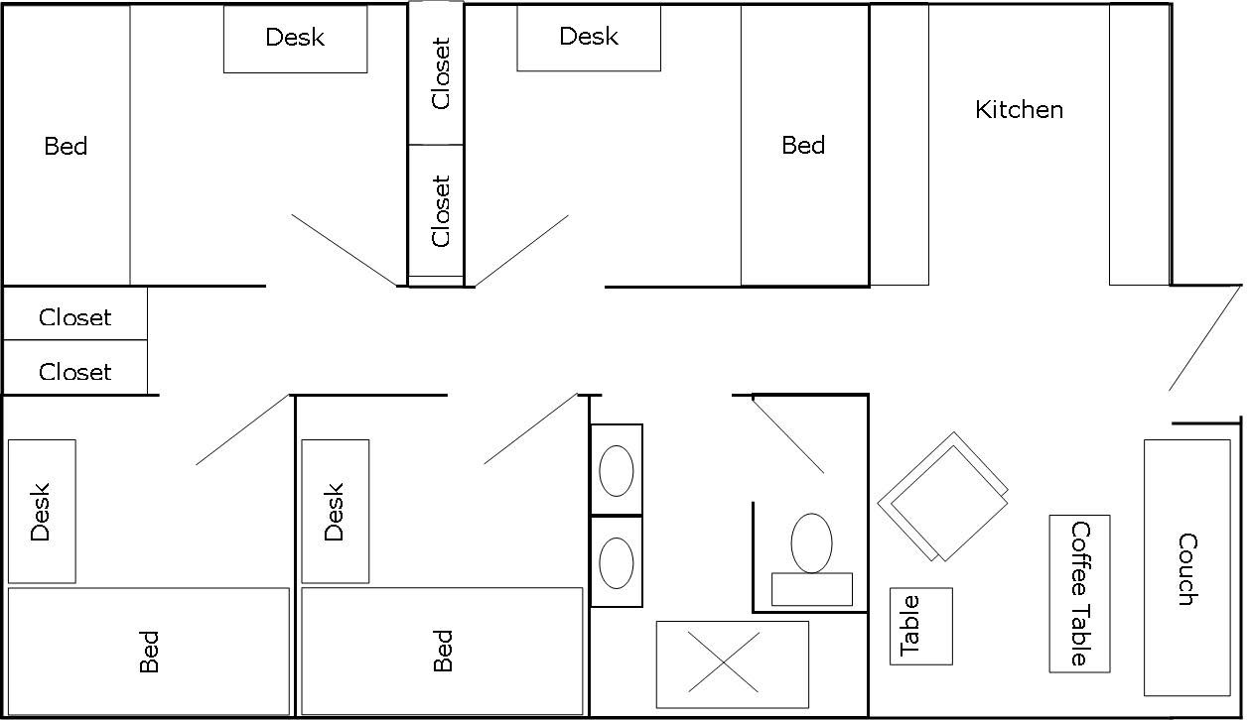
Residential Communities
Suite-style rooms with semi-private bathrooms; Apt. Communities for upper-class students
Community Spaces including: reception desks, study lounges, laundry facilities, vending and ice-machines
Individual temperature control
Ethernet & Wireless internet access
Cable Television, with 100+ stations including HBO
Meal plans (required in halls; optional in apartments)
Campus Safety including: campus law enforcement, emergency phones, emergency alert system and student escorts
Refer to the website for a list of items to bring (and not bring) to campus
West Hill Apt. Community – Upper Classmen
orientation.umbc.edu

Slide 7

Living Learning Communities
Living and Learning Communities (LLCs) will:
Connect students with one another through shared interest in culture, academics and community service.
Integrate curricular and co-curricular experiences that complement classroom learning.
Foster faculty and resident interaction that enhances both intellectual and personal growth of the residents.
LLC Choices:
  Center for Women and Information Technology (CWIT)
  Honors College
  Humanities
  Intercultural Living Exchange (ILE)
  Shriver (Community Service)
  Visual & Performing Arts (VPA)
  Women Involved in Learning & Leadership (WILL)
  Discovery Scholars
  Science, Technology, Engineering, & Mathematics (STEM)
  Interdisciplinary Studies (INDS)
orientation.umbc.edu

Slide 8

Living Learning Communities
Apply for Housing – 2 Steps to your on-campus experience
Log on to www.umbc.edu/reslife , click on Apply for Housing Fall 2016
(Be sure to read all application procedures on the website)
Step 1: Log In to apply for housing
Step 2: Accept your housing offer
Read and accept the terms of the Housing License online and pay deposit
**New Housing spaces available through renovation for fall 2016 only. Limited guaranteed housing offers if you apply by July 1st!
Physical Room Assignments are provided in early August via UMBC email account.
For students with disabilities or specific needs, please contact the Jackie Wilson, Assistant Director for Assignments (jawilson@umbc.edu)
Email: jawilson@umbc.edu.
orientation.umbc.edu

Slide 9




Questions & Contact Information
UMBC Reslife
UMBC Off-Campus Student Services
www.umbc.edu/reslife
www.umbc.edu/ocss
reslife@umbc.edu
ocss@umbc.edu
410-455-2591
410-455-2770

